Slide 1


Stephens County
Hospital
August 8, 2017

Slide 2
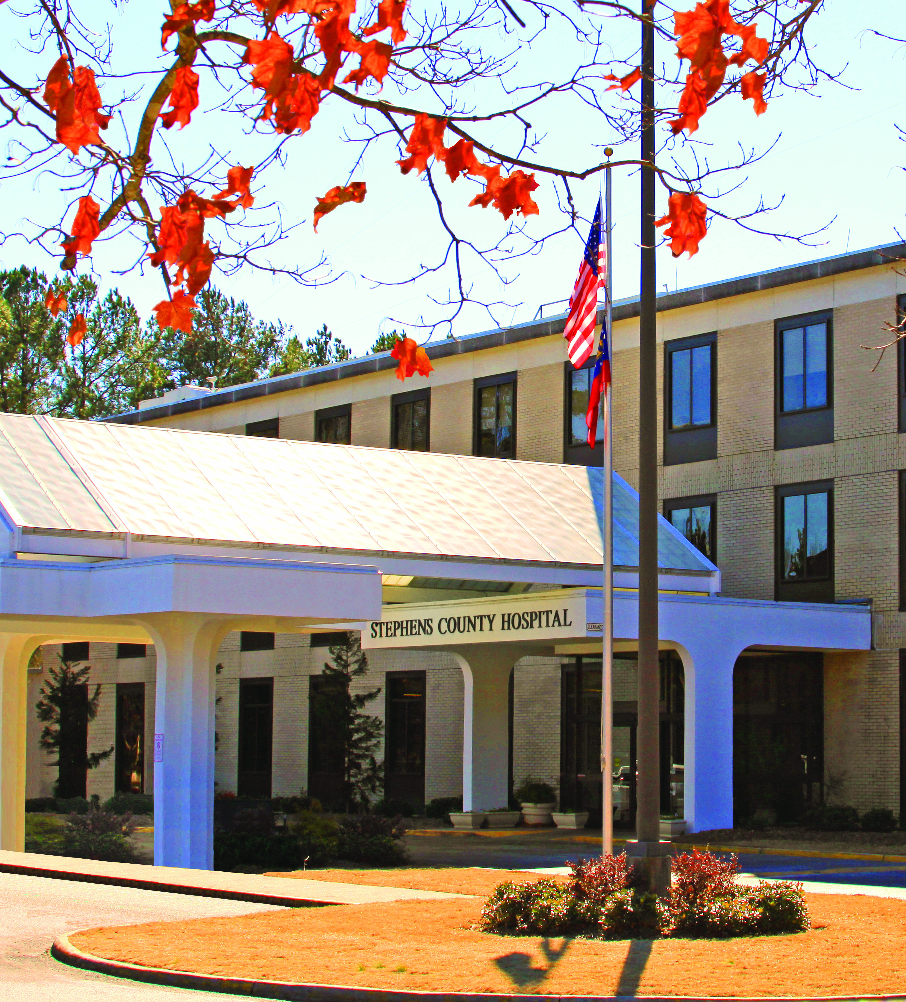
OUR HOSPITAL

Slide 3
INTRODUCTION
Lynne Anderson, FACHE
CEO at Stephens County Hospital for 18 months
Prior hospital administration in Columbus, Georgia (Columbus Regional Health System) and Atlanta, GA (DeKalb Medical)

Slide 4
OBJECTIVES TODAY
Acquaint you with Stephens County Hospital
Share hospital issues and challenges
Identify ways State may assist us in our struggle to provide healthcare to our residents and surrounding area

Slide 5
COMPONENTS
Stephens County Hospital Authority
Stephens County Hospital
Stephens County Hospital Physician Group
Edward C. Gambrell Wound Care Center
Personal Care Homes

Slide 6
OUR STATISTICS
417 Employees (FTEs)
538 people
37 Physicians
30 Volunteers
96 Hospital beds
104 Personal Care beds

Slide 7
PERTINENT FACTS
Hospital has been in existence for 80 years
Only independent hospital within 55 mile radius
Major Community Health Needs
  Obesity and Lifestyle
  Chronic Illness (Pulmonary, Diabetes)
  Mental Health and Substance Abuse
  Access to Care
Physicians retiring/leaving community
Major physician group owned by competitor

Slide 8
IMPACT ON COUNTY
Second largest employer
Median salary $42,432
Nurses
Physicians
Non-nursing employees
Jobs for our county
Jobs for which our young people return to the county

Slide 9
PAYOR MIX
Medicare 48.8%
Medicaid 17.5%
Blue Cross 12.1%
Commercial Insurance 11.2%
Private Pay 10.4%

Slide 10
PATIENT ORIGIN
Stephens County 70.5%
Franklin County 8.4%
Habersham County 6.4%
Rabun County 5.1%
South Carolina 1.4%
Hart County 1.7%
Banks County 0.7%
Elbert County 0.4%
Other 5.4%

Slide 11
VOLUME INDICATOR TRENDS
 | FY 2012 | FY 2013 | FY 2014 | FY 2015 | FY 2016
Adult Admissions | 3,330 | 2,632 | 2,649 | 2,548 | 2,254
Total Census Days | 17,542 | 14,446 | 13,521 | 13,589 | 12,002
Births | 496 | 463 | 374 | 392 | 290
Surgical Cases | 3,317 | 3,191 | 3,082 | 2,443 | 2,159
ER Patients | 21,367 | 20,209 | 18,990 | 19,525 | 19,236
Ambulance Trips | 4,152 | 4,033 | 4,134 | 4,452 | 4,537

Slide 12
STEPHENS COUNTY HOSPITAL
NET INCOME
FY 2010 | $841,038
FY 2011 | ($438,556)
FY 2012 | $738,623
FY 2013 | ($2,447,690)
FY 2014 | $85,137
FY 2015 | $1,145,348
FY 2016 | ($4,571,230)

Slide 13
LONG TERM DEBT
$15M bonds from 2017
(prior to June 2017 we had only $3.8M in long term debt)

Slide 14
SUPPORT FROM STEPHENS COUNTY (FY16)
EMS Support
  $675,336
Indigent Care
  7/10 Mill
  $412,966

Slide 15
TRENDS AFFECTING FINANCIAL PERFORMANCE
Volumes flat or reduced
Revenues up
Net Revenue down
Reimbursement down

Slide 16
RURAL HOSPITAL TAX CREDIT
Stephens County Qualified
Ranked third in need
Have received $188,000 in donations so far
Did not participate in Georgia Heart

Slide 17
STATE SUPPORT
Maintain CON
Help us maintain the DSH program
Create a fund for short term emergency financial assistance for hospitals if needed
Ensure that insurers are timely and objective in adding physicians/hospitals to networks (with retro dates back to date of application)

Slide 18
SUMMARY
Facts about Stephens County Hospital
Our issues and challenges
State assistance and partnership ideas

Slide 19

QUESTIONS/DISCUSSION

