Slide 1
The Case for Improving GEORGIA’s LEGAL CLIMATE
November 19, 2019
Senate Study Committee on
Reducing Georgia’s Cost of Doing Business

Slide 2
Tort Reform HISTORY
1970s / 1980s
Premiums surge approximately 25% per year and physicians begin fleeing state
1982 MagMutual Insurance Company formed by physicians in Georgia
1987 Georgia Legislature adopts tort reform
1990s
Courts erode 80’s Legislation
1990 Punitive damages reforms struck down
1991 The admissibility of collateral source payments is struck down
2000s
We begin to see another crisis
2005 Georgia Legislature adopts SB3, stabilizing the marketplace
2010 Supreme Court rules noneconomic damages cap unconstitutional

Slide 3
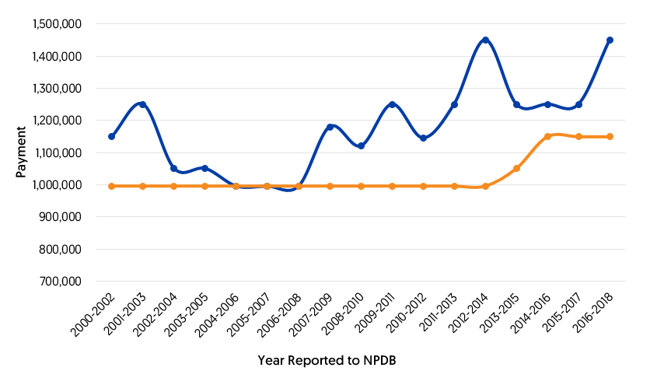
Georgia
2005
* 3 year rolling average, 95th Percentile
Georgia
All States
Notes:
2006—more favorable venue statute struck down by Georgia Supreme Court in EHCA Cartersville v Turner
2007—requirement for a Medical authorization form along with the complaint struck down by Supreme Court in Allen v. Wright
2010—Noneconomic damages cap of $350,000 struck down by Supreme Court in Atlanta Oculoplastic Surger v. Nestlehutt
2018—Supreme Court expanded statute of limitations in Thomas v. Tenet Health Systems

Slide 4
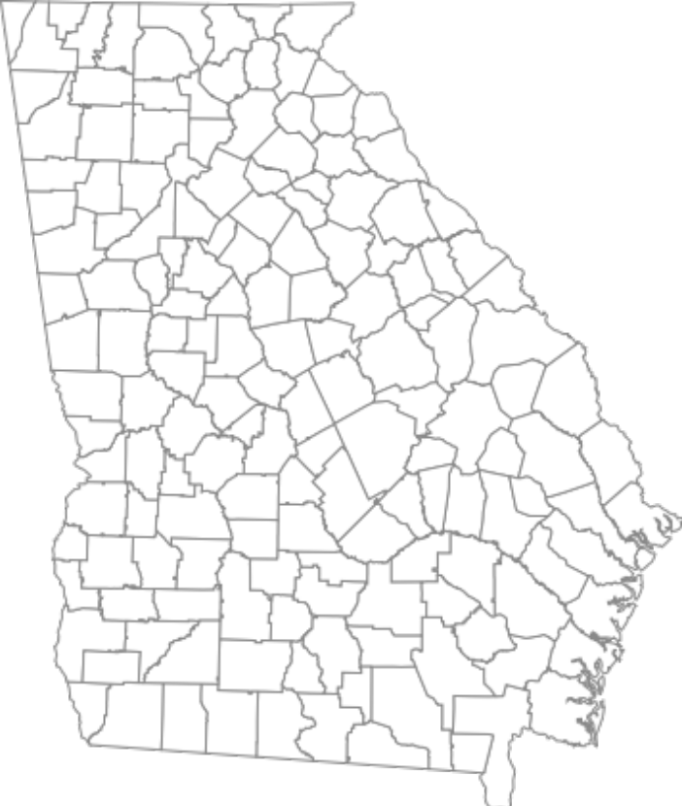
Georgia severity
trends higher than nationwide average
SEVERITY (amounts Paid)
Aggregate severity of claims paid in Georgia has continuously increased since 2010.
Increased 46% in the last 5 years
In 2018, average severity in Georgia was 23% higher than nationwide.
In 2018, five of the Top 25 verdicts in Georgia were medical malpractice-related
FREQUENCY
Since 2016 there has been a 47% increase in number of paid claims.
Over this time, the national average has decreased.

Slide 5

RANK | STATE | AVG. PAYMENT | RANK | STATE | AVG. PAYMENT
Worst | Illinois | $675,274 | 27 | Missouri | $312,992
2 | D.C. | $647,044 | 28 | Maryland | $310,220
3 | Maine | $623,091 | 29 | Tennessee | $301,439
4 | Connecticut | $619,411 | 30 | Iowa | $295,317
5 | Oregon | $572,337 | 31 | North Dakota | $292,083
6 | Rhode Island | $547,545 | 32 | Nebraska | $275,111
7 | New Hampshire | $546,964 | 33 | Colorado | $273,491
8 | Massachusetts | $535,364 | 34 | West Virginia | $270,899
9 | Georgia | $478,499 | 35 | North Carolina | $269,514
10 | New Jersey | $472,969 | 36 | Oklahoma | $253,472
11 | Hawaii | $462,941 | 37 | Alaska | $251,364
12 | Washington | $449,407 | 38 | Florida | $238,803
13 | New York | $430,613 | 39 | Louisiana | $238,227
14 | Virginia | $422,479 | 40 | Mississippi | $238,106
15 | Alabama | $402,366 | 41 | Michigan | $238,061
16 | Pennsylvania | $392,718 | 42 | South Carolina | $231,192
17 | Arkansas | $373,341 | 43 | Indiana | $227,728
18 | New Mexico | $363,095 | 44 | Wyoming | $224,318
19 | Montana | $362,060 | 45 | California | $199,367
20 | Utah | $361,311 | 46 | Nevada | $180,332
21 | Ohio | $345,754 | 47 | Texas | $189,255
22 | Arizona | $343,650 | 48 | Vermont | $170,444
23 | Idaho | $336,250 | 49 | South Dakota | $148,625
24 | Delaware | $335,886 | 50 | Wisconsin | $145,806
25 | Kentucky | $331,893 | Best | Kansas | $135,874
26 | Minnesota | $316,130
Georgia severity
trends higher than nationwide average
$346,283
NATIONAL AVERAGE
+Sources: National Practitioners Data Bank (“NPDB”). Data through June 2018.

Slide 6
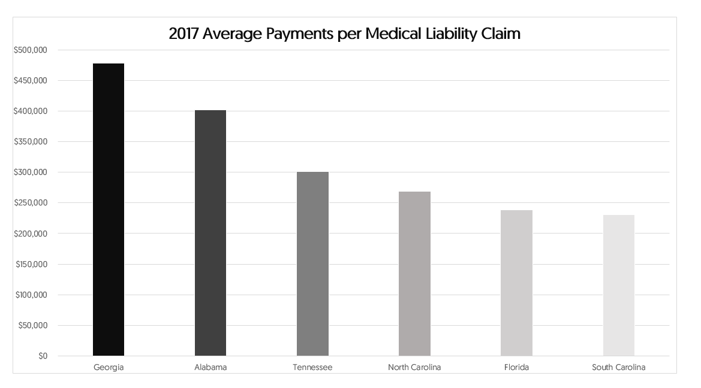

Georgia severity
trends higher than NEIGHBORING STATES
+Sources: National Practitioners Data Bank (“NPDB”). Data through June 2018.

Slide 7
This is not just a med mal problem.
This is a Legal environment problem.

Slide 8
AWARDS
IN GEORGIA
ARE RAPIDLY INCREASING
TOP 25 VERDICTS TOTAL
+Sources: VerdictSearch.com and Daily Report

Slide 9



Verdict Breakdown
Are they really for the People?
40% FEE
$560M
40% OF TOTAL REWARD
÷ 2,000
PERSONAL INJURY ATTORNEYS+
= $280K
PER PERSONAL INJURY ATTORNEY
$1.4B
TOP 25 VERDICTS TOTAL
$3,631
Tort cost per household
US Chamber Institute for Legal Reform
$840M
REMAINING AFTER FEE
÷ 10.5M
GEORGIA POPULATION
= $80
PER PERSON
+Sources: GTLA.org

Slide 10
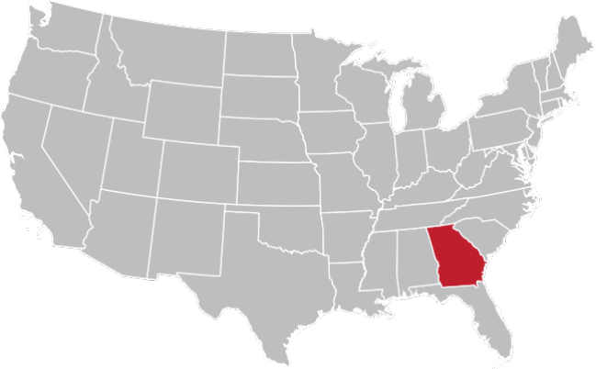

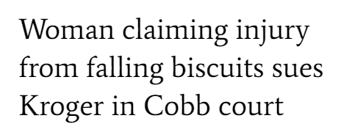
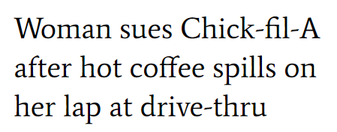



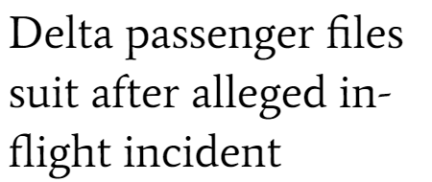

2019 On Trend to Be another BAD YEAR for Georgia Business

Slide 11



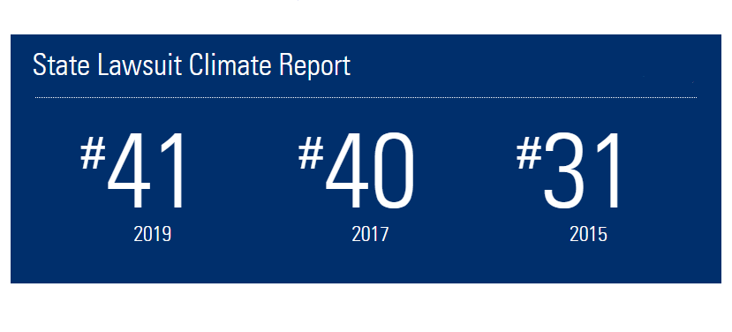
Troubling National recognition of Georgia’s Legal Climate

Slide 12
Who does this hurt?

Slide 13
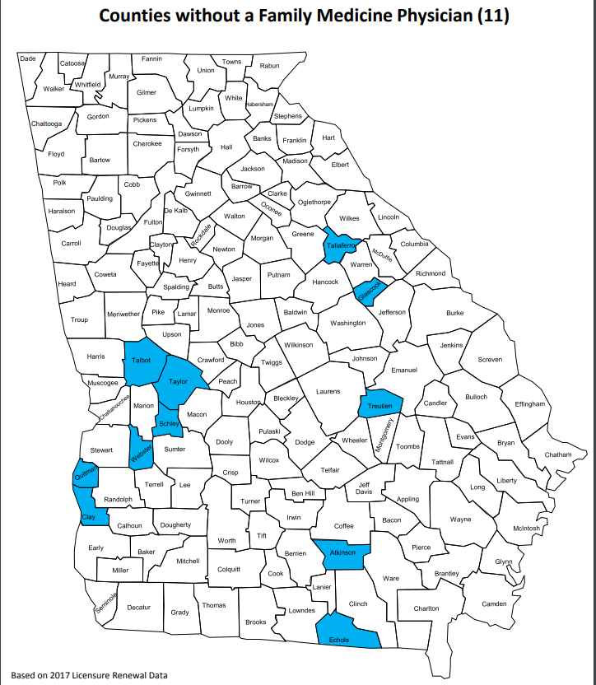
Georgia’s distorted legal environment disproportionately hurts rural and poor urban areas
Lower income + Higher medical liability premiums + Higher volume patients = Fewer primary care physicians
BASED ON 2017 LICENSURE RENEWAL DATA IN GEORGIA:
  11 counties lacked a family medicine physician
  75 counties lacked an OBGYN
  37 counties do not have an internal medicine physician
  63 counties do not have a pediatrician
  78 counties do not have a general surgery physician
  8 counties with no physician
+Sources: Georgia Board for Physician Workforce: Counties without Primary Care Practitioners Report

Slide 14
Texas, California and North Carolina:
Attracting Physicians, Stabilizing HealthCare Costs, and Keeping Premiums Low

Slide 15
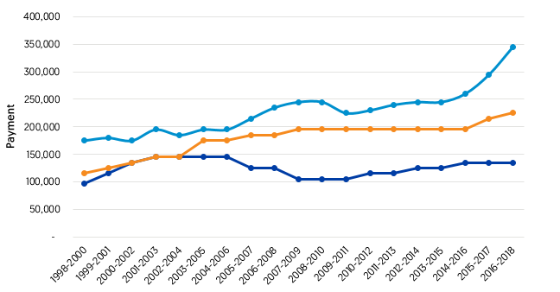
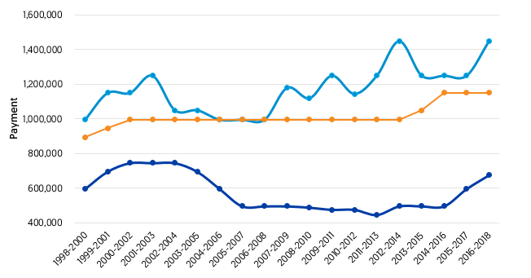
Texas enacted tort reform 2003
median
95th Percentile
Texas
Georgia
All States

Slide 16
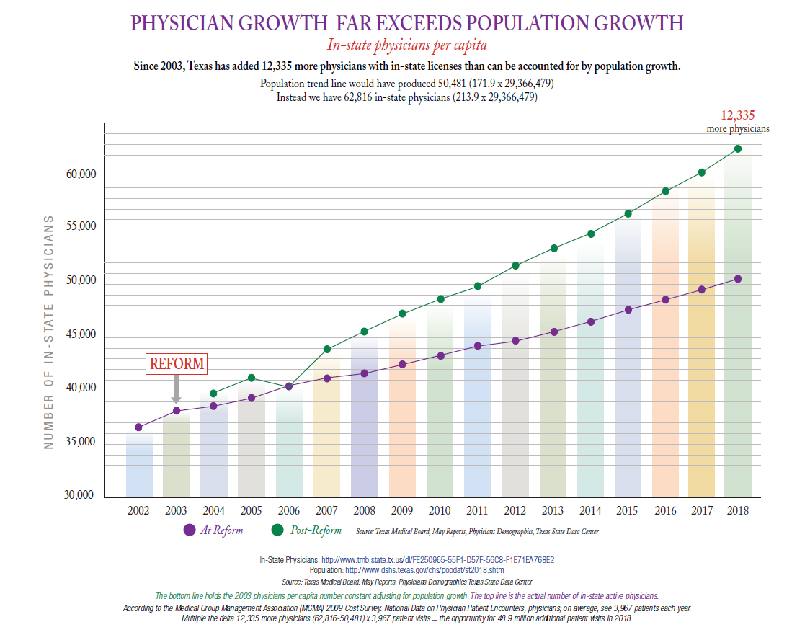

Slide 17




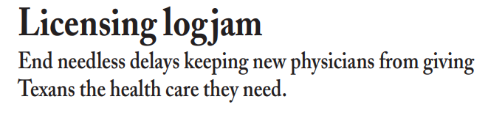

Physician Migration to Texas outpaceS
Population Growth Following Tort Reform

Slide 18
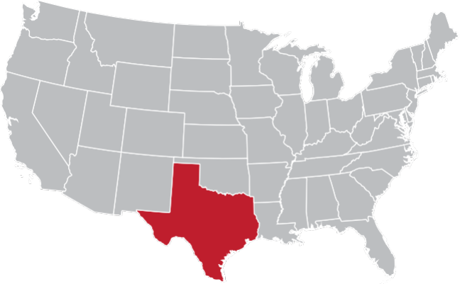
What can we learn?
TEXAS
Non-Economic Damages Cap
Stacked cap of $750,000 for non-economic damages.
Physicians are capped at $250,000. Economic damages remain uncapped.
Proof of Damages
Recovery of health care expenses is limited to the amount actually paid or incurred by the patient, not what was initially billed by the health care provider.

Slide 19
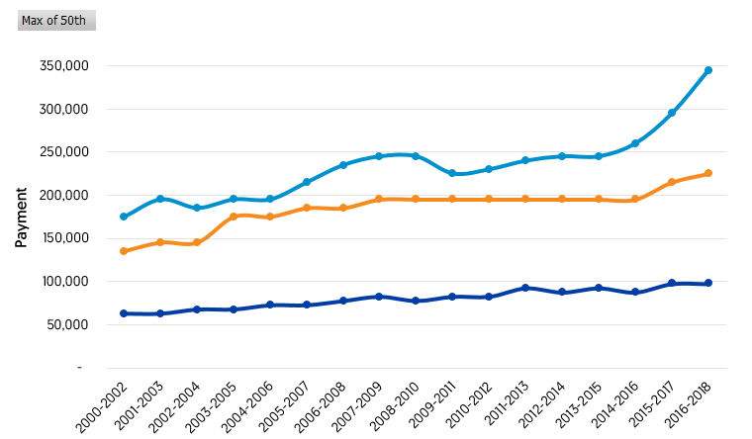
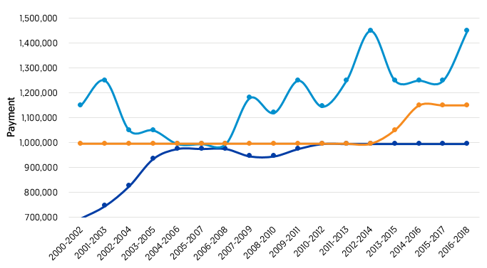
California enacted tort reform 1975
median
95th Percentile
California
Georgia
All States

Slide 20
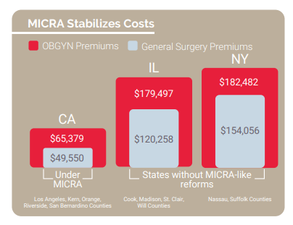
California
Stabilized healthcare costs
A recent study⁺ found that eliminating California’s tort reform would have annual direct and indirect costs of $11.4 Billion:
  Increased doctors fees passed on to consumers and ultimately employers and taxpayers who fund public and private health plans
  Increase in “defensive medicine”
“If MICRA is changed and our medical liability rates go up… it’s our patients, mostly low-income and people of color with few health options, who will lose access to health care services. We should be focused on lowering health care costs to expand access to care, not the other way around.”
-Jim Mangia, President & CEO, St. John’s Well Child & Family Center
+Source: MICRA and Access to Health Care, May 2019

Slide 21

What can we learn?
CALIFORNIA
Non-Economic Damages Cap
Cap of $250,000 for non-economic damages, all other damages are unlimited
Limit on Attorney’s Fees
Plaintiff’s attorneys cannot receive more than 40% of the first $50,000 recovered, 33-1/3% of the next $50,000 recovered; 25% of the next $500,000 recovered; 15% in excess of $600,000
Limitations shall apply regardless if recovery is by settlement, arbitration, judgement of if person for whom the recovery is made is a responsible adult, infant or person of unsound mind.
Notice for Filing Claim
90 days’ advance notice to bring a claim of professional negligence against a healthcare provider

Slide 22
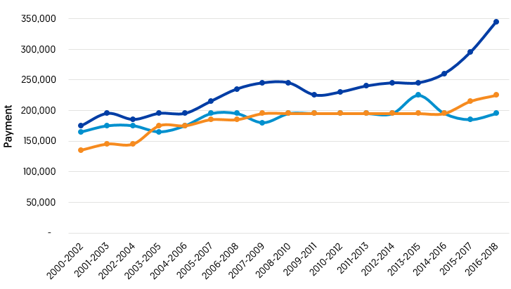
North Carolina
ENACTED TORT reform 2011
median
Georgia
North Carolina
All States

Slide 23
North Carolina
Lower Medical Malpractice Premiums
Georgia physicians pay more than their counterparts in North Carolina
OB/GYN
GENERAL SURGEON
INTERNAL MEDICINE PHYSICIAN
52%
56%
49%
MORE
MORE
MORE

Slide 24
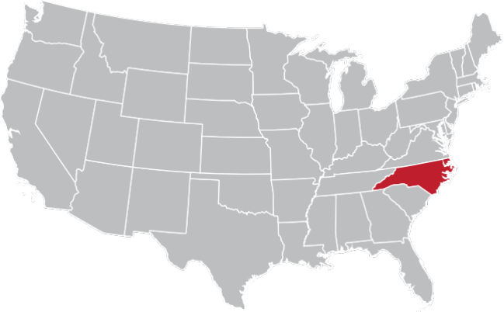
What can we learn?
NORTH CAROLINA
Elimination of Phantom Damages
Requires that juries be given accurate information about the medical bills actually paid.
Bifurcation of Trials
In actions where damages exceed $150,000, any party may request separate trials for the issue of liability and the issue of damages
Evidence relating solely to compensatory damages shall not be admissible until liability has been determined.
Noneconomic Damages Reform
Limits noneconomic damages in medical liability cases to $500,000.
The limit is adjusted very 3 years based on the Consumer Price Index.
There are exceptions for disfigurement, permanent injury, death, etc. as well as situations in which the defendant acted fraudulently, with malice, etc.

Slide 25
OVERALL Recommendations
Eliminate phantom damages
Mandatory bifurcation at motion of any party
Limit attorney’s fees
Prohibition of “anchoring”
Mandatory scheduling orders for damages exceeding $150,000
Replace Georgia’s pre-testimony dismissal without prejudice rule with federal rule

