Slide 1



Rural Georgia Tourism
Presented to the
Senate Rural Development Study Committee
August 8, 2017

Slide 2





















Georgia Travel Association
Alpharetta CVB ⬆ Athens CVB ⬆ ATL Airport District ⬆ Callaway Gardens ⬆ The Classic Center
Cobb Travel & Tourism ⬆ Douglasville CVB ⬆ Dunwoody CVB ⬆ Explore Gwinnett
Georgia Distillers Association ⬆ Georgia Hotel & Lodging Association ⬆ Georgia Restaurant Association
Kingsland CVB ⬆Milledgeville CVB ⬆ Visit Tybee ⬆ Visit Valdosta

Slide 3
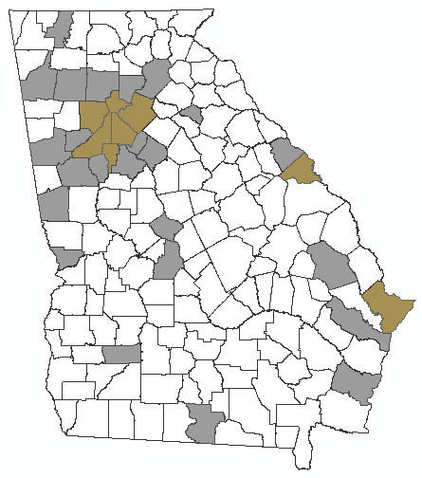




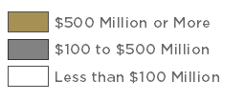
Tourism Impacts Across Georgia
TOURISM SPEND 2015
NATIONAL RANKINGS
$27.5 BILLION SPEND
$59 BILLION IMPACT
$3 BILLION STATE AND LOCAL TAXES
439,000 JOBS
DOMESTIC TOURISM SPEND #7
INTERNATIONAL TOURISM SPEND #8
BEST TRIPS 2017 by National Geographic
U.S.FILM PRODUCTION #3
Source: GDEcD 2015

Slide 4
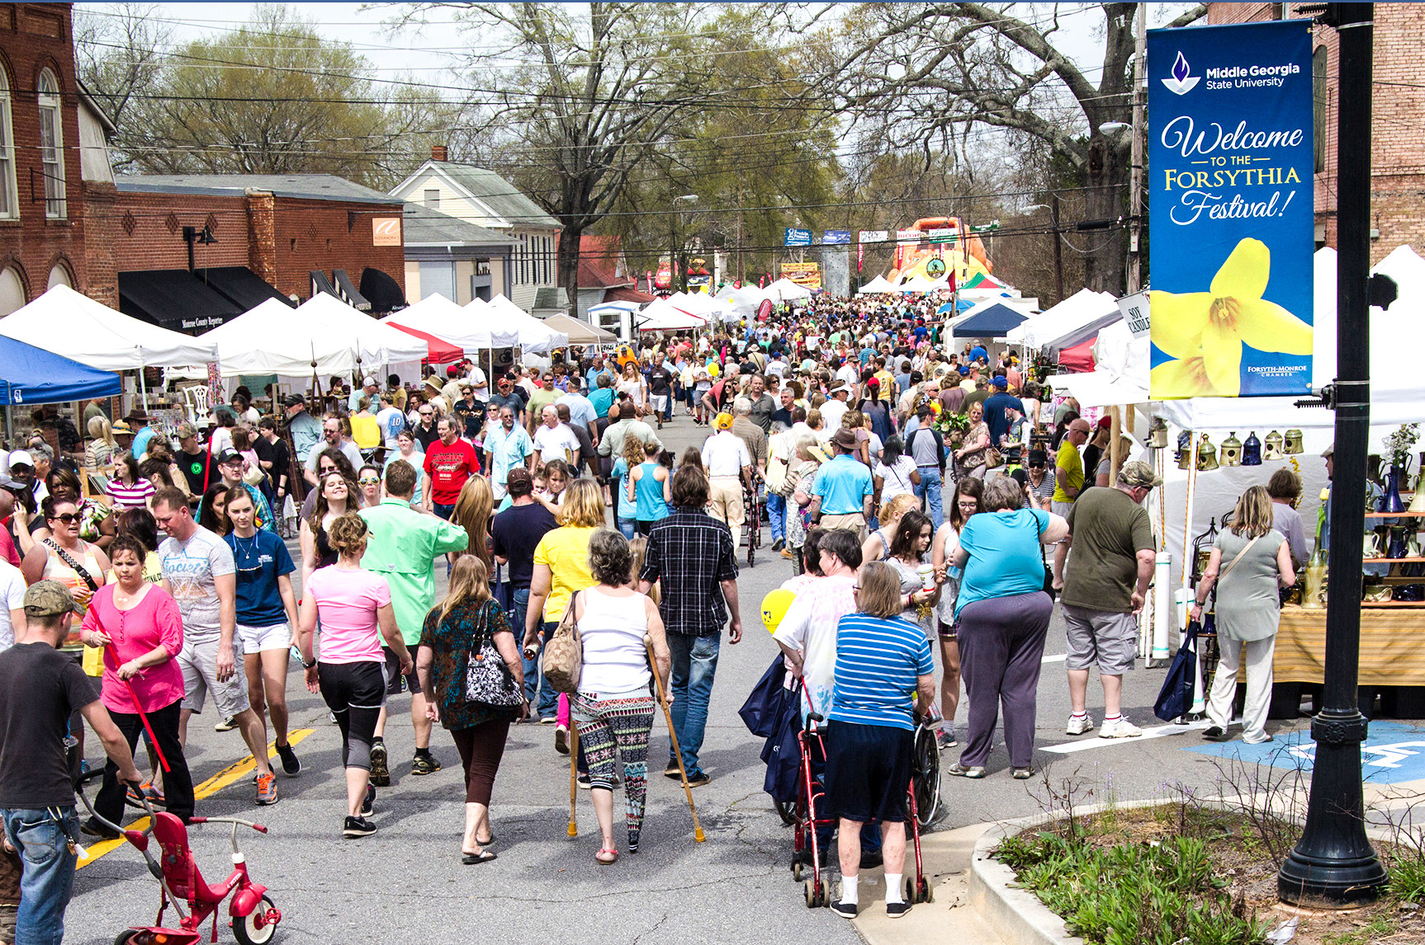
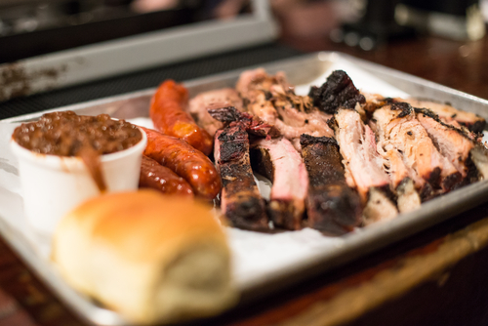

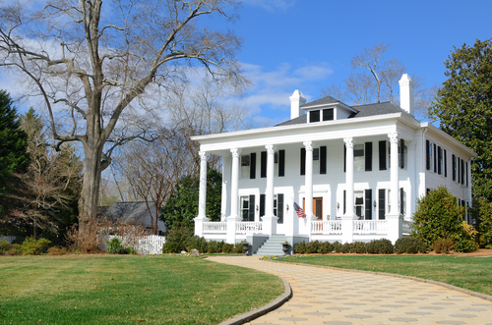
Rural Tourism Perception

Slide 5
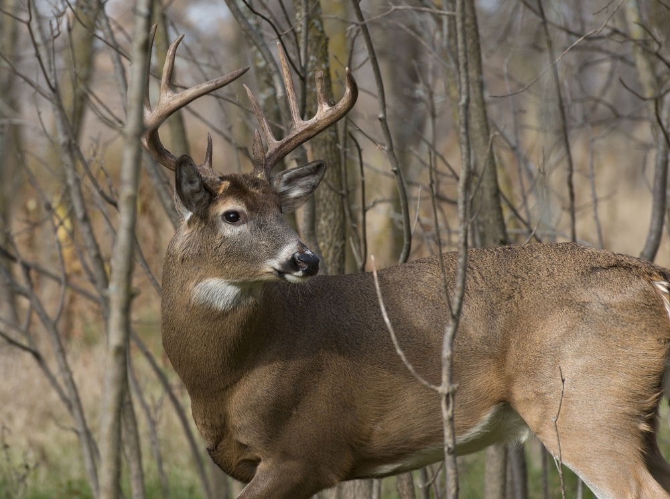
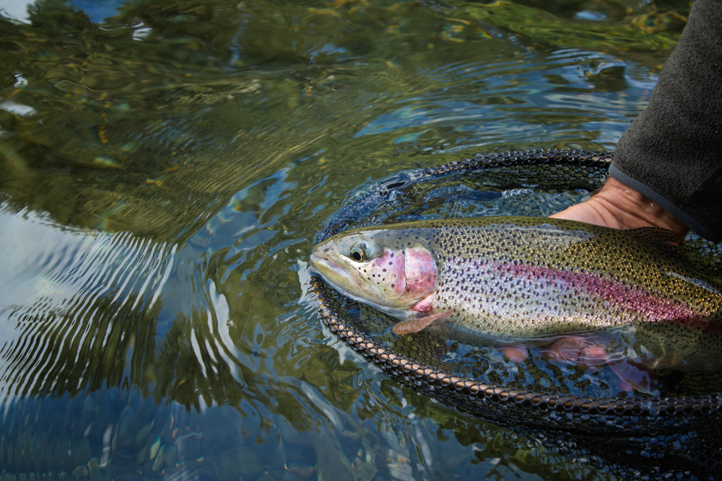
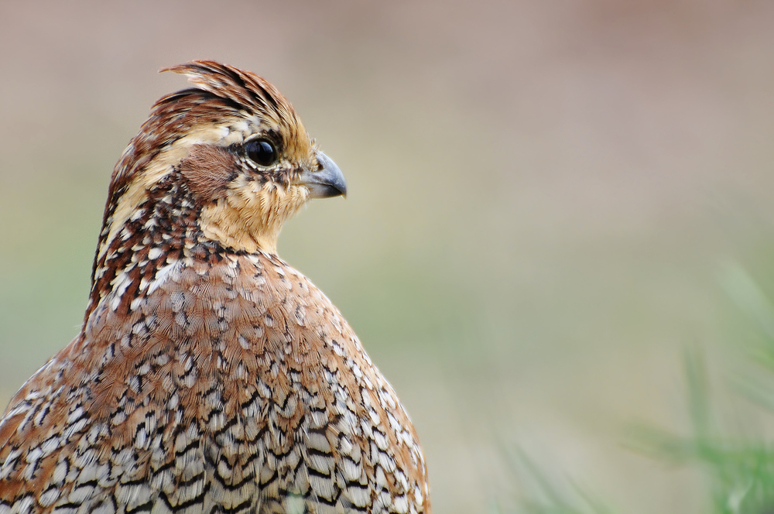




Outdoor Recreation
NATIONAL RANKINGS
$2.27 Billion retail spend by hunters & fishermen
#7 in US for attracting out of state hunters
39,000 jobs connected to hunting and fishing in GA
Source: Ga DNR, 2017

Slide 6
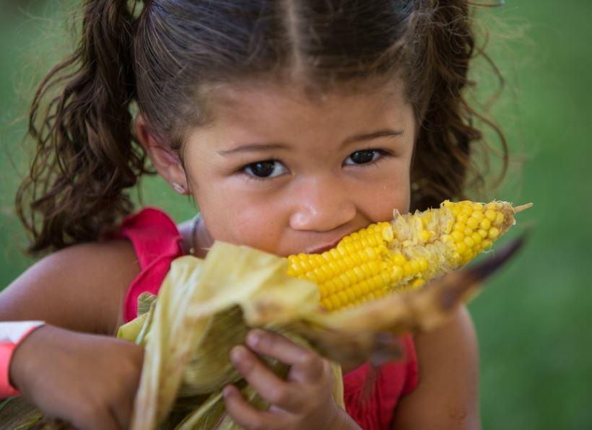

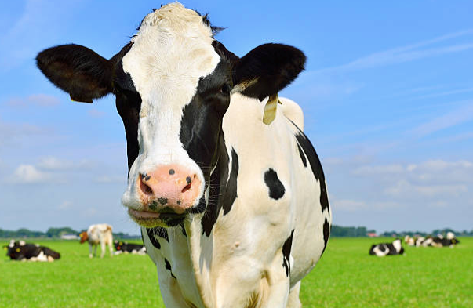

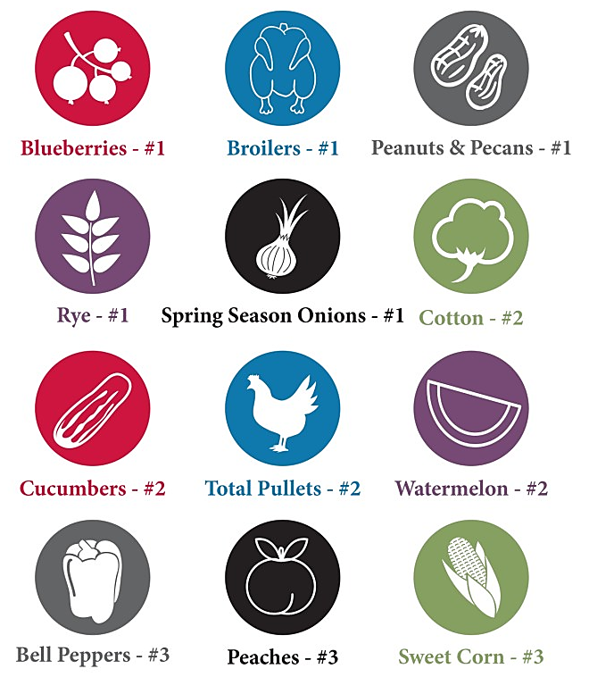
Agritourism Experiences
NATIONAL RANKINGS FOR GEORGIA
Source: UGA Center for Agribusiness
& Economic Development

Slide 7







Film Tourism
U.S. Film production #3
1,000 productions shot in GA
25-30 Film tours per week
Source: GDEcD, 2017

Slide 8



Opportunity to Enhance Rural Tourism
FY 2015-2016 Marketing & Promotional Budgets
Tennessee | $13.16 M
Virginia | $13.02 M
Alabama | $6.38 M
South Carolina | $11.52 M
Louisiana | $11.19 M
Kentucky | $8.26 M
West Virginia | $6.42 M
Georgia | $5.02 M
Mississippi | $3.32 M
$10.1M = Average southern state promotional budget
11:1 ROI in GA tax revenue from FY15 advertising
626,000 Trips influenced by GA advertising
Source: GDEcD, 2016
Source: US Travel

Slide 9
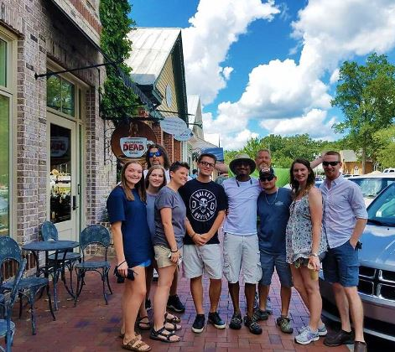
Opportunity to Enhance Rural Tourism
Embrace alternate forms of tourism
  Hunting & fishing
  Film location tourism
  Agritourism
Encourage communities to promote all aspects of the their tourism portfolio
Support increased funding for tourism promotions
Photo: Atlanta Movie Tours

Slide 10

Rural Georgia Tourism
Presented to the
Senate Rural Development Study Committee
August 8, 2017

