Slide 1
Senate Study Committee on Youth Mental Health and Substance Use Disorders
Laura Searcy
President-elect National Association f Pediatric Nurse Practitioners
Vice-Chair Cobb Community Alliance to prevent Substance Abuse

Slide 2
Scope of the Problem
In 2014:
22.5 million Americans age 12 and over reported needing treatment for alcohol or illicit drug use during the past year
11.8 million adults reported needing mental health treatment or counseling during the past year
13 –20 percent of children living in the United States (up to 1 out of 5 children) experience a mental disorder in a given year and an estimated $247 billion is spent each year on childhood mental disorders.
By 2020 Mental and substance abuse disorders will surpass all physical diseases as a major cause of disability
1. http://www.samhsa.gov/prevention
2. http://www.cdc.gov/features/childrensmentalhealth/

Slide 3
Scope of the Problem
Yet there is an alarming decline in perceived risk of harm
Regular smoking of marijuana and taking of prescription stimulants among 12th graders (52-36% and 69-55% over 5 years
Explosion of e-cigarette use (only 14% of 12th graders view as harmful
Marijuana use exceeding cigarette use in all high schoolers
Prescription drugs seen as “safer” than illegal drugs
Parental perceptions of harm also declining
“right of passage” mythology
https://www.drugabuse.gov/publications/drugfacts/nationwide-trends

Slide 4
Effects of Substance Use/Abuse on the
Developing Brain
Brain Plasticity:
The ability of circuitry in the brain to physically change and grow new dendrites as a result of new learning and experiences
    Age 10-21 is a peak time for plasticity
Alcohol use during this time slows down brain activity and hinders development in both the hippocampus and pre-frontal cortex
http://odp.idaho.gov/underage_drinking_files/Final&20tabloid_files/Final%20Tabloid.dpf
Notes:
Plasticity has peak periods between birth and pre-school age begins to increase against about age 10 and has another peak around age 15 gradually declining through late adolescence and the 20’s

Slide 5
Effects of Substance Use/Abuse on the
Developing Brain
Hippocampus:
Important for learning and memory, converting short term memory to more permanent memory, and for recalling spatial relationships
Long term alcohol use results in 10% smaller hippocampus
Short term or moderate drinking impairs learning and memory more in youths than adults
Frequent users may never catch-up in adulthood
  System crucial for storage permanently affected
http://odp.idaho.gov/underage_drinking_files/Final%20tabloid_files/Final%20Tabloid.pdf

Slide 6
Effects of Substance Use/Abuse on the
Developing Brain
Prefrontal cortex:
Responsible for thinking, planning, judgment, decision-making and impulse control
Undergoes the most change during adolescence
Plays an important role in forming adult personality and behavior
This part of the brain does not begin to mature until age 19 and only fully matures by around age 21-25 in women and age 23-28 in men.
Damage from alcohol use may be long term and irreversible and can have life-long consequences for the young person’s memory, personality and behavior
http://odp.idaho.gov/underage_drinking_files/Final&20tabloid_files/Final%20Tabloid.dpf

Slide 7
Effects of Substance Use/Abuse on the
Developing Brain
White Matter Damage
Brain composed of gray and white matter
White matter:
Coating that insulates portion of neurons that send electrical signals
Proper development impaired with alcohol and probably other drug use
White matter negatively affects thinking and memory skills
http://www.npr.org/templates/story/story.php?storyId=122765890

Slide 8
Effects of Substance Use/Abuse on the
Developing Brain
Alcohol in particular
Hijack’s the brain’s pleasure/reward system
Tricks the brain into generating pleasure/reward feelings fro a harmful v=chemical—not real experiences (affects dopamine, a potent neurotransmitter)
Teen brain produces an abundance of dopamine
Can progress from liking to wanting to needing
Programs the brain for addiction

Slide 9
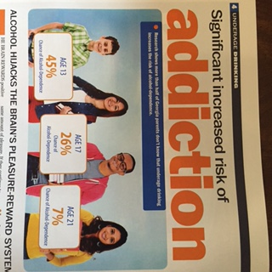

Slide 10
National Association of Pediatric Nurse Practitioners
Strongly supports increasing the utilization of SBIRT in pediatric health care settings and other evidence based efforts to prevent and treat substance abuse disorders
Evidence shows that lack of reimbursement is an impediment to implementation of these strategies in health care settings
By 2020 Mental and substance abuse disorders will surpass all physical diseases as a major cause of disability. This constitutes a public health crises. We cannot afford not to address it.

Slide 11
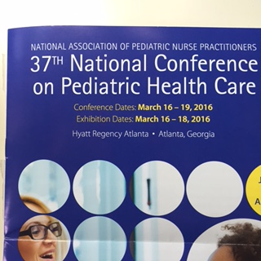

Slide 12
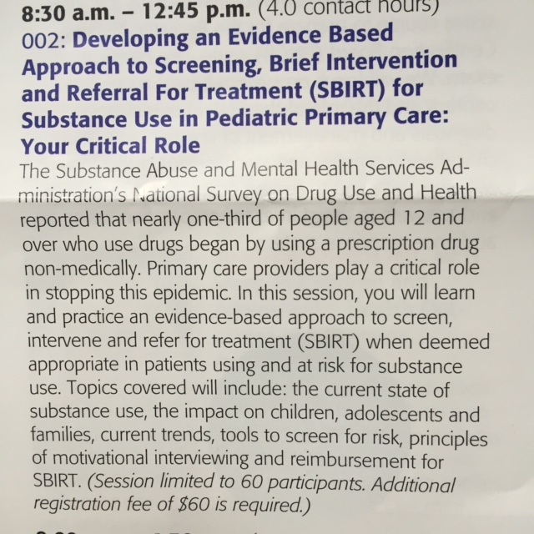

Slide 13
Georgia is in the minority of states that do not reimburse for SBIRT
As we bring 1600 Pediatric Nurse Practitioners from around the nation to Atlanta in March of 2016, lets be able to tell them that the State of Georgia is focused on prevention of substance abuse disorders and has enacted policies that support increased use of SBIRT

Slide 14

Thank You!

