Slide 1
OBHP Overview
Travis fretwell
director
Office of Behavioral Health Prevention
September 2015

Slide 2

OFFICE OF BEHAVIORAL
HEALTH PREVENTION
Substance Abuse Prevention
Suicide
Prevention
Mental Health
Promotion
Notes:
Our office has re-organized to reflect some of these common linkages with Substance Abuse and Suicide Prevention, and Mental Health Promotion.
In the past, Behavioral Health has focused on the prevention of a single separate disorders, such as substance abuse or suicide. Recent research has shown that substance abuse and other behavioral health problems—such as psychological distress and suicide—are interrelated and can be addressed at the same time. They share common risk and protective factors. Improvements in one area often directly impact others.
Mental Health Promotion has been included also because:
Promotion enables people “to increase control over, and to improve, their health”.³ Promotion refers to interventions that help people take charge of their life and improve their well being. The aim of promotion is to enhance people’s ability to “achieve developmentally appropriate tasks,” acquire a “positive sense of self-esteem, mastery, well-being, and social inclusion”, and to “strengthen their ability to cope with adversity”.⁴
As prevention practitioners, we are responsible for identifying opportunities to address health in a more comprehensive way—i.e. address many of the shared risk and protective factors to reach people in at risk settings and during those times in their lives where and when services are most likely to have the greatest impact.
COMMON R/P FACTORS
• Risk factor: a characteristic at the biological, psychological, family, community, or cultural level that precedes and is associated with a higher likelihood of problem outcomes
• Protective factor: a characteristic associated with a lower likelihood of problem outcomes or that reduces the negative impact of a risk factor on problem outcomes
Resources for Shared Evidence-based Practices (Suicide & SAP):
National Registry of Evidence-Based Programs & Practices
Suicide Prevention Resource Center Best Practices Registry
Kauffman Best Practices Project
Handbook of Injury and Violence Prevention
Guide to Community Preventive Services
Promising Practices Network for Children, Families, and Communities
Primary Care: Continuing Medical Education Opportunity
http:??www.medscape.org/viewarticle/830331

Slide 3
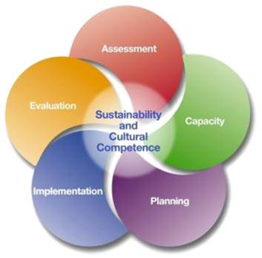
Strategic Prevention Framework
What’s going on?
(What, who, when, where, why and how?
Process & Outcome Results
Resources & Readiness
Create A Comprehensive Strategic Plan
Implement the Plan with Fidelity
Notes:
OBHP’s utilizes a public health approach (population based) and the Strategic Prevention Framework Model.
[Click to reveal each text box 1 – 5]
Assess the situation (what, who, when, where, why, and how) – often called a Needs Assessment because once completed you have a better understanding of the prevention needs for the issues and community. Use data to identify and prioritize problems and see where there are gaps.
Capacity – (Resources & Readiness) Assess and Building Capacity
Planning – Create a strategic comprehensive plan that addresses the problems (Choose appropriate evidence based strategies to impact the problems (via risk/protective factors)
Implementation – implement the plan with fidelity (stick to the plan). Indicate any/all Adaptations (if needed).
Evaluation – a systematic collection and analysis of information: Process (what was done) and Outcomes (results)

Slide 4
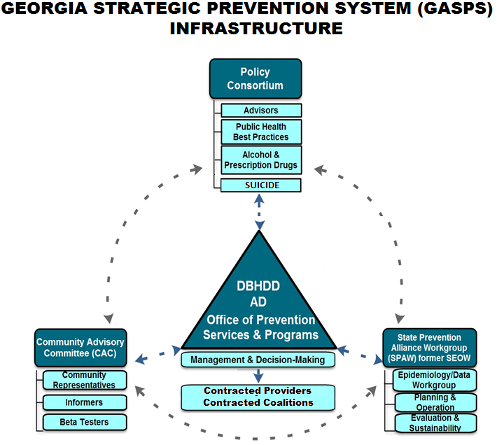
The Georgia Strategic Prevention
System (GASPS) Infrastructure
Is a multilevel network-based system aimed at preventing substance use and abuse and promoting healthy choices and lifestyles among Georgians through the use of evidence –based strategies (programs, policies, and practices).
Notes:
GASPS Infrastructure
Click – image of components

Slide 5
OBHP Organizational Chart
(Programs Only)
Travis Fretwell
OBHP Director
Red Ribbon & Synar
Coordinator
Tricia Mills
OBHP Assistant Director
TBD
SPFS Coordinator
Donna Dent
Suicide Prevention Coordinator
Sally Vander Straeten
T/TA Contract
Marcus Bouligny
& Krystal Lokkesmoe
Data Analyst
Olufemi O. Oyedele
GLS Youth Suicide Prevention Director
Michelle Zelaya
PFS Coordinator (GenRx) Amy Benson
RPS Supervisor
Mary Daise Basil
R1 RPS
Brian Le
12 Community Coalitions
3 Contracted Prevention Providers
Evaluator Contract
GSU: Sheryl Strasser
R2 RPS
Sheena Berry
R3 RPS
Nykia Greene-Young
47 Contracted Prevention Providers
R4 & R5 RPS
Cathy Wendholt-McDade
R6 RPS
Trese Flowers

Slide 6
OFFICE OF BEHAVIORAL
HEALTH PREVENTION
Substance Abuse Prevention

Slide 7
Substance Abuse Prevention
Current Initiative/Projects
Alcohol Prevention Project (APP)
Prevention Clubhouses
Red Ribbon Campaign
SYNAR (GA DOR) Tobacco Compliance
GA Rx Drug Abuse Prevention Collaborative (GADAPC)
Drugs Don’t Work Program
PFS II (GenRx) Prescription Drug
Maternal Substance Abuse (MSA) Child Development Project
GA Helpline (HODAC)
Georgia Teen Institute
Voices For Prevention (V4P)
GASPS Data Warehouse Project
Notes:
What about Drug Free Community Coalitions (DFCC) & Contact Information?
What about MDS?

Slide 8
OFFICE OF BEHAVIORAL
HEALTH PREVENTION
Suicide
Prevention

Slide 9
Suicide Prevention
Current Initiative/Projects
Suicide Education & Training Project
Suicide Prevention Resource Center (SPRC)
Suicide Prevention Coalition of Georgia (SPCGA)
Garrett Lee Smith Youth Suicide Prevention Grant

Slide 10
OFFICE OF BEHAVIORAL
HEALTH PREVENTION
Mental
Health Promotion

Slide 11
Mental Health Promotion
Current Initiative/Projects
Strategic Planning for incorporation throughout OBHP work.
Know the signs initiative

