Slide 1

Industry Perspective
Potential
COAM
Current
Maturity

Slide 2

Table of Contents
Assessment / Learning from Past Page 3
Industry Players Page 4
Roles and Responsibilities Page 5
Revolution of COAM Industry - HB487 (2013) Page 6
The Evolution of the COAM industry Page 7
Statistics Page 8
Potential Market Impact from Stability Page 9
Future Potential Page 10
Industry Stability Page 11
What We Gain from Enhanced Stability Page 12
Maturity Page 13
COAMs – Legacy vs New Page 14
Challenges Page 15
Conclusion Page 16

Slide 3
Assessment / Learning from Past
How increased stability will benefit all players
2. How a mature industry would look in Georgia
3. Opportunities for potential ahead

Slide 4

Industry Players
INDUSTRY
Consideration of:
1. Location owner
2. Master Licensee
3. Regulator
MASTER LICENSEE
REGULATOR
LOCATION OWNER

Slide 5


Roles and Responsibilities
Locations
Provide space
Patrons service
Utilities
Environment
Capital investment
Equipment service
Marketing
Master Licensee
Licensing
Enforcement
Compliance
GLC

Slide 6

Revolution of COAM Industry - HB487 (2013)
BEFORE
AFTER
No GLC, just DOR for licensing
Tax accountability struggles
No governance, no protection
Provided limited value to the state
Birth of an ”industry”
Central accounting system
Enhanced regulations / compliance
Increased revenue to state/GLC

Slide 7
The Evolution of the COAM Industry
Pre-2013 UNREGULATED
INDUSTRY
2013
HB 487 – REGULATION
(50/50) RULE
2015
SB 190 –
ARBITRATION
2016
SB 388 –
“9-MONTH RULE”; MORE REGULATIONS
2020
TODAY – REGULATION REFINEMENT
2021-2022
THE FUTURE – STABILITY, MATURITY, POTENTIAL.

Slide 8

Current State
1. 178 Master License holders in Georgia
2. 5,100 Locations
3. 24,000 COAMs
4. 4.6 machines per location
5. 1,800 location applications (2019 – 2020)

Slide 9

Industry Stability
Increased stability fosters economic growth
  Allows companies to attract capital
  More tax revenue to the state/GLC
  Additional jobs
Increased stability fosters enhanced compliance
  Companies invest in infrastructure
  Sophistication of operations
  Additional oversight from lenders

Slide 10

What We Gain from Enhanced Stability
Increased capital Investment in Georgia
  Growth
  Sustainability
  Innovation
Improved Infrastructure
  Better, more modern equipment
  Attracting more and better patrons
  Master licensees providing greater operational support
A higher standard of self-regulation and additional tools for GLC in order to push bad actors out

Slide 11
Maturity
The location owner would see:
Master Licensees able to provide most recent COAMs
Improved COAM curb appeal
An increase in revenue
The master licensee would see:
An increase in investments into new COAMs
Improvements in service provided to location operators
Organic growth and expansion
The GLC would see:
Fewer disputes between licensees
Enhanced compliance by licensees
Increase in revenue
The COAM manufacturers & distributors would see:
Increase in the replacement rate of legacy COAMs - manufactured/distributed
Market for more innovative games

Slide 12
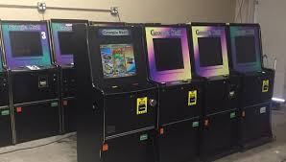
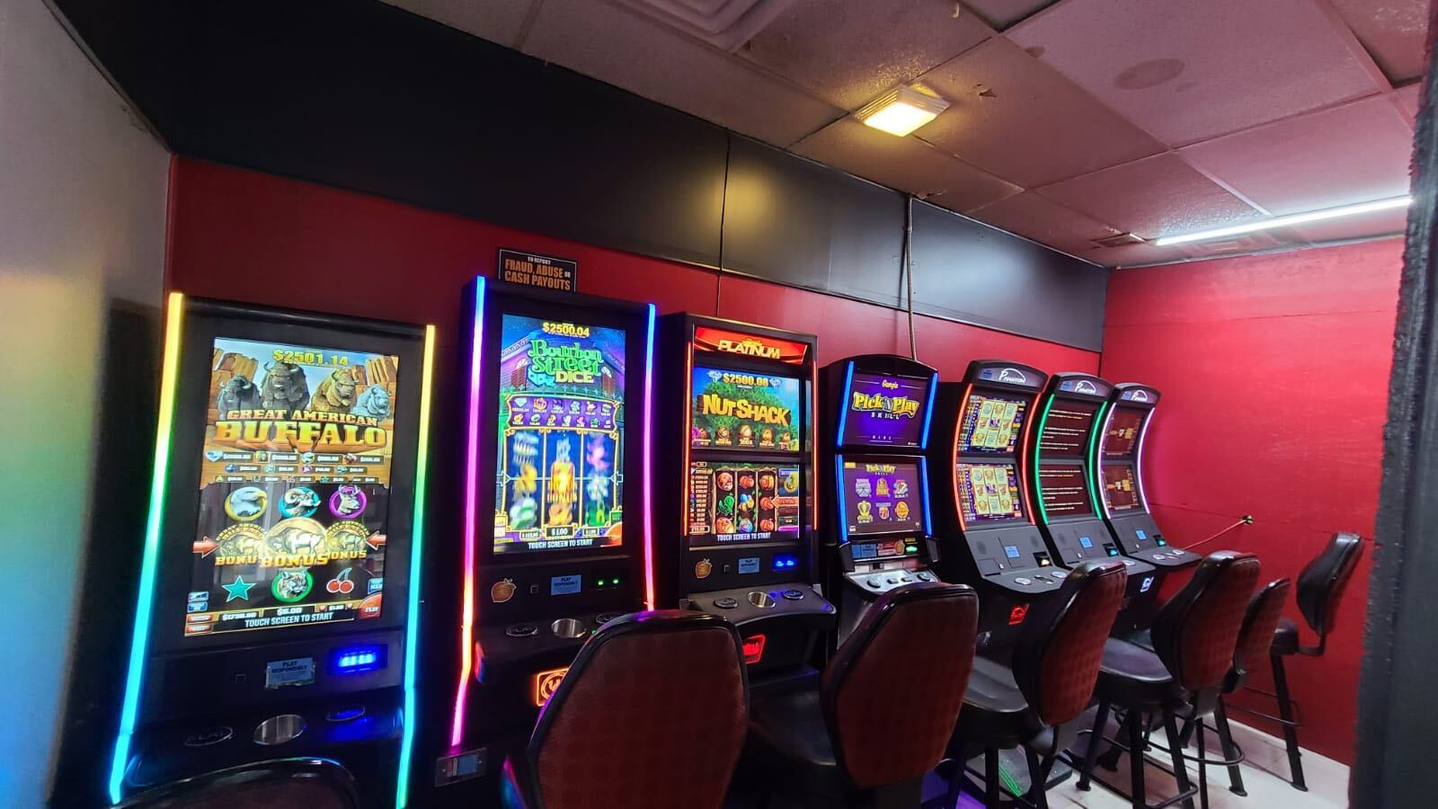
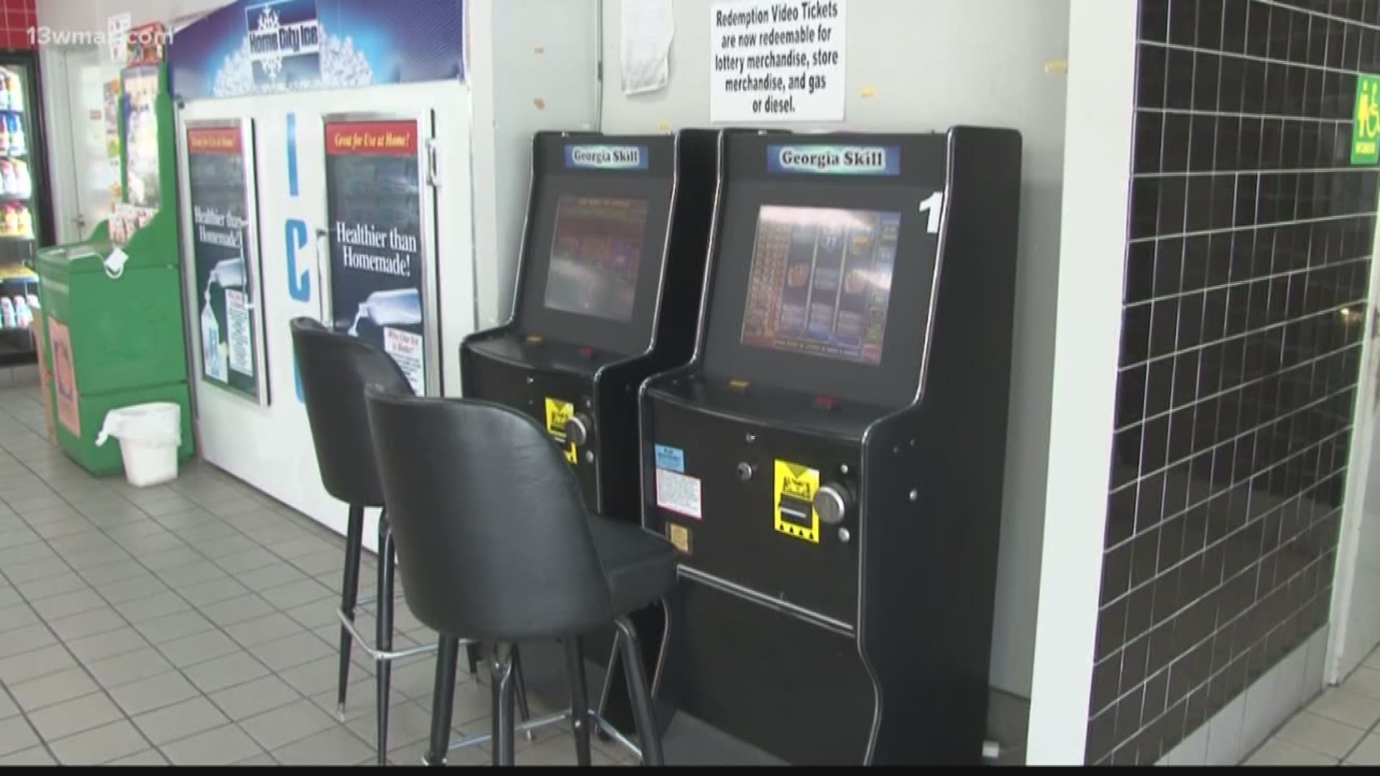
COAMs - Legacy vs New

Slide 13
Potential Market Impact from Stability
2016 | 2017 | 2018 | 2019 | 2020 | 2021-2022
GLC Revenues | GLC Revenues | GLC Revenues | GLC Revenues | GLC Revenues | GLC Revenues
$9.5M Licensing/Decals | $9.5M Licensing/Decals | $10.9M Licensing/Decals | $9.3M Licensing/Decals | $10.7M Licensing/Decals | $15M Licensing/Decals
$1.4M Fines/ Fees | $1.2M Fines/ Fees | $3.9M Fines/ Fees | $3.5M Fines/ Fees | $4.0M Fines/ Fees | $4.0M Fines/ Fees
$35.9 M CAS @ 6% | $47.2 M CAS @ 7% | $58.8 M CAS @ 8% | $70.6 M CAS @ 9% | $90 M CAS @ 10% | $172M CAS @ 10%
 | $4.5M Auction/Admin | $900K Auction/Admin | $73K Auction/Admin | $81K Auction/Admin | $81K Auction/Admin
$33.5M to Education | $47.5M to Education | $58.1M to Education | $66M to Education | $85M to Education | $190M to Education

Slide 14
Future Potential
$102
WPD
$142
WPD
Source: other gaming markets, GA state averages, historical uplift from newer products from internal data analytics from several companies

Slide 15

Challenges
Contributing factors may include:
  Fraudulent ownership changes
  Unscrupulous business practices
  High churn rate of LLH ~ 18% (900/5100 locations)
  Annual license renewals
  Redemption

Slide 16

Q & A

