Slide 1
Premium Peanut
Premium Quality
Premium Service
Premium Food Safety

Slide 2
Company Overview
Formed in the fall of 2014 by a group of local businessmen, farmers, and buying point owner / operators to:
Grower Benefits
Secure peanut market access for our growers
Improve farm income and profitability through vertical integration of growing, warehousing, shelling, and marketing crops cooperatively
Stabilize the peanut market in the south Georgia area for local farmers, to assist in the process of crop rotations in order to improve quality and yields
Customer Benefits
Ensure a stable supply of high quality peanuts for our manufacturer partners at a competitive cost
Create Stability & Value for Growers, and Customers
Notes:
Premium Peanut was a concept in late 2014.
A couple local businessmen came together and decided to build a shelling plant, to provide their buying point & fertilizer customers an opportunity to own a shelling plant.
The company was formed as a co-op, with shares to be owned by peanut growers. Unique versus even other co-ops, the shareholders are the ones who must grow the peanuts themselves…aligning the entire supply chain towards a common goals: to create the maximum value for peanuts grown by the company’s owners (200+ farmers).
Shareholders must sign a 10-year agreement to grow peanuts exclusively for their company, Premium Peanut. Purchase of 1 share obligates the shareholder to deliver 1 ton of farmerstock peanuts each year.
The concept provides security and stability for growers and buying points…they know they are guaranteed a customer (Premium Peanut) each year, for their designated quantity of peanuts. And, they will get 100% of the value…whether up-front (at harvest) as option payments, or after the shelling year (as dividends).

Slide 3
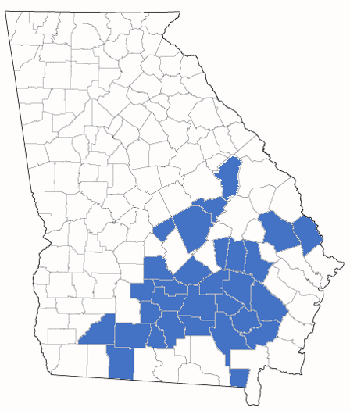
Diverse & Growing Farmerstock Base
350+ Shareholders in 30+ counties – All Peanut Growers
2016 guaranteed tons : 140,000 tons
2017 handlings : 251,000 tons
2018 guaranteed tons (minimum) : 210,000 tons
2018 handlings (estimate) : 230,000 tons
$175M+ in sales
$10M+ EBITDA
1st dividend paid in early 2018, for 2016 crop!
  Successful, and Growing
Premium Peanut and Buying Points
Notes:
Shareholders grow peanuts in 28 counties throughout southern Georgia, providing secure, reliable, market access to growers across a large part of the state.

Slide 4
Home County of Employees
Difficult to attract employees from other counties.
Challenging to incent employees to move.
Notes:
Shareholders grow peanuts in 28 counties throughout southern Georgia, providing secure, reliable, market access to growers across a large part of the state.

Slide 5
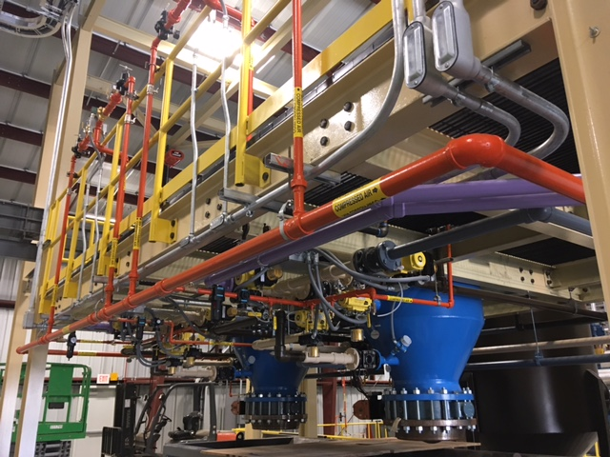
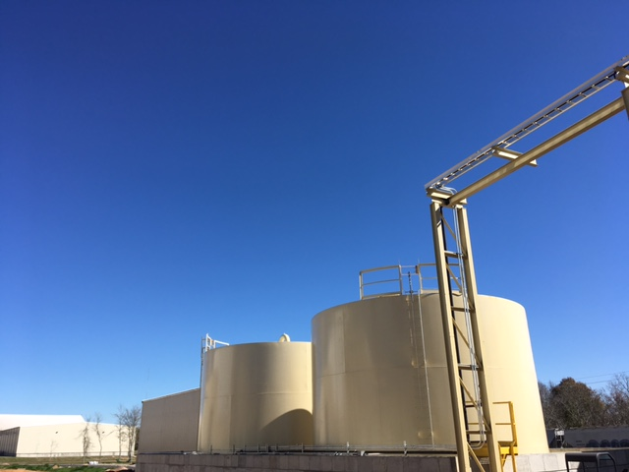
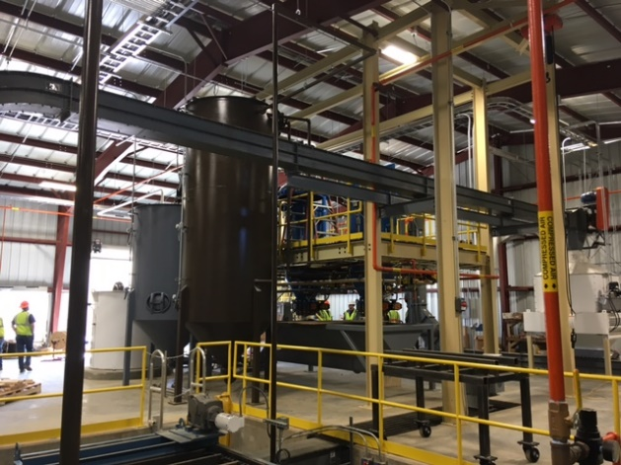
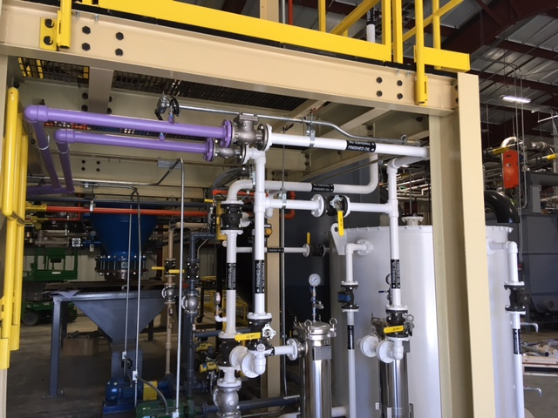
Oil Mill Expansion
With an investment of approximately $14 million, Premium Peanut has constructed a filtered crude peanut oil facility, located adjacent to the shelling plant. This new operation has the capacity to produce over 3 million gallons of peanut oil per year.
Notes:
Currently, the United States is a net importer of peanut crude oil!
Premium Peanut sells the majority of its non-edible peanuts, oilstock, to Golden Peanut & Sessions for crushing into peanut oil…both of whom are also shelling competitors.
In order to maximize the value from its oilstock, and reduce risk (i.e. not relying on a competitor to buy its oilstock), Premium Peanut has broken ground on a peanut oil plant.

Slide 6
Future Growth
Future growth is hindered by the availability of a trained, skilled, stable workforce.
Traditional methods to attract & retain talent ‘are not enough’
Notes:
Currently, the United States is a net importer of peanut crude oil!
Premium Peanut sells the majority of its non-edible peanuts, oilstock, to Golden Peanut & Sessions for crushing into peanut oil…both of whom are also shelling competitors.
In order to maximize the value from its oilstock, and reduce risk (i.e. not relying on a competitor to buy its oilstock), Premium Peanut has broken ground on a peanut oil plant.

Slide 7
Year-to-Date Separations
70 separations YTD, or approximately 30% annual turnover
Failed drug tests, absenteeism, and performance issues are key drivers
Notes:
The economic impact of the company is significant. All profits will create value for its shareholders, but in addition to that value, the company has already created a significant economic impact.
The numbers above denote the actual dollars paid / invested by the company to local farmers, buying points, service providers, etc.

Slide 8
Traditional Methods for Retention
Pay
Avg. hourly rate ~$14
Overtime
Avg. annual pay $39,000
Quickstart, Development Courses
32 promotions / pay increases YTD due to skill enhancement (15%)
Skill
Enhancement
401(k) match
Medical - $3,800 / employee / year
Benefits
  Traditional Methods are not Enough
Notes:
The economic impact of the company is significant. All profits will create value for its shareholders, but in addition to that value, the company has already created a significant economic impact.
The numbers above denote the actual dollars paid / invested by the company to local farmers, buying points, service providers, etc.

Slide 9
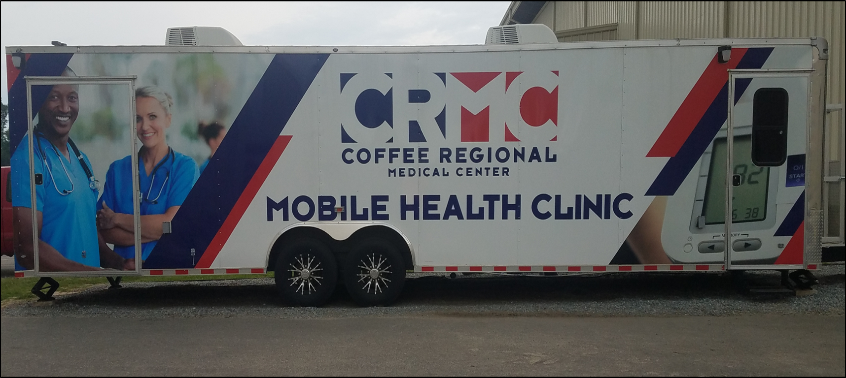
Non-Traditional Retention
$4,200 / month base fee – paid by PP ; $10 / visit – paid by PP
Open 2 hours / day, Monday – Friday
Open to all employees & shareholders, and their families
Notes:
International sales have been a key component of Premium Peanut’s success.
Close to 40% of its sales have been to international customers. Given the company’s close proximity to the port of Savannah, and willingness to develop new customers internationally, over 2,000 containers of product has been exported!

Slide 10

Mobile Clinic Benefits???
  Leap of Faith
Notes:
International sales have been a key component of Premium Peanut’s success.
Close to 40% of its sales have been to international customers. Given the company’s close proximity to the port of Savannah, and willingness to develop new customers internationally, over 2,000 containers of product has been exported!

Slide 11
Mobile Clinic Benefits
Address absenteeism, due to sickness of employee or family??
Reduce medical costs by employees??
Reduce medical costs to Premium Peanut??
  ‘Self-funded’ plan costs driven by catastrophic health events
  Reduced ER visits benefit local hospital, not the company
Reduce time & frustration at doctor offices
  Language barrier
  Insurance difficulties
  Appointment & waiting times
Without a ‘leap of faith’, difficult to justify
Incentives need established to provide direct support, versus reliance on indirect benefits
Notes:
International sales have been a key component of Premium Peanut’s success.
Close to 40% of its sales have been to international customers. Given the company’s close proximity to the port of Savannah, and willingness to develop new customers internationally, over 2,000 containers of product has been exported!

Slide 12
Thank You

