Slide 1
Adult Education
Preparing for a New Workforce
Stephen L. Pruitt, Ph.D.
President
Twitter: @DrSPruitt

Slide 2
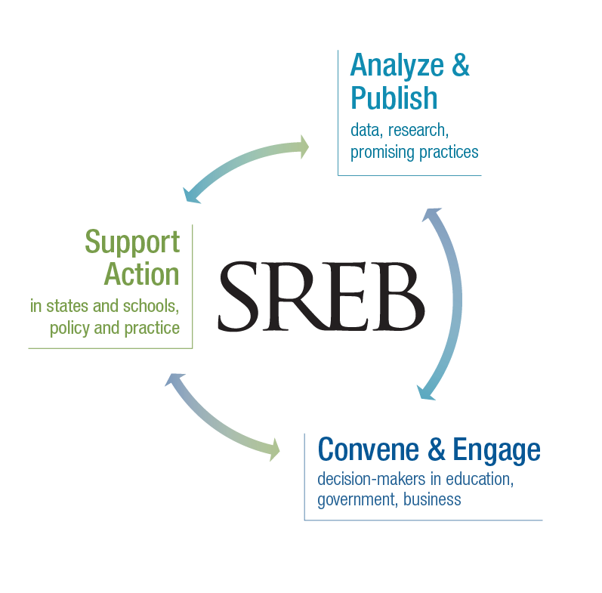

Slide 3

A More Dependent Population
By 2030, for every 52 dependent people in Georgia there will be just 48 working-age adults to provide for them.
Notes:
The dependent population is …
Children through traditional college-age young adults
People who qualify for Social Security and Medicare
In between are working-age adults, 25-64.
Many among this 47 percent will be unprepared and unaware
Children under age 5, students ages 5 through 24, and adults 65 and older represented 48 percent of the SREB region’s population in 2017. These groups are often referred to as the dependent portion of the population. By 2020, the dependent portion of the population is expected to almost equal the working-age population — people between the ages of 25 and 64. Dependent representation is projected to reach 53 percent in the SREB region by 2030. It is at that time that working-age adults will no longer outnumber the dependent portion of the region’s population. So by 2030 the responsibility of working-age adults (including the unprepared and unaware) to take care of the dependent population concentrates: For every 53 dependent people, 47 working age adults will need to provide for or contribute to their economic viability. [Table 6 in Population chapter]

Slide 4

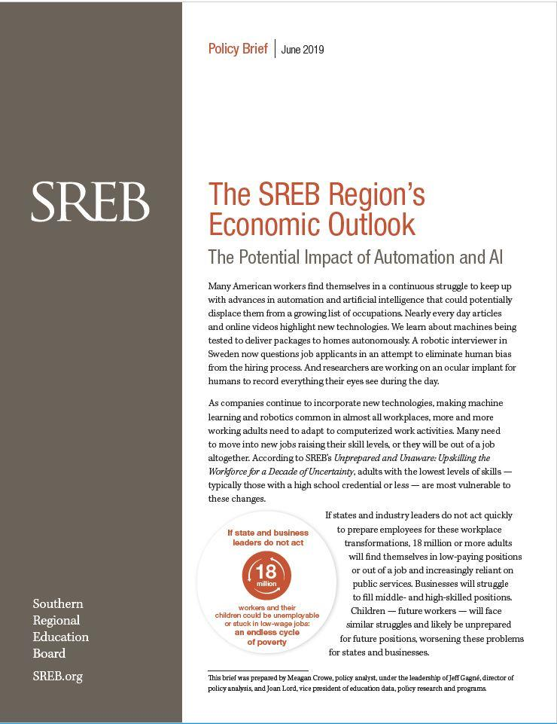

Slide 5
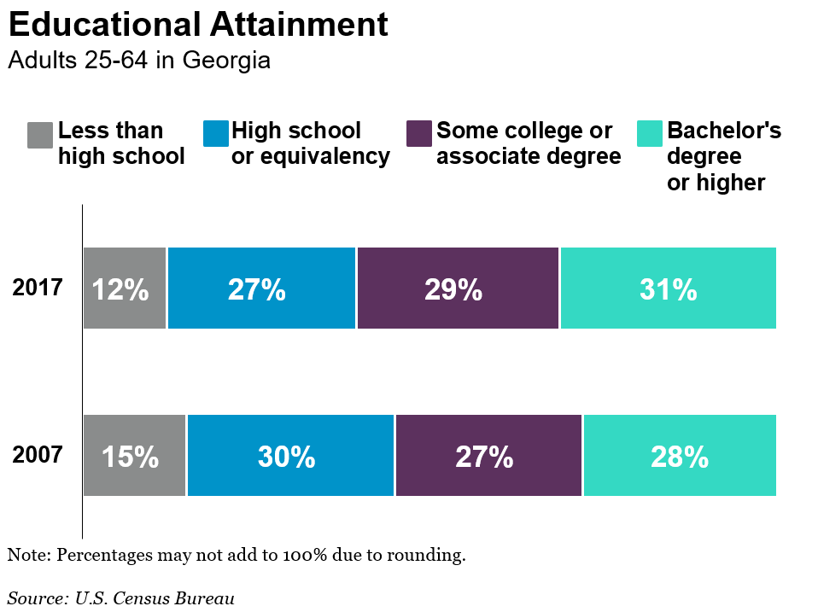

Slide 6
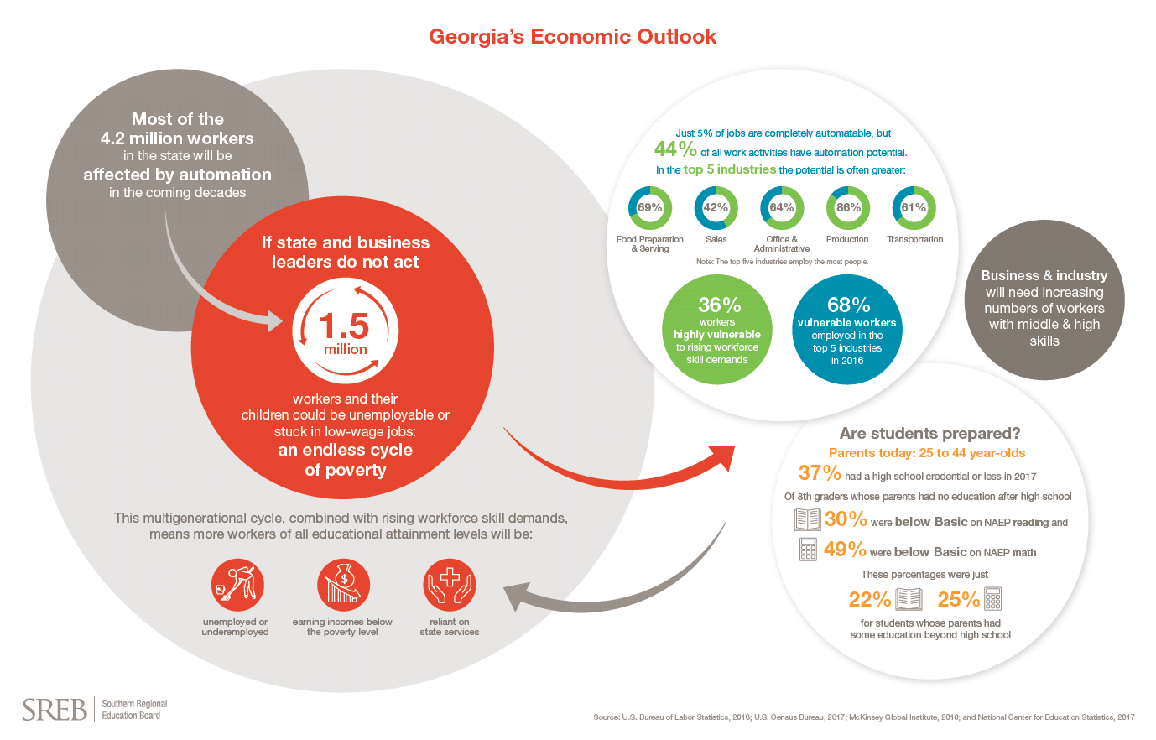
Notes:
I would say to remind people that automation potential here is based on percentage of work activities by industry. The 1.5 million workers could be unemployable of stuck in low-wage jobs due to their level of educational attainment.

Slide 7
Pre-Pandemic Total Automation Potential
Work activities in the Top 5 Employing Industries
(2014-2030)
Food Preparation and Serving
Sales
Office and Administrative
Production
Transportation
Notes:
This is automation potential of work activities based on 2016 employment data/2017 analysis from McKinsey & Company. This is the TOTAL potential for automation based on already demonstrated technologies over the time period from 2014 to 2030.

Slide 8
The pandemic advanced “consumer and business digital adoption” by an estimated five years in just eight weeks.
Notes:
-McKinsey Company + others, they say in the early (8) weeks of the pandemic/shutdowns, digital adoption advanced 5 years.

Slide 9
By 2025 – no longer 2030 – accelerated digital adoption due to the pandemic could eliminate the full-time equivalence of
389,000 positions at the most conservative rate,
1,295,000 positions at a midpoint rate, or
2,590,000 positions at the fastest estimated rate.
Notes:
Remember that 1.5 million low-skilled adults were likely to be unemployable or stuck in low wage jobs by 2030. Now, almost 1.3 million full-time positions could go away by 2025.

Slide 10
If just 50% of automation potential is realized,
15% of all work activities could be automated
between 2020 and 2025.
Food Preparation and Serving
Sales
Office and Administrative
Production
Transportation
Notes:
This is automation potential of work activities based on 2016 employment data/2017 analysis from McKinsey & Company. This is the potential automation of work activities by industry. Ex: From the previous slide, 69% of activities in the food prep industry are automatable at all. If we realized just half of that automation (so a midpoint rate of adoption) then 34% of activities would be automated over the total period (2014-2030). But we’ve already been automating for 5 years and we’re condensing the last 10 years (2020-2030) into 5. So, 23% of food prep activities could be automated between 2020 and 2025.

Slide 11
Percentage of the Workers that are Vulnerable During the Pandemic in Each Top 5 Industry
Food Preparation and Serving
Sales
Office and Administrative
Production
Transportation
…together, they make up almost one-third
of the total workforce in Georgia.
Notes:
So, by industry, this is the percentage workers that are vulnerable to unemployment, layoffs, dropping out of the labor force, etc. during the pandemic as a percentage of each industry. When I look at “at-risk” workers in just the top-five employing industries, they make up one-third of the TOTAL current (most recent data is from May 2019) workforce. 45% of GA’s total workforce are considered at risk due to the pandemic.

Slide 12
Working Toward a Unified Vision

Slide 13
Setting Workforce “North Star”
Preparing and educated and skilled workforce
English and math, high school graduation rate and English proficiency
Other goals aligned to the vision
Meeting the skilled workforce needs of employers
Required by Perkins V and WIOA
States can add other goals under all three statutes
Required by Perkins V and WIOA
Required by ESSA

Slide 14
Ensure that your programs help everyone take part in achieving the vision
Career pathways
Share labor market data
Use a shared set of criteria and processes to develop high-quality pathways
Work-based learning
Focus funds on WBL in the most in-demand fields
Articulate what high-quality work-based learning looks like
Equity
Collaborate on professional learning, plan together, share resources
Target the same set of in-demand industries
Coordinate support services
Engage shareholders together
Get K-12 students involved earlier

Slide 15
Work-Based Learning Recommendations

Slide 16
Recommendations
Process
Engage business and industry leaders in forging and strengthening regional industry sector partnerships in support of career education.
Prioritize state resources and efforts to develop career pathways in critical industry sectors as identify by regional business partnerships.
Supportive Policies
Adopt a business-friendly statewide policy for K-16 and work-based learning that promotes a continuum of experiences beginning in the middle grades and extending through postsecondary.
Recognize the importance of work-based learning in high school by including those experiences in graduation requirements and high school accountability ratings.
Provide policy solutions for workers' compensation and liability insurance for work-based learning placements.
Notes:
After assessing the future of work and conducting a gap analysis, the commission developed 11 recommendations. The recommendations have been categorized as process, supportive policies, funding, educator effectiveness, and tools/mechanisms. On this slide you see the first five recommendations. I’ll give you a couple of minutes to review the recommendations.

Slide 17
Recommendations continued..
Funding
Support industry sector partnerships by braiding funding from multiple sources — federal, state, local, private and philanthropic.
Provide incentives to employers offering paid work-based learning experiences.
Tools and Mechanisms
Promote Simulated Workplace and other virtual solutions to expand work-based learning opportunities in rural and hard-to-serve communities.
Designate a state agency or special council to work with employers and secondary and postsecondary education agencies to identify, evaluate and approve industry certification examinations, technical skills assessments, dual credit courses and end-of-course assessments that are part of a system of stackable credentials.
Promote structured dual enrollment programs for career pathways and establish uniform statewide policies so students can earn credits toward high school graduation that are automatically added to students’ transcripts at postsecondary institutions. .
Notes:
You will see the remaining recommendations on this slide. Today we are going to address three topics and promising practices. The topics include sector partnerships, employability skills, and legal barriers and concerns.
Now Jon is going to share an example of a strong strategic partnership in the state of Georgia.

Slide 18
Contact me:
Stephen L. Pruitt, Ph.D.
President
Stephen.Pruitt@SREB.org
Twitter: @DrSPruitt

