Slide 1
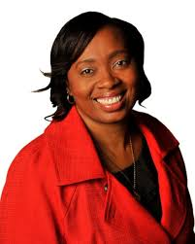

Felony Disenfranchisement in Georgia
Senate Study Committee on
“Revising Voting Rights for Nonviolent Felons”
Roberta Meyers
Dir. of State Strategy & Reentry
October 22, 2019
LaGrange College

Slide 2


The Legal Action Center is the only non-profit law and policy organization in the United States whose sole mission is to fight discrimination against people with histories of addiction, HIV/AIDS, or criminal records, and to advocate for sound public policies in these areas.
The Legal Action Center’s National H.I.R.E Network is a national clearinghouse of information and policy advocacy project that aims to improve employment and other opportunities for people with criminal records.
The Legal Action Center’s No Health = No Justice Campaign is a Multistate Plan envisioning a system of mass decarceration where health care is provided to all and people are no longer criminalized for conditions related to their health.

Slide 3


The Criminalization of Drug Use
Millions of Americans are suffering today because of decades of unjust public policy favoring punishment over treatment.
More people with substance use disorders are in the criminal justice system (6 million) than in treatment (2.3 million).
60-80% of people in the criminal justice system suffer from substance use disorders.

Slide 4
Consider…
The history of racial discrimination and oppression in Georgia
Relationship between race, drug laws, and mass incarceration
Georgia’s commitment to being smart on crime, safety and justice
Practicing redemption and restoring humanity

Slide 5
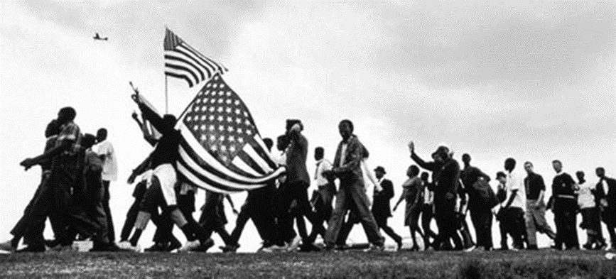
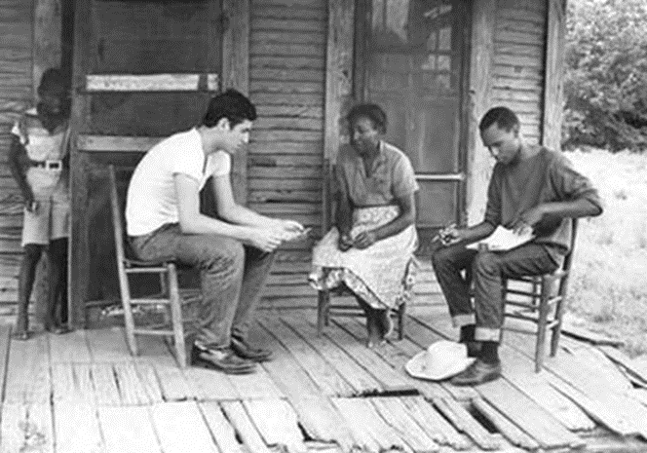
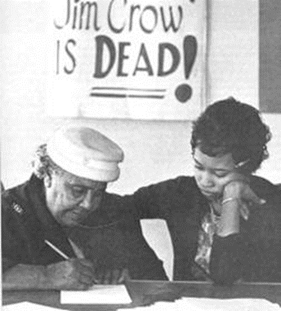
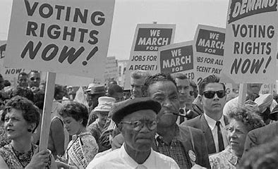

Slide 6
“No person who has been convicted of a felony involving moral turpitude may register, remain registered or vote except upon completion of the sentence.”
Problems With “Moral Turpitude”
→ Possible Racist Motives
→ Vague
→ Meaningless

Slide 7
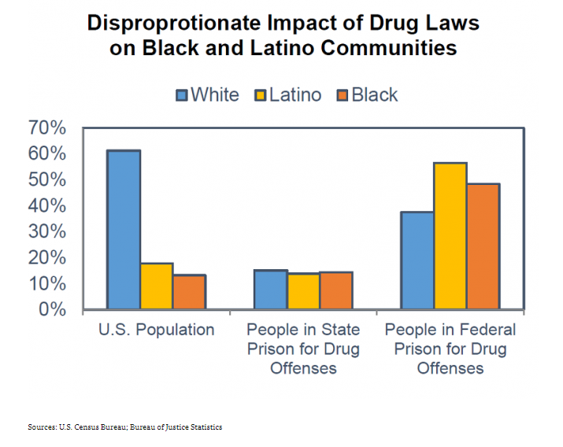
Nothing has contributed more to the systematic mass incarceration of people of color in the United States than the War on Drugs.”
Michelle Alexander, The New Jim Crow (2010)
Graph source: Drug Policy Alliance

Slide 8
Georgia Criminal Justice Statistics
Probation sentences in Georgia average 6.3 years, near double the US average
202,421 people on felony probation and living in their community
    35% (71,667) for felony drug offenses (possession, sale, etc.)
    32% (64,579) for property offenses (burglary, vehicle theft, fraud, etc.)
    1% (1,723) for driving while intoxicated or under influence of alcohol or drugs
20,426 Georgians were on felony parole (8.7%)
    Over 60% are people of color and 57% had non-violent crimes (property, drug)

Slide 9
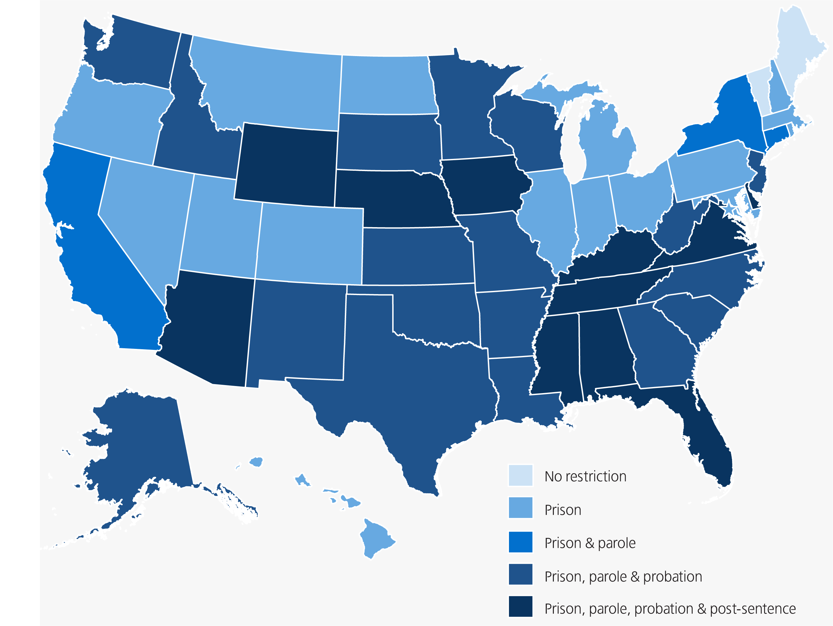
Felony Disenfranchisement by State
Graphic Source: Sentencing Project, www.sentencingproject.org

Slide 10
JUSTICE
What is our goal when seeking justice?
PUNISHMENT OR CHANGING BEHAVIOR

Slide 11
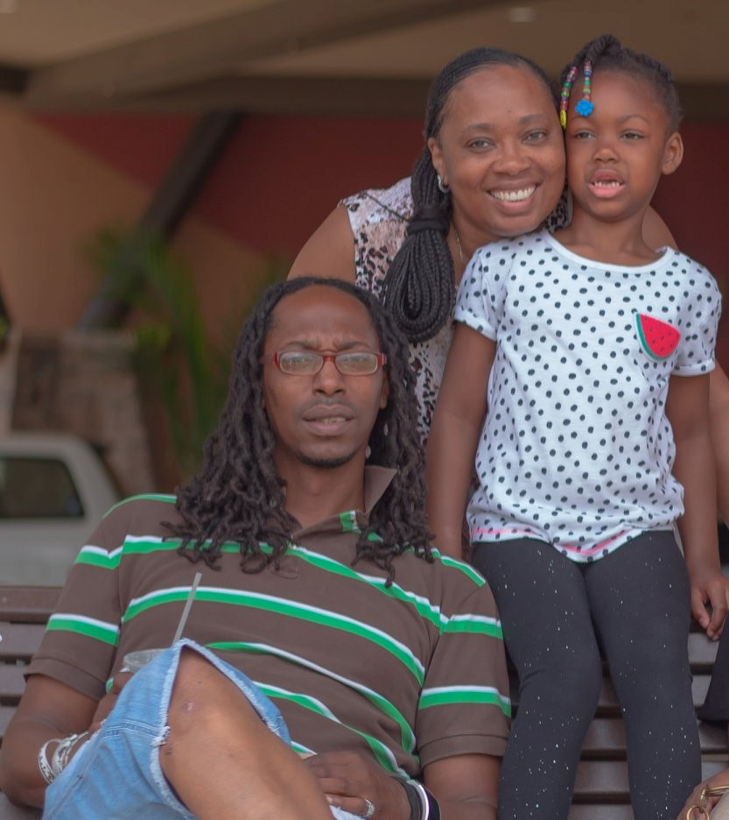
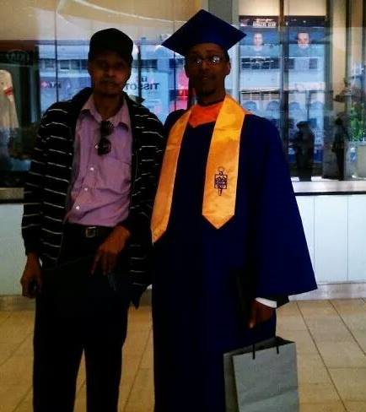

Slide 12
Recommendations
Automatically restore voting rights of all individuals who are serving their sentence under community supervision along with those who completed their sentences; or
Limit criminal disenfranchisement to a list of specific offenses – Georgia law should be clarified to define a list of disqualifying felony offenses to be considered felonies of moral turpitude. Individuals convicted of any other offense not listed should have their voting rights automatically restored; and
Allow people to register to vote regardless of outstanding legal financial obligations – Clarify the law to ensure that voting rights restoration is not conditioned on a person’s ability to pay any fines, fees or other criminal justice debt.

Slide 13
Roberta “Toni” Meyers
Legal Action Center
225 Varick Street, Suite 402
New York, NY 10014
Home Office: Stockbridge, GA 30281
212-243-1313 ext. 135
Email: rmeyers@lac.org
www.lac.org
www.hirenetwork.org
www.lachealthandjustice.org

