Slide 1



Skills for Reading Screenings
Skill | AL | AR | KY | LA | MD | MS | NC | OK | TN | TX
Letter Naming / Alphabet Knowledge | K | K – 2+ | K – 3 |  | ✓ | K – 1 | K – 3 |  | K – 1
Letter Sounds / Sound-Symbol Recognition | K | K – 2+ | K – 3 |  | ✓ | K – 1 |  |  | K – 1
Phonemic Awareness (unspecified) |  | K – 2+ | K – 3 |  | ✓ | K – 1 |  | K – 3 |  | K – 1
Phoneme Segmentation | K |  |  |  |  |  | K – 3 |  | K – 1
Phoneme Blending |  |  |  |  |  |  |  |  | K – 1
First Sound Fluency |  |  |  | K |  |  | K – 3
Phonological Awareness (unspecified) |  | K – 2+ | K – 3 |  |  | K – 1 |  |  |  | K – 1
Rapid Automatic Naming |  | K – 2+ | K – 3 |  | ✓ | K – 1
Nonsense Word Fluency / Decoding Skills / Phonics | K – 12 |  | K – 3 | 1 | ✓ | K – 3 | K – 3 | K – 3 | 1+ | K – 2
Word Reading / Oral Reading Fluency | 1 – 12 |  |  | 2 |  | 1 – 3 | K – 3 | K – 3 | 1+ | 1 – 2
Spelling / Encoding Skills | 1 – 12 | K – 2+ | K – 3 |  |  | K – 1 |  |  | 1+
Sight Word Reading / Word Identification | 1 – 12 |  |  |  |  | 1 – 3
Vocabulary |  |  |  |  |  | K – 3 |  | K – 3 |  | K – 2
Comprehension |  |  |  | 3 |  | 1 – 3 |  | K – 3 |  | K – 2
Note: Some states (like Maryland) recommend certain skills if schools choose to screen students, but do not require screenings.
Notes:
Ten SREB states lay out either requirements or suggestions for skills that should be included in screening for reading difficulties in given grades, which you see here. You can also see that there is a lot of variation in the skills states advise or require. This is because a lot of these skills are highly correlated, so a student who performs very poorly on one measure is likely to perform poorly on others. Making sure a universal screener is as short and quick as possible while also providing the data you need requires selecting the number and variety of skills carefully.

Slide 2

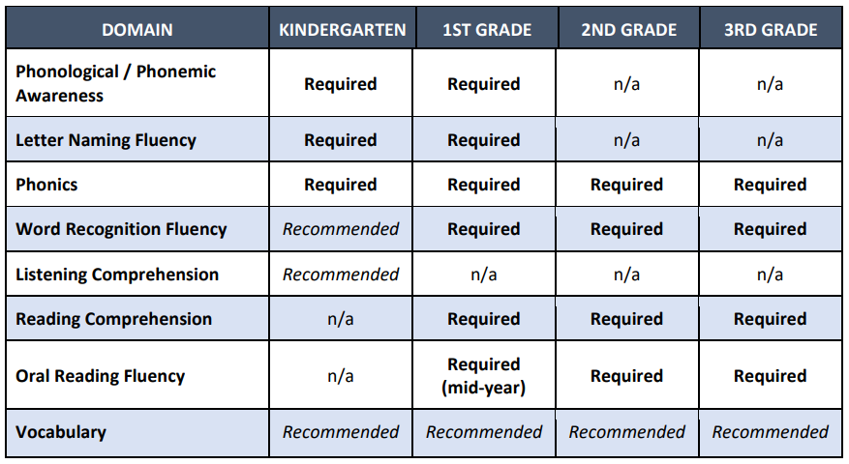
Skills for Universal Reading Screenings: Mississippi
Content criteria based on International Dyslexia Association Guidance
Source: Mississippi Department of Education
Notes:
Mississippi’s screening criteria are based on guidance from the International Dyslexia Association. You can see that first grade is the only grade level in which screening of more than four skills is required, and the skills are a bit different from year to year. Providing this kind of detail can help make sure there is consistency across schools and districts, especially if the state has approved certain screening tools for measuring these skills.

