Slide 1

USDA Rural Development Community Facility Program

Slide 2
What Is An Essential Community Facility?
  Provides an essential service to the local community – the service must be a function customarily provided by a local unit of government.
  Must be a public improvement needed for the orderly development of a rural community.
  All facilities must be for public use and be located in an eligible rural area.

Slide 3
An Eligible Facility Must Be:
A function customarily provided by a local unit of government
Operated on a non-profit basis
Able to demonstrate significant support (N/A for Public Bodies)

Slide 4
Eligible Rural Areas
Cities, towns, and census designated places (CDPs)
with populations of 20,000 or less according to
the latest decennial census of the United States.
There is no limitation placed on population in unincorporated rural areas, with the exception of CDP’s.
Notes:
There is an AN regarding “Definition of Rural and Rural Area.”

Slide 5
Eligible Applicants
PUBLIC BODIES
Such as:
  municipality
  county
  district
  authority, or,
  other political subdivision of a state
Notes:
Other political subdivision of a state could be a borough, parish, precinct, etc.

Slide 6
Eligible Applicants
NON-PROFIT ORGANIZATIONS
An organization operated on a not-for-profit basis, such as an association, cooperative, or private corporation.
Need to provide organizational documents to demonstrate nonprofit status.
Notes:
Cooperatives are only eligible when they are organized as nonprofits and they don’t restrict membership – have OGC review their organizational documents for eligibility. Typically what we see are corporations that are described in section 501(c)(3) of the Internal Revenue Code, or organized under Membership Corporation Laws (volunteer fire departments).

Slide 7
Nonprofit Corporations
Must have significant ties to local community
  To ensure that a facility under private control will carry out a public purpose
  Facility will continue to primarily serve rural areas
  Elected officials support the project
Notes:
Significant ties to the local community are required for loan making. These significant ties are extremely important if the project has problems once the facility is operating. There is a much better chance the facility will be able to recover and continue operating, if there is strong support from the community.
Discuss YMCA example – significant support from the community turned things around. They held a major fundraising campaign to bring the account current and to retire the debt within 5 years. Flip-side – Daycare Center in the same state, failed due to lack of community support – only parents of kids in the center were providing support.

Slide 8
How Can Funds Be Used?
Eligible Loan Purposes
Purchase real estate/buildings
Construction, expansion, or renovations, to essential community facilities
Purchase vehicles and major equipment
Notes:
Fire/rescue vehicles, police cars, garbage trucks, refrigerated trucks, snow plows, highway vehicles, CT scanners, MRI’s, thermal imaging cameras, jaws of life, gas lines, emergency shelter, warning system/sirens, jail, animal shelter, airport/runways, and recycling center.

Slide 9
Eligible Loan Purposes
Purchase an existing facility to improve or to prevent a loss of service;
Construct buildings, roads, bridges, day care facilities, hospitals, medical clinics, public safety facilities, city halls, court houses, etc.
Finance anything essential for orderly community development except recreational facilities
Notes:
It is important to look at the impact the proposed project will have; i.e., we have had requests to fund dams, it is very important to determine who will benefit from this type of facility – it can’t be done just to protect a specific group of homes; and you have to consider what impact changing the water flow will have on surrounding communities.

Slide 10
Loan Terms
Up to 40 years dependent upon the useful life of the security and repayment ability.
Principal can be deferred for up to 3 years to allow facility to become operational.

Slide 11
Interest Rates (as of July 1, 2017)
Present rates (subject to change quarterly):
  Market - 3.250% (above $49,785)
  Intermediate -3.875% ($39,828 - $49,785)
  Poverty - 4.500% (below $39,828)
  NOTE: Rates based on applicant’s median household income as shown in the 2010 Census Data. The Poverty rate involves alleviating an existing health or sanitary problem.

Slide 12
Maximum Loan Amount
Up to 100% of eligible project costs subject to:
  Adequate security
  Ability to repay
  Applicant’s authority to borrow
  Availability of funds

Slide 13
Security
Public Bodies
Non-Profit Corporations
revenue bonds
general obligation bonds
special assessment bonds
promissory notes
real estate mortgages
promissory notes
real estate mortgages
financing statements
security agreements
revenue anticipation bonds

Slide 14
A few pointers:
  Contact USDA early
  If the request involves any construction or renovation, you will need an Architect
  Any construction method other than design/bid/build will need National Office concurrence
  A financial feasibility report will be required. An examination opinion from a CPA may also be required.
  Some projects may include Historic Preservation involvement

Slide 15

USDA Georgia Community Facilities Loan Case Study 2016
City of Vienna, GA
USDA Rural Development Community Facility direct loan of $858,525
Project Description: | Rural Development funds will be used to purchase the existing building that houses its Fire Department. The City currently leases the building from a private, non-profit company.
Loan Terms: | 20 years at 2.8750 percent
USDA is an equal opportunity provider, employer, and lender.

Slide 16
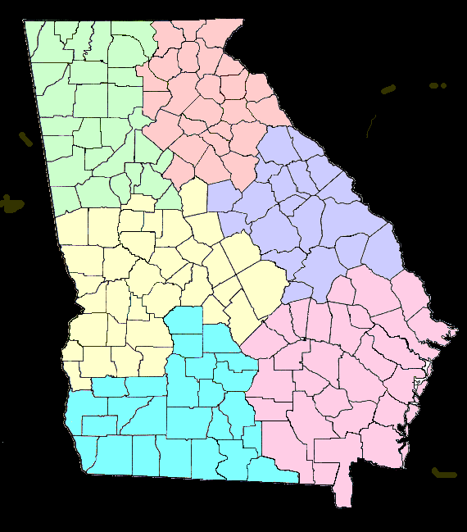
USDA GEORGIA AREA OFFICES
Cartersville
770-386-3393
Monroe
770-267-1413
Fort Valley
478-827-0016
Sandersville
478-552-0901
Tifton
229-382-0273
Douglas
912-384-481
Cartersville
Monroe
Sandersville
Fort Valley
Douglas
Tifton

Slide 17
Contact Information
USDA Georgia Rural Development Contacts:
Jack Stanek, Acting State Director
Jack.Stanek@ga.usda.gov
(706) 552-2568
Kathy L. Ross, Acting Community Programs Director
Katherine.ross@ga.usda.gov
(706) 546-2171
Reggie Taylor, EDFP – Community Development Specialist
Reggie.Taylor@ga.usda.gov
(706) 552-2557
Georgia USDA webpage
http://www.rd.usda.gov/ga

