Slide 1


SR 325 Portable Benefits for Independent Workers Study Committee
Jesse Weathington
Executive Director

Slide 2
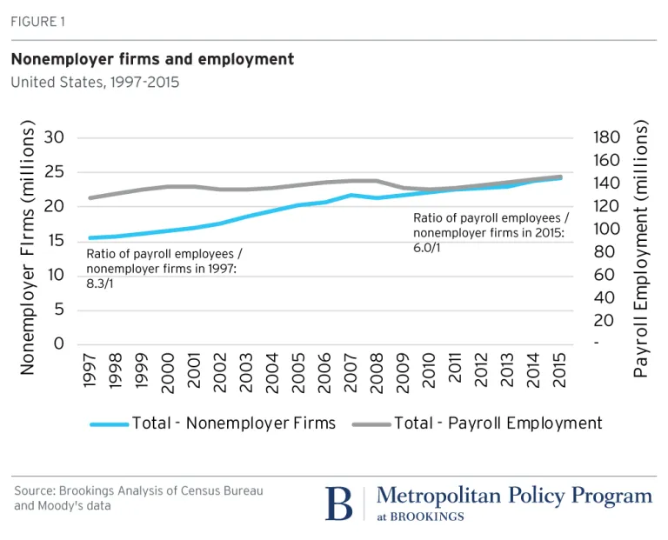
Relationship between Nonemployer firms and jobs market
Ratio changed from 8.31:1 to 6:1 in 18 years.
Total payroll employment decreased significantly during the Great Recession.
Growth in this sector has outpaced growth in payroll employment over the previous two decades.
  2.6% vs. 0.8%
A 2014 study found that more than one in three workers—53 million Americans—are now freelancing.

Slide 3
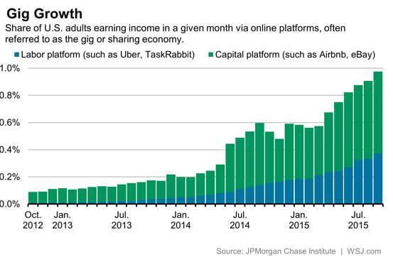

Slide 4
Portable Health Benefits
Exchange Plans
MEWAs, AHPs
Multiemployer plans
Short-term policies
PEOs
Notes:
Exchange:
MEWAS
Multiemployer plans - an employee benefit plan shared by two or more employers, who are often in the same geographic area or industry. The benefits provided to workers are based on a negotiated hourly contribution made to the Multiemployer Plan on behalf of an employee by his or her employer. This provides a useful mechanism to share the costs of benefits when a worker has multiple employers or regularly switches employers, such as actors or construction workers. The terms of the plan are collectively bargained between the employers and a union, or group of unions. As set forth in the Taft-Hartley Act, these plans are governed by a board comprised equally of employer and union representatives, and are only applicable to unionized workforces. About 20 million people get benefits through a MEP.
Example – Screen Actors Guild-Producers pension and benefit plan, created in 1961 under SAG President Ronald Reagan. MEPs are not available to cover independent workers without and amendment to the Taft- Hawley Act
The Black Car Fund – NY for-hire drivers (~130,000 drivers ~300 companies) uses a 2.5% rider surcharge to finance Worker’s Comp. It did not give competitive advantage to any marketer and was not construed as a benefit of employment but rather a legal mandate.
PEOS - The PEO enters into a contractual co-employment agreement with its clientele. Through co-employment, the PEO becomes the employer of record for tax purposes through filing payroll taxes under its own tax identification numbers.
As of 2017, industry gross revenues in the United States were estimated to be over US$174 billion annually. ^{[1]} In 2017, there were 907 PEOs operating in the United States alone, servicing 3.7 million worksite employees (WSEs), which were spread over approximately 175,000 PEO clients.^{[2]}

Slide 5
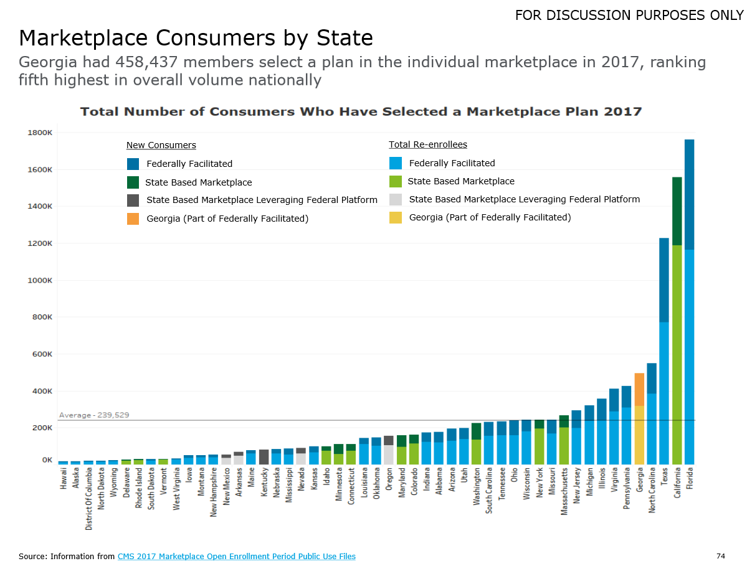

Slide 6
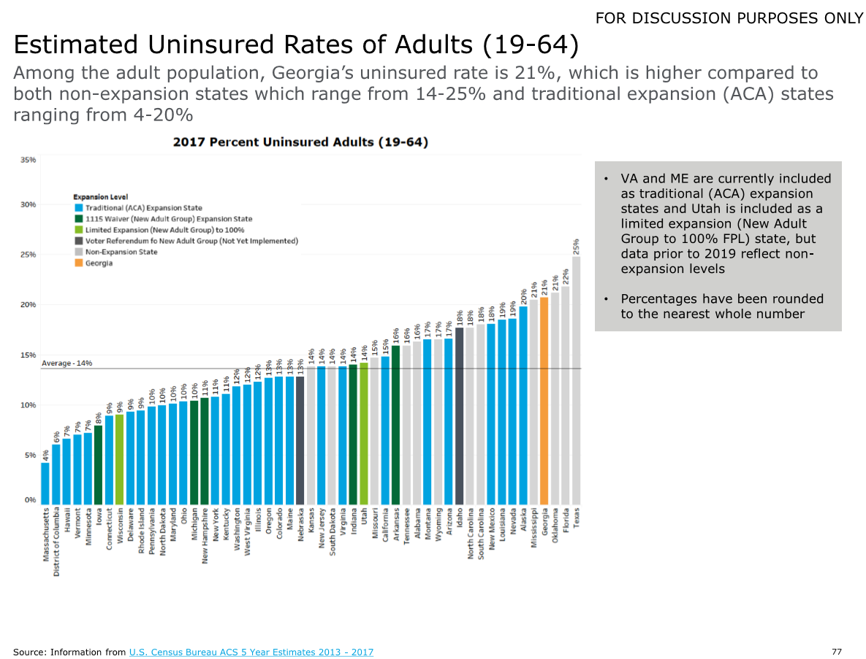

Slide 7
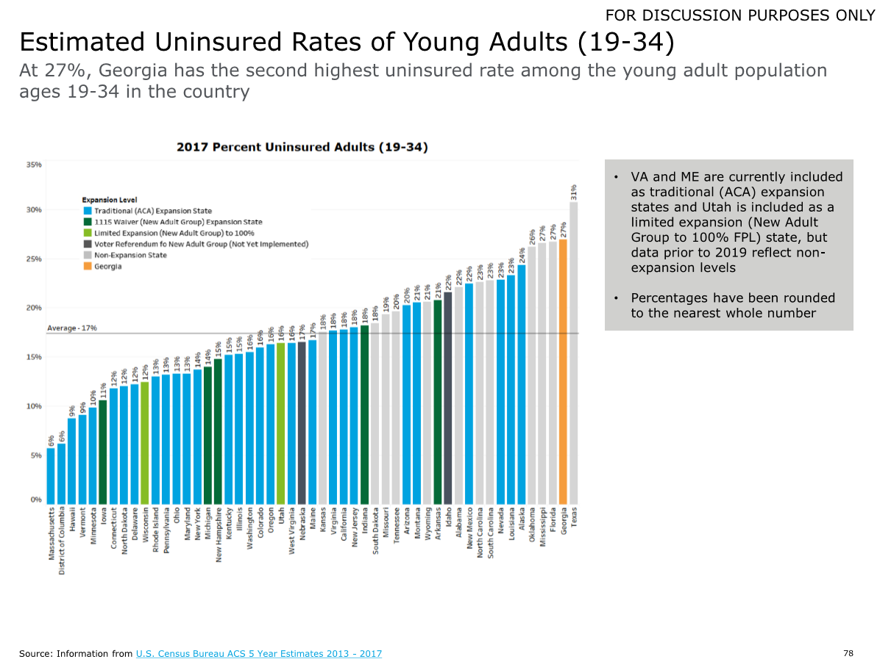

Slide 8
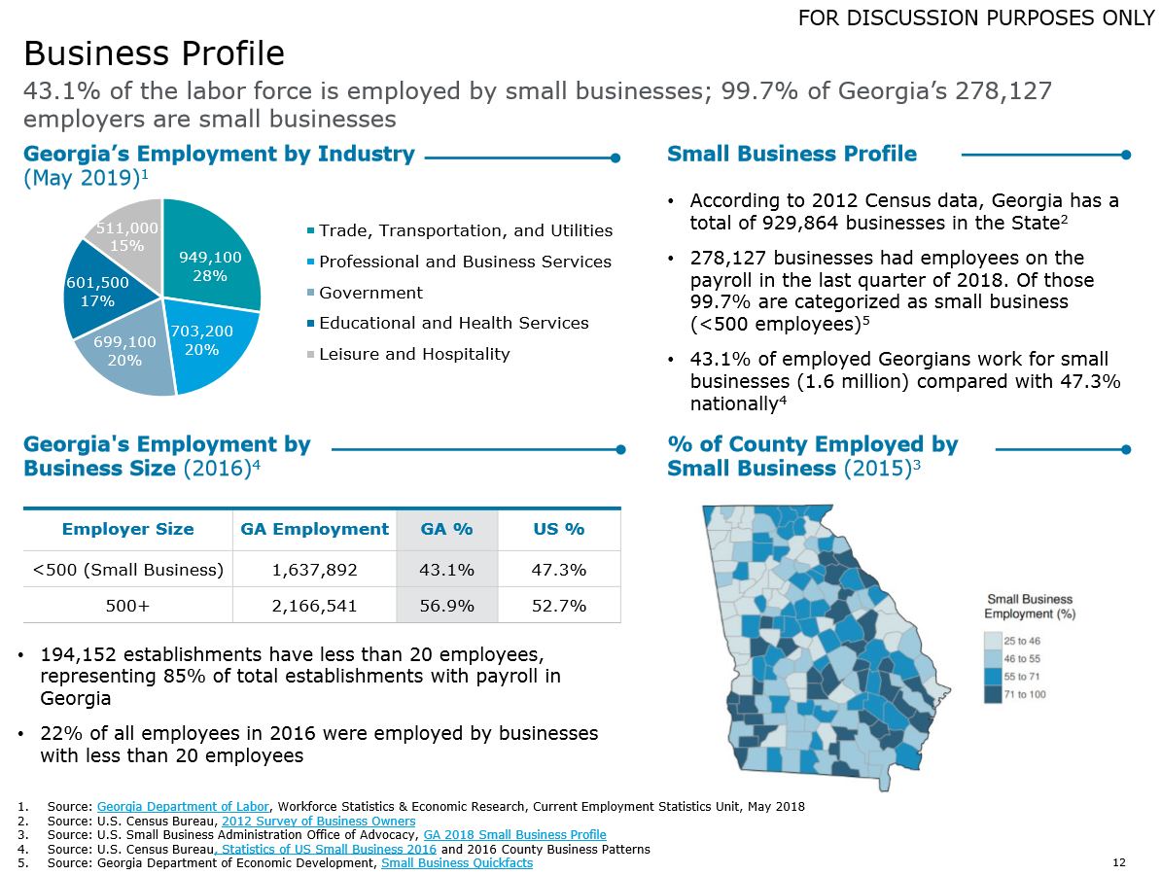

Slide 9
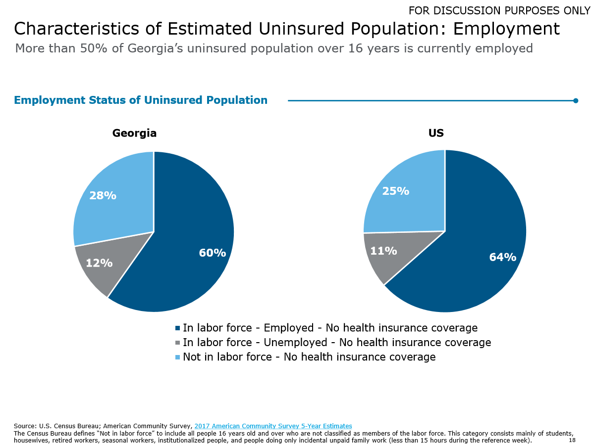

Slide 10
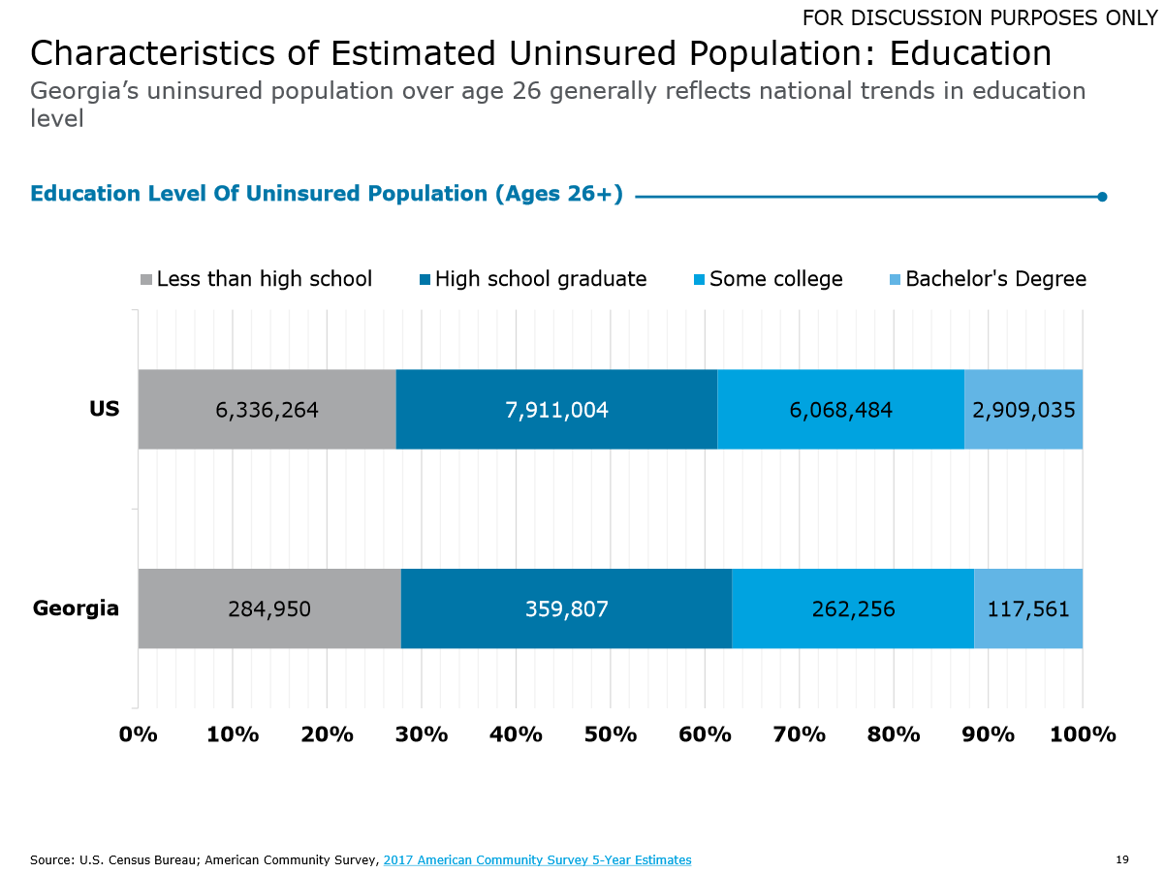

Slide 11
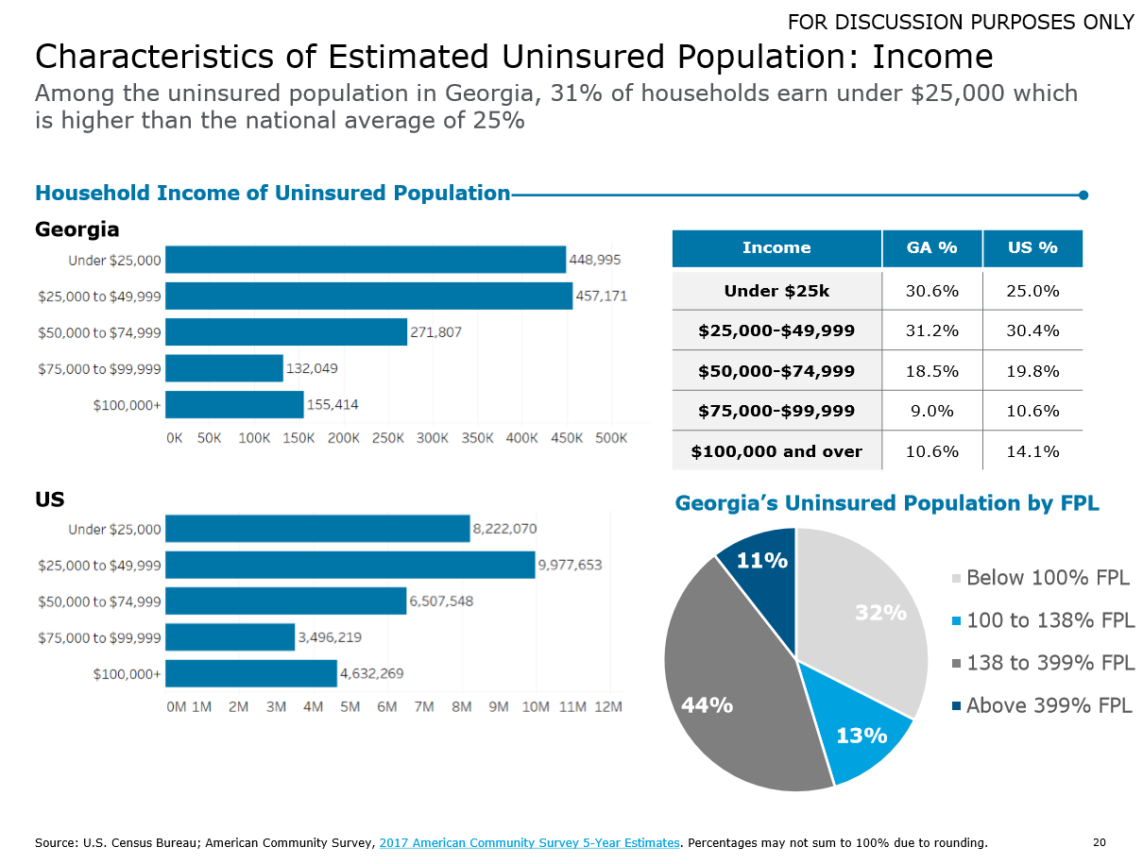

Slide 12
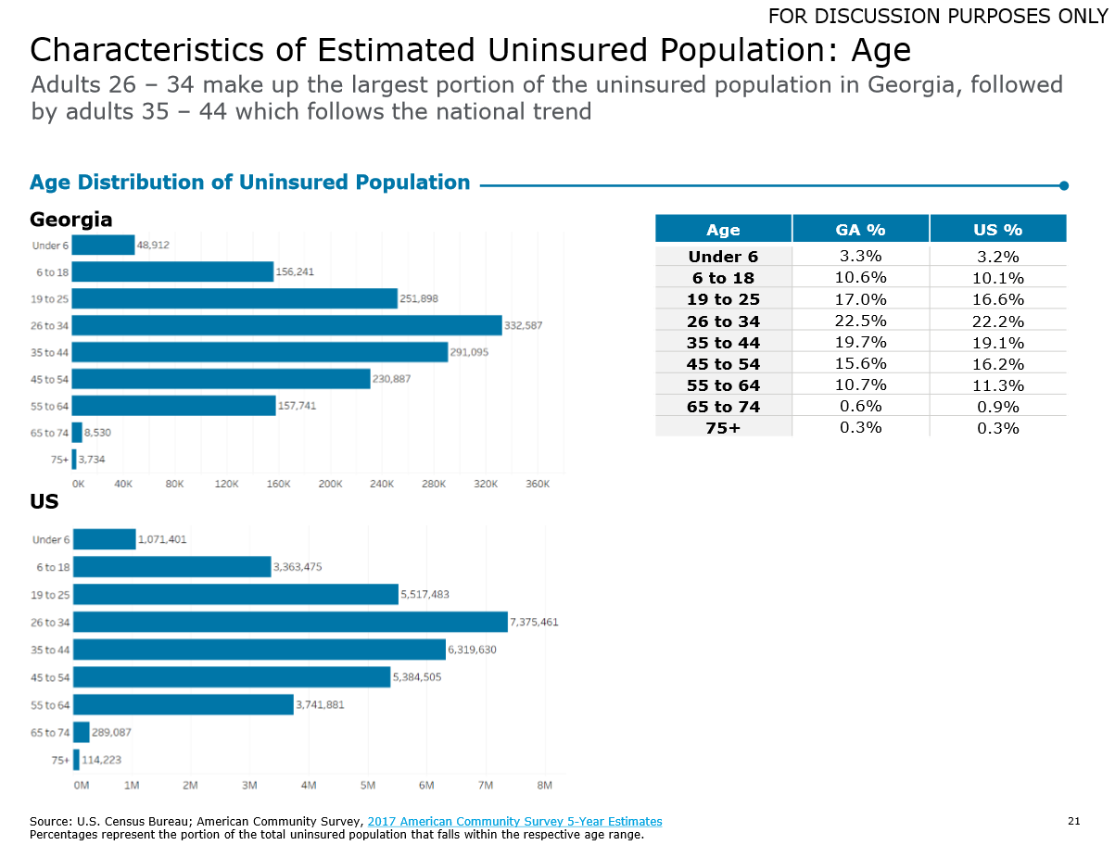

Slide 13
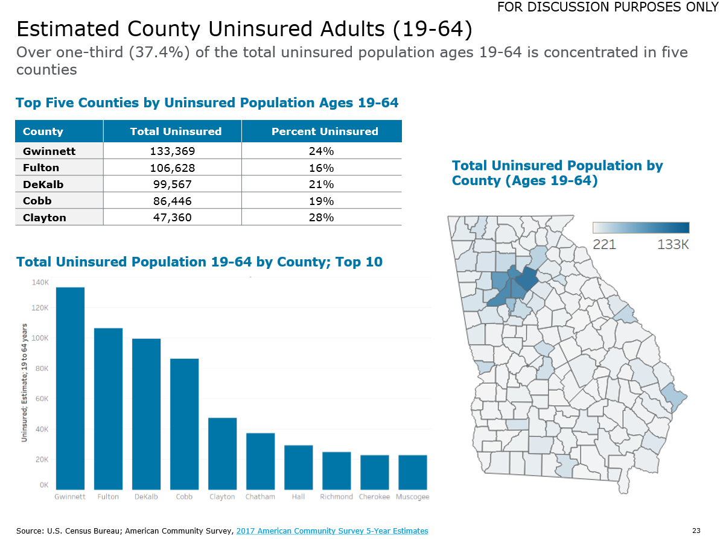

Slide 14
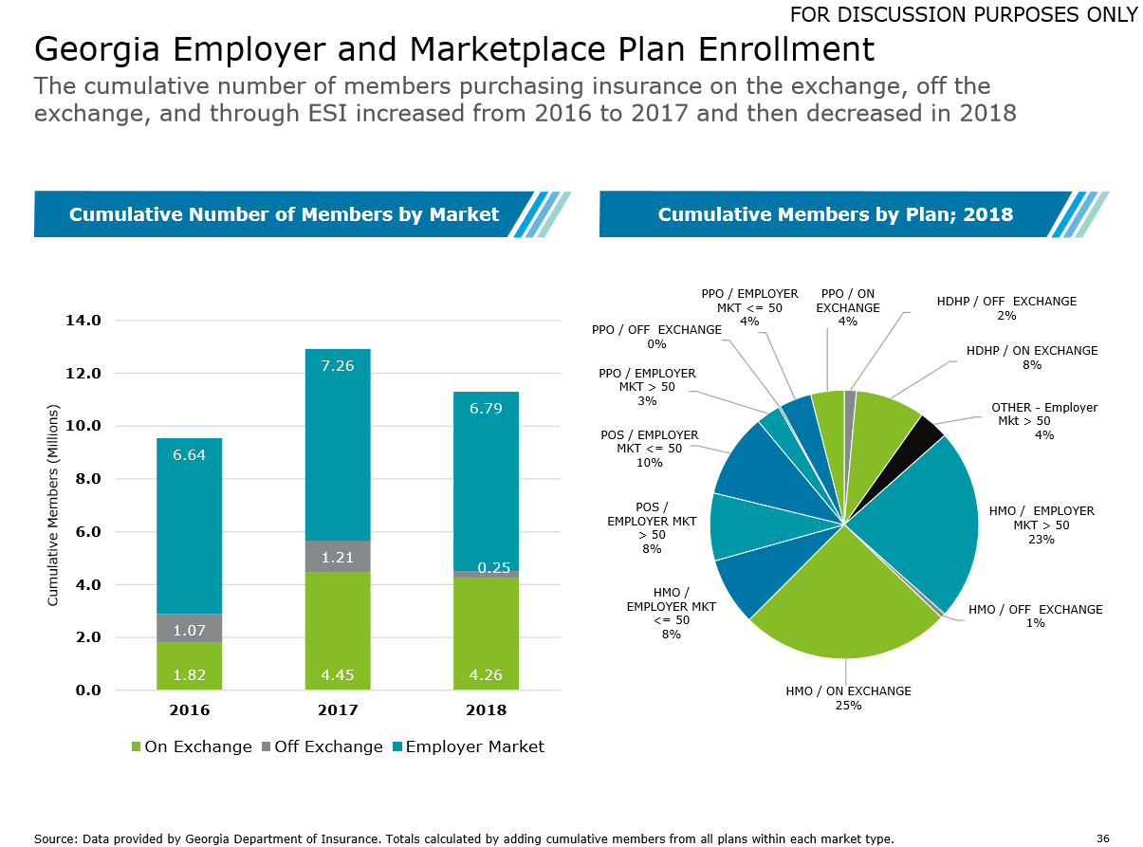

Slide 15
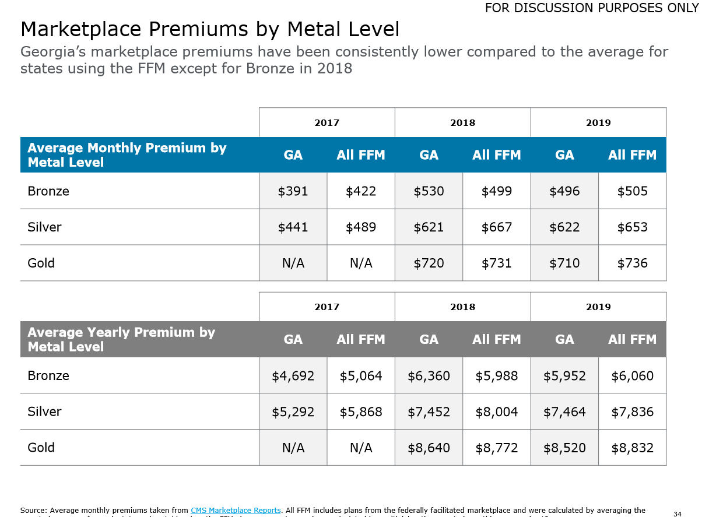

Slide 16
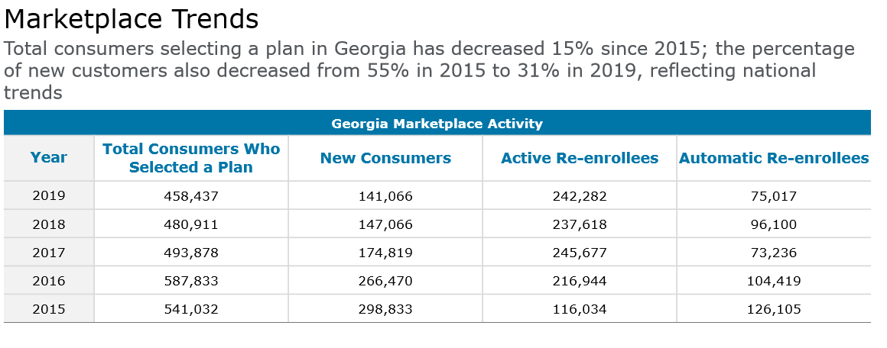

Slide 17
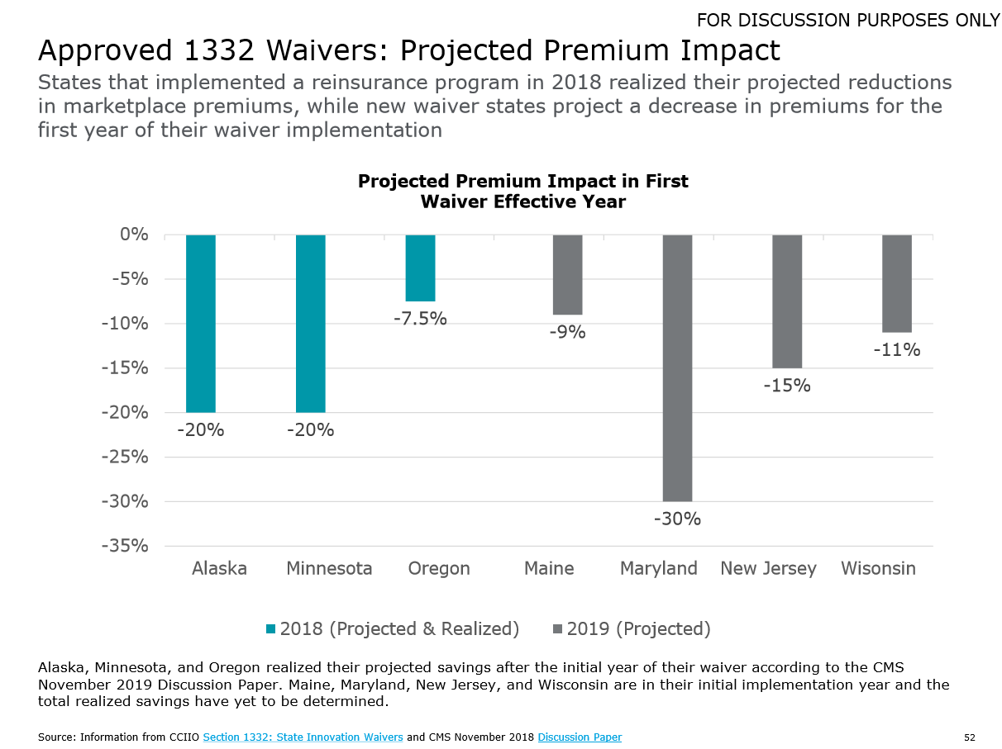
Estimated Impact of 1332 Reinsurance Program on Exchange Premiums

