Slide 1
Overview of State Farmers’ Markets
Prepared by Senate Research Office

Slide 2
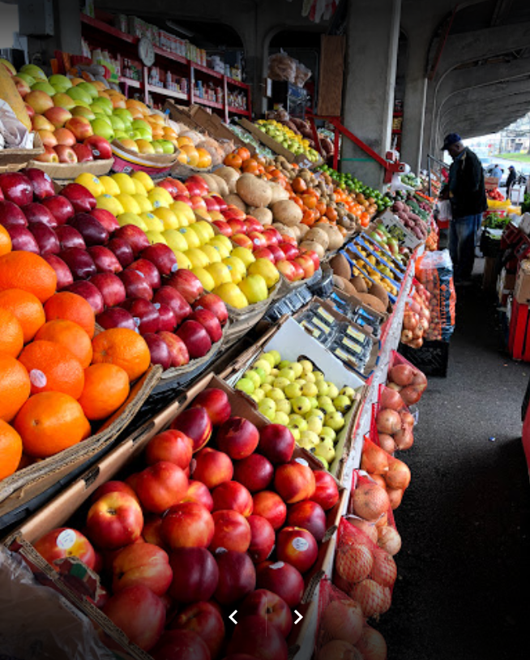
Overview of Farmers’ Markets
Georgia Department of Agriculture operates nine farmers’ markets
The markets generated about $5.6 million in revenue for FY19
The markets expended around $2.3 million for FY19

Slide 3
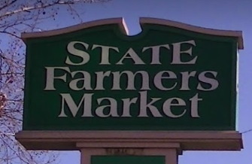
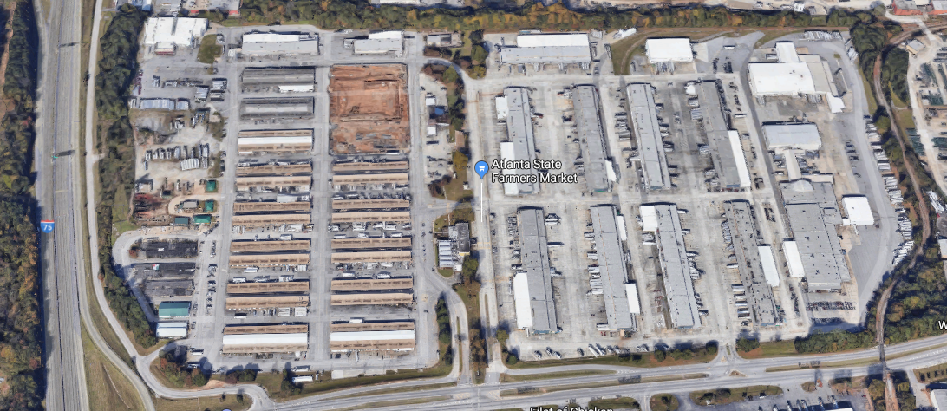
Atlanta Farmers’ Market
16 Forest Pkwy, Forest Park, GA 30297
Aquired in 1956, owned for 63 years
Largest and most comprehensive of the markets
Responsible for 84% of total revenues and 60% of total expenditures for all markets combined
For FY19:
  Revenues totalled $ 4,745,478.14
  Expenses totalled $1,410,534.47
  Net Profit $3,334,943.67
This location offers:
Agricultural Brokers
Agricultural Wholesalers/Retailers
Grocery Store
Florist
Restaurant
Gift Shop
Trucking/Logistics Companies
Overnight Parking

Slide 4
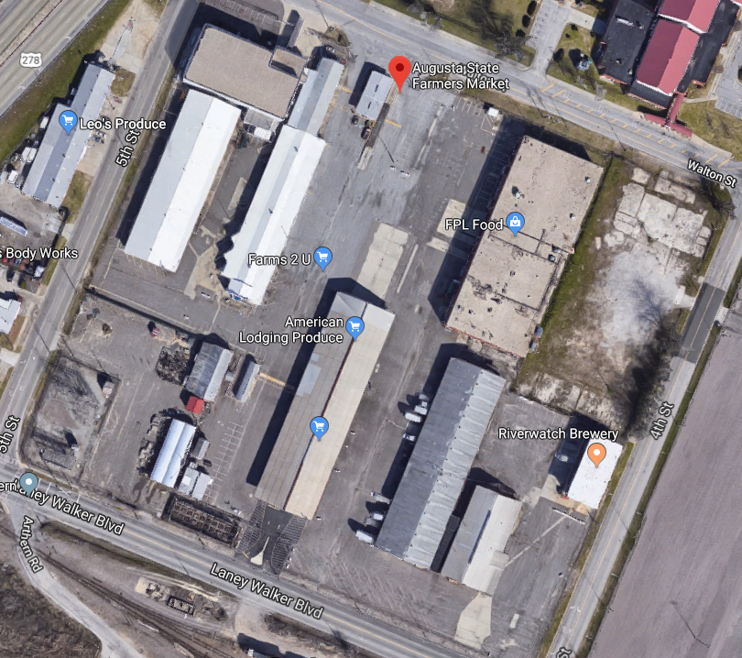
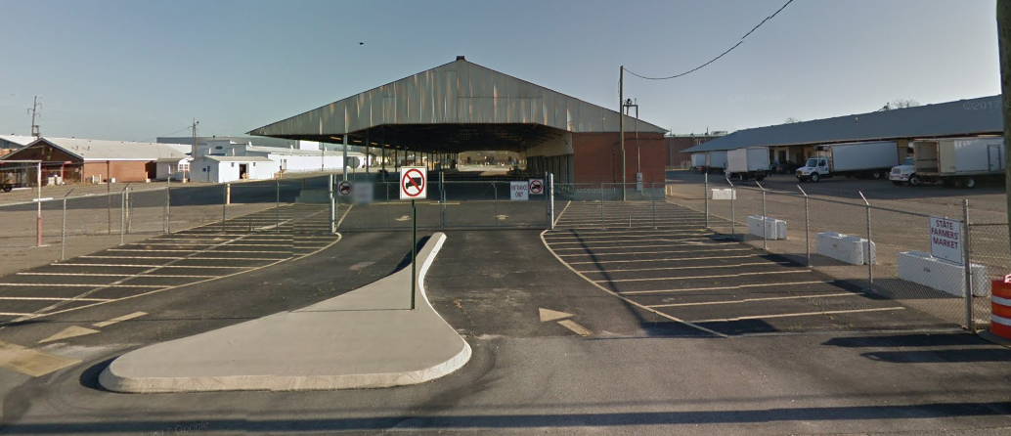
Augusta Farmers’ Market
1150 5th St, Augusta, GA 30901
Aquired in 1950, owned for 69 years
For FY19:
  Revenues totalled $174,344.06
  Expenses totalled $166,417.22
  Net Profit $7,926.84
This location offers:
Agricultural Wholesalers/Retailers
Pharmaceutical Company
Garden Center
Craft Brewery
Truck Scales
Restaurant

Slide 5
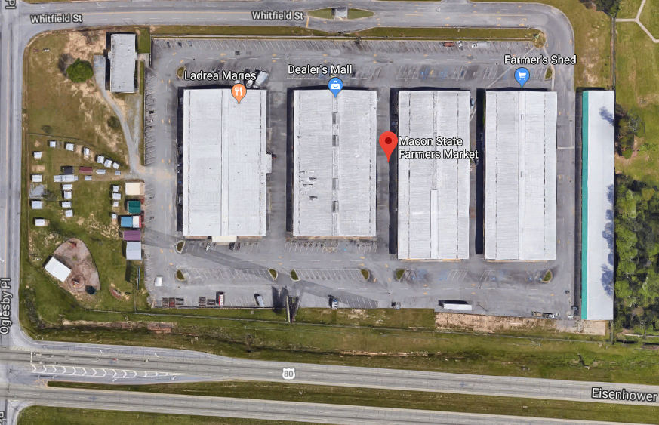
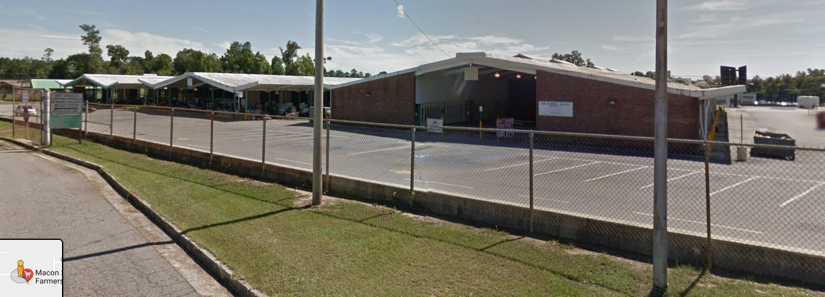
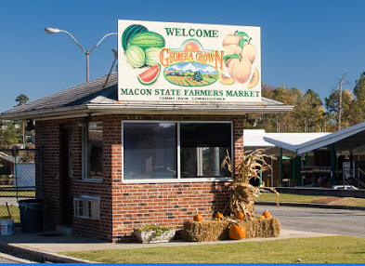
Macon Farmers’ Market
2055 Eisenhower Pkwy, Macon, GA 31206
Aquired in 1976, owned for 43 years
For FY19:
  Revenues totalled $153,135.00
  Expenses totalled $ 201,883.40
  Net Loss ($48,748.40)
This location offers:
Agricultural Retailers
Bakery
Meat Market
Bridal Shop
Restaurant

Slide 6
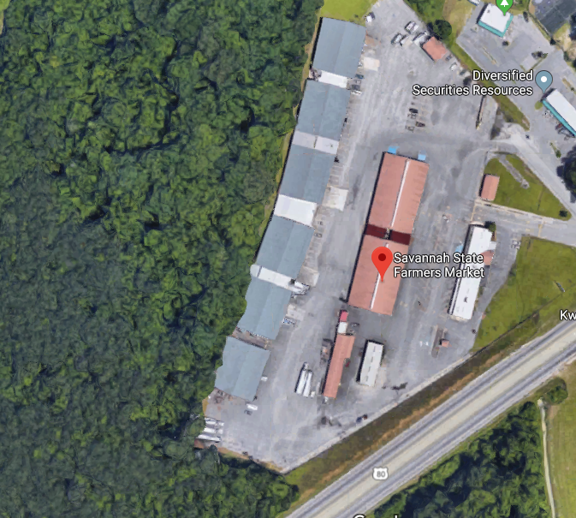
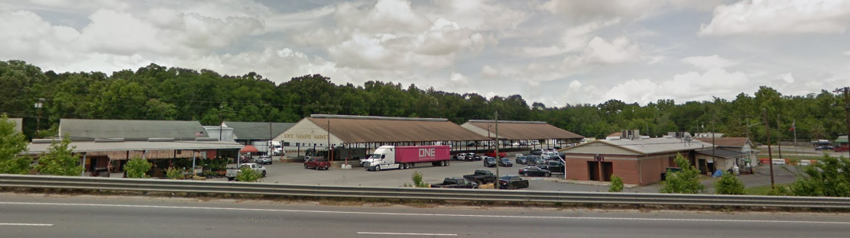
Savannah Farmers’ Market
701 U.S. Highway 80, West Savannah, GA 31408
Aquired in 1951, owned for 68 years
For FY19:
  Revenues totalled $138,967.10
  Expenses totalled $158,486.77
  Net Loss ($19,519.67)
This location offers:
Agricultural Wholesalers/Retailers
Sign Shop
Florist
Spice Company
Restaurant
Truck Scales

Slide 7
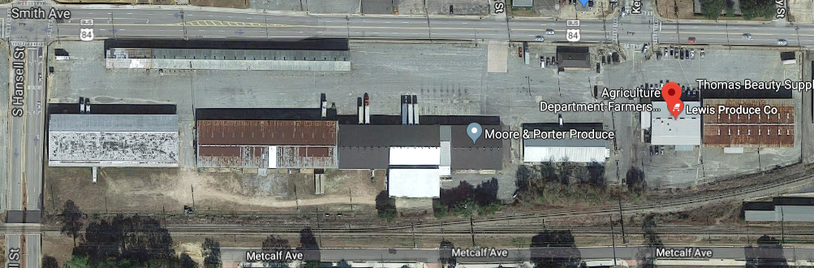
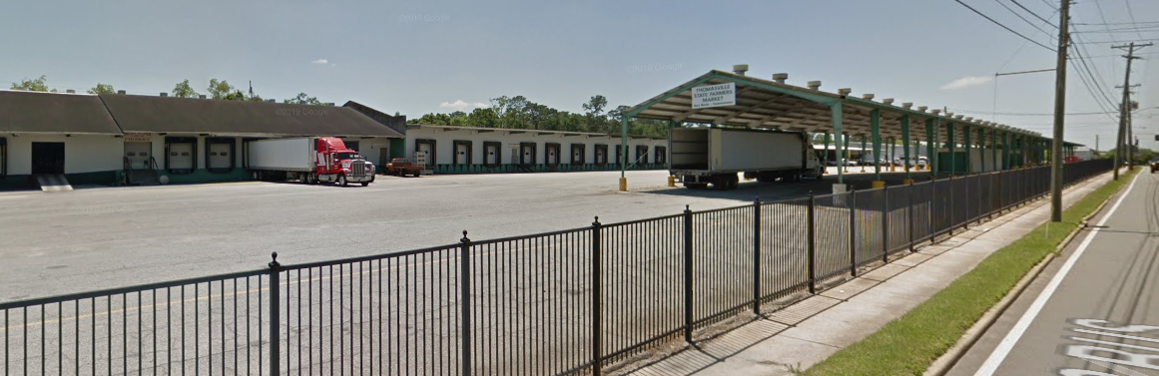
Thomasville Farmers’ Market
502 Smith Avenue, Thomasville, GA 31792
Aquired in 1970, owned for 49 years*
For FY19:
  Revenues totalled $156,084.00
  Expenses totalled $103,550.16
  Net Profit $52,533.84
*functioning as a farmers’ market for about 20 years before aquisition
This location offers:
Agricultural Retailers/Wholesaler
Air Conditioning Repair Company
Carpenter
Restaurant
Truck Scales

Slide 8
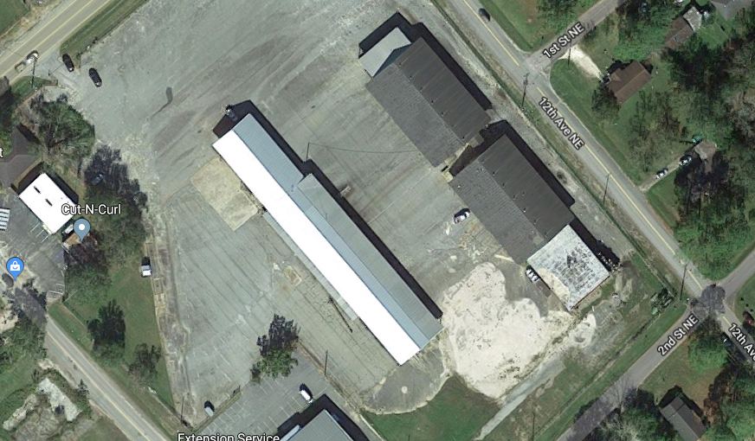
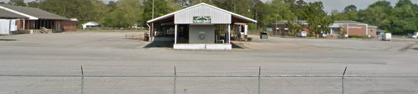
Cairo Farmers’ Market
1110 North Broad Street, Cairo, GA31728
Aquired in 1953, owned for 66 years
For FY19:
  Revenues totalled $11,415.00
  Expenses totalled $ 1,655.78
  Net Profit $ 9,759.22
This location offers:
Agricultural Wholesaler/Retailer

Slide 9
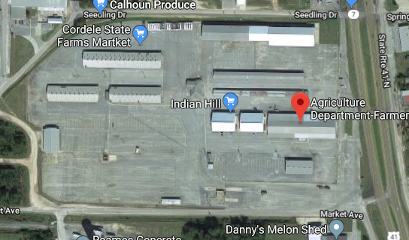
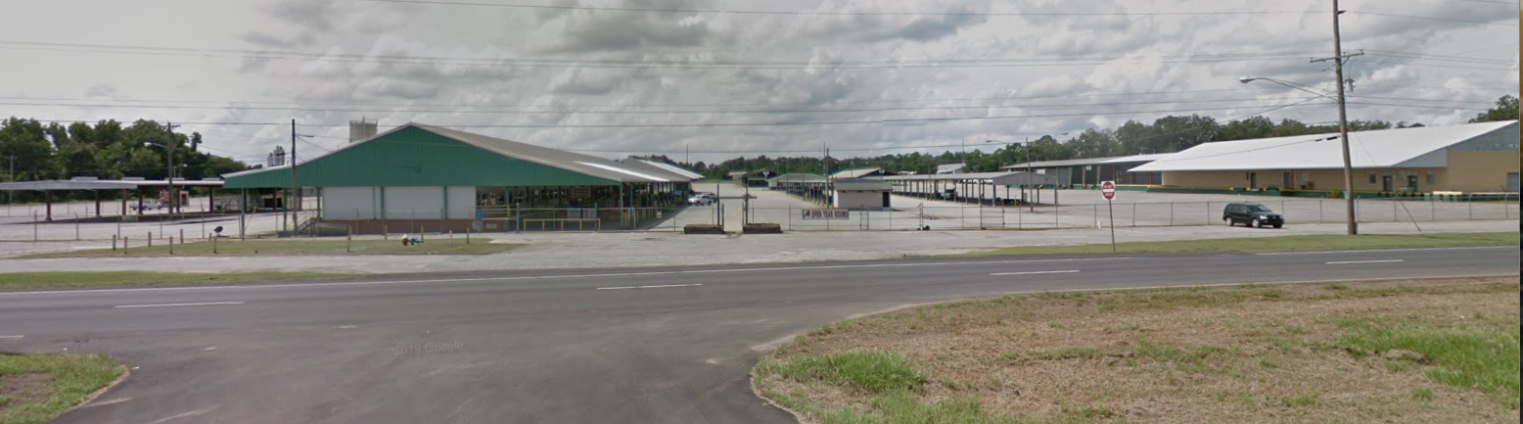
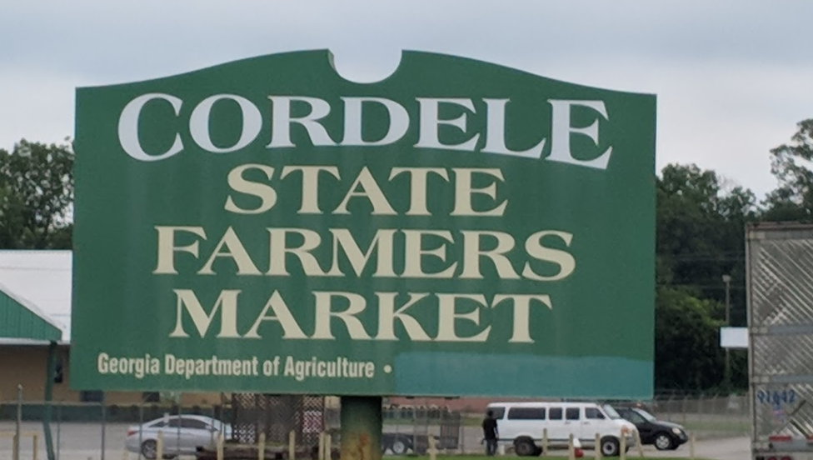
Cordele Farmers’ Market
1901 U. S. Highway 41 North, Cordele, GA 31015
Aquired in 1947, owned for 72 years
For FY19:
  Revenues totalled $ 83,943.86
  Expenses totalled $ 200,492.13
  Net Loss ($116,548.27)
This location offers:
Agricultural Retailer
Georgia Development Authority
Truck Scales

Slide 10
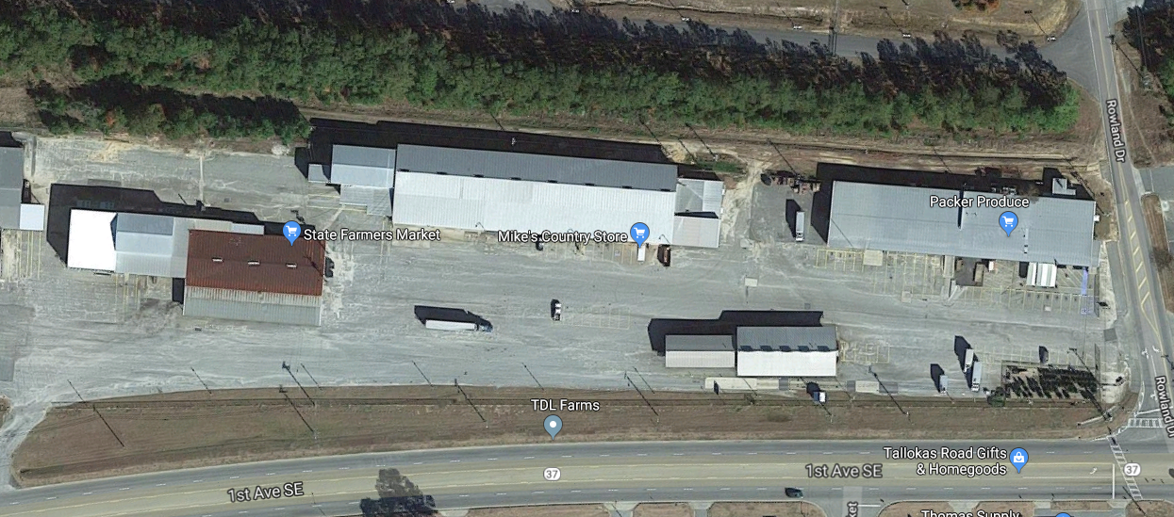
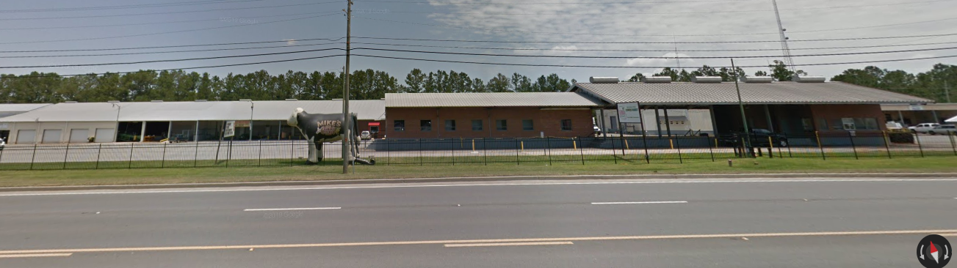
Moultrie Farmers’ Market
1st Ave SE, Moultrie, GA 31768
Aquired in 1944, owned for 75 years
For FY19:
  Revenues totalled $140,980.00
  Expenses totalled $ 68,778.22
  Net Profit $72,201.78
This location offers:
Ice Company
Restaurant
Garden Center
Seafood Market
Country Store
Clothing Store
Truck Scales

Slide 11
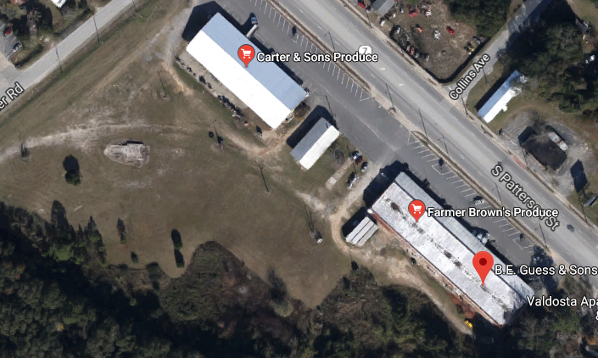
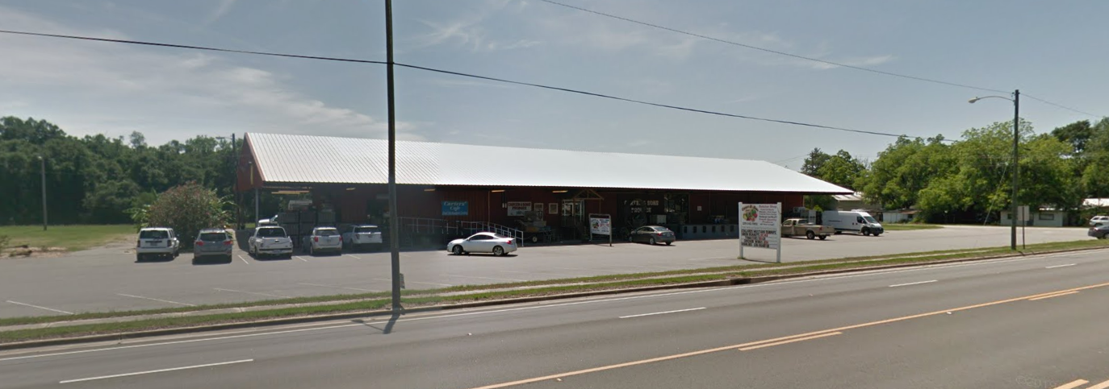
Valdosta Farmers’ Market
1500 South Patterson Street, Valdosta, GA 31601
Aquired in 1945, owned for 74 years
For FY19:
  Revenues totalled $ 39,497.00
  Expenses totalled $ 7,864.97
  Net Profit $ 31,623.03
This location offers:
Agricultural Wholesaler
Country Store

