Slide 1

Dyslexia Policies and Impacts in SREB States
Stephen Pruitt, President
Samantha Durrance, Policy Analyst
Southern Regional Education Board

Slide 2




Promising Practices
Teacher training for dyslexia
Leveraging funds to support students with dyslexia
Screening to identify all at-risk readers
Evidence-based reading instruction and intervention
$

Slide 3
Presentation Topics
Teacher training for dyslexia
Using state funds to support students with dyslexia
Screening to identify all at-risk readers
Evidence-based reading instruction and intervention
$

Slide 4

Teaching reading
is
rocket science

Slide 5
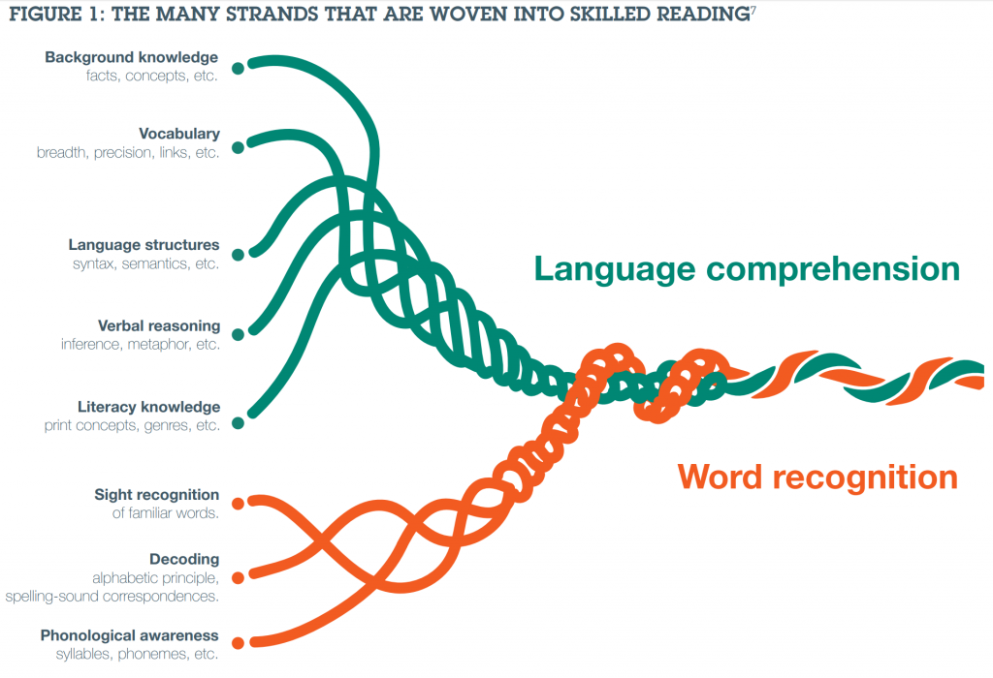
Background knowledge
Vocabulary
Language Structures
Verbal Reasoning
Literacy Knowledge
Sight Recognition
Decoding
Phonological Awareness
Image source

Slide 6
Improving Reading Instruction
Arkansas: Reading Initiative for Student Excellence (RISE) Academy has trained 4,500 K-6 teachers in the science of reading and providing systematic, explicit reading instruction using LETRS framework
DE
Oklahoma
State offers training in Language Essentials for the Teachers of Reading and Spelling (LETRS)
Mississippi
State offers training in Orton-Gillingham Phonics First® and more advanced OG training for general ed teachers, as well as training in building foundational skills
MD

Slide 7

Student in K-3 exhibits a “substantial deficiency in reading”
Intensive, explicit, systematic, and multisensory reading interventions
Intervention Policy Model: Florida

Slide 8
Presentation Topics
Teacher training for dyslexia
Using state funds to support students with dyslexia
Screening to identify all at-risk readers
Strong reading instruction and intervention
$

Slide 9

Identification: Points to Consider
Balance simplicity with necessary detail
  Require what is necessary to achieve desired outcomes
  Provide support
  Make the process as easy to follow as possible
  Cost
  Allow multiple options for screening tools or
  Provide a common universal screening tool across the state

Slide 10
SREB States that Require Screenings in K – 3
for Dyslexia or Difficulties with Foundational Reading Skills
DE
MD

Slide 11
Early and Consistent Identification
First stage: Universal skills-based screening
  Assess grade-level skills that accurately predict reading performance:
    Kindergarten: phonological awareness (especially phoneme segmentation), letter sound knowledge, rapid automatic naming (letters)
    1st: phonological awareness, rapid automatic naming (letters)
    2nd and up: oral reading fluency and comprehension

Slide 12
Early and Consistent Identification
First stage: Universal skills-based screening
  Use tools that are scientifically validated and have strong:
    Reliability: consistently produces similar results
    Validity: measures and predicts what it says it does
    Accuracy: correctly identifies students who are at risk and does not misidentify students as “at risk” who ultimately are not

Slide 13
Early and Consistent Identification
First stage: Universal skills-based screening
  Use objective, norm-referenced measures, e.g. percentile ranking
    Note: Running records are neither objective nor norm-referenced
  Measure more than one skill
  More than once per year
  Efficient: quick and inexpensive

Slide 14
Policy Model: North Carolina, Tennessee
Universal screening for specific reading skills
Targeted intervention & progress monitoring through RTI model
Referral for
special education or §504 evaluation as needed
For students who do not make adequate progress with interventions or may need accommodations
All struggling students; some states require dyslexia-specific intervention for students with characteristics of dyslexia
Using DIBELS components, for example

Slide 15
Universal screening for specific reading skills
Dyslexia-specific screening
Dyslexia-specific intervention
School team determines if student may have dyslexia
Policy model: Alabama, Arkansas, Mississippi
DIBELs, AIMSweb, iStation, etc.
More in-depth look at specific skills
Considers info including family history and diagnostic checklists, e.g. Scottish Rite Characteristic Profile of Dyslexia
Explicit, systematic, sequential, cumulative, multisensory, individualized

Slide 16
Policy Model: Texas
Poor performance in reading and/or spelling
Characteristics and risk factors of dyslexia
Evaluation for dyslexia by
504 or special education committee
Student does not have dyslexia
Student has dyslexia and is eligible for a 504 plan
504 Plan
Student receives specialized dyslexia instruction
Student has dyslexia but is NOT eligible for a 504 plan
Student has dyslexia and requires special education
IEP

Slide 17
Identification: A Possible Model for K-3
“At risk” on universal screener
Lack of progress despite good instruction* and intervention*
Identification as student with dyslexia
Multiple signs of or risk factors for dyslexia
40%
15%
10%
10%
* Explicit, systematic and phonics-based; ideally, using the structured literacy model

Slide 18
Identification: Data Reporting
Kentucky
Districts electing to develop a policy for identifying students with dyslexia must report the numbers of students identified, evaluated, and/or provided dyslexia interventions
Mississippi:
Districts must report number of students screened and number and percentage of students who failed screener
Kentucky: Identification, evaluation and intervention data, screener type
Mississippi: Screening results
DE
MD

Slide 19
Identification: Data Reporting
DE
2017-18
School Year
MD
Arkansas
Student data system has a checkbox for students who receive dyslexia intervention
Texas:
Student data system compiles district-reported data on students identified with dyslexia
3.9%
3.1%

Slide 20
Identification: Points to Consider
Balance simplicity with necessary detail
  Require what is necessary to achieve desired outcomes
  Provide support
  Make the process as easy to follow as possible
  Cost
  Allow multiple options for screening tools or
  Provide a common universal screening tool across the state

Slide 21
Intervention
Screening

Slide 22
Presentation Topics
Teacher training for dyslexia
Using state funds to support students with dyslexia
Screening to identify all at-risk readers
Strong reading instruction and intervention
$
Notes:
SREB has identified four essential elements for state dyslexia policies and added to those a call for evaluation of state initiatives. The essential elements are: identification, instruction and intervention, teacher training, referrals for special education, and evaluation.

Slide 23
SREB States that Require Training for Current Early Grades Teachers
on Identifying Dyslexia and Specific Teaching Methods for Students with Dyslexia
DE
*
MD
‡
‡ Only teachers who screen or teach
students with dyslexia
* Required for license renewal

Slide 24
SREB States that Require Training for Preservice Early Grades Teachers on Identifying Dyslexia and Specific Teaching Methods for Students with Dyslexia
DE
‡
MD
‡ Required by 2019-20

Slide 25

Current Teacher Training for Dyslexia
Arkansas: Each teacher must receive professional awareness on the characteristics of dyslexia and evidence-based interventions and accommodations for dyslexia.
Louisiana
Each LEA will provide training so that teachers are knowledgeable about and can implement multisensory structured language programs.
Tennessee
Training shall formally address dyslexia and provide effective instruction for students with dyslexia using brain-based multisensory intervention methods and strategies.
DE
MD
Source: SREB review of state documents

Slide 26
Preservice Teacher Training for Dyslexia
Arkansas: All teacher education programs offered at state-supported institutions must provide training on the characteristics of dyslexia and evidence-based interventions and accommodations.
Kentucky
Programs shall include instruction on:
the definition and characteristics of dyslexia;
processes for identifying dyslexia;
evidence-based interventions and accommodations for dyslexia; and
the implementation of dyslexia instructional practices in the classroom setting.
DE
MD
Source: SREB review of state documents

Slide 27
Presentation Topics
Teacher training for dyslexia
Using state funds to support students with dyslexia
Screening to identify all at-risk readers
Strong reading instruction and intervention
$

Slide 28


How do states fund district efforts to address dyslexia
and/or struggling readers?
Award targeted grants
Allocate supplemental funds
Help families access specialized schools
$
$
$
$

Slide 29

Award targeted grants
$
Mississippi:
Three-year competitive grants awarded for implementing dyslexia programs in K-6
Texas:
One-time startup funding for innovative school-level models of instruction for students with dyslexia
Mississippi: Dyslexia Program Grant: $225,000 (FY18)
Texas: 2018-19 Services to Students with Dyslexia Grant: $10 million
DE
MD

Slide 30
Help families access specialized schools
Provides scholarship money for students with diagnosed dyslexia to attend an approved school with a dyslexia program
Served 210 students in 17-18
Average grant: approx. $4,909
Mississippi: Dyslexia Therapy Scholarship: $1.03 million (FY18)
DE
MD

Slide 31
Allocate supplemental funds
$
$
$
Kentucky: Read to Achieve grants to districts: $15 million
North Carolina: Read to Achieve early literacy funds: $15 million
Kentucky:
Currently awards $50,000 per school to 301 elementary schools for intensive reading intervention
North Carolina:
In 2018-19, part of funds used to train 400 master literacy trainers in structured literacy intervention
DE
MD

Slide 32
Allocate supplemental funds
$
$
$
Florida: Research-based Reading Instruction Allocation: $130 million (FY19)
Georgia: Early Intervention Program: $627 million (state funds, FY 19)
Florida:
Funds must be used to provide evidence-based reading instruction and intervention
Georgia:
Funds must be used to provide accelerated instruction for students at risk in reading and math
DE
MD

Slide 33

Parent Education and Resources
Develop dyslexia resource guide or handbook for parents and schools
At minimum: FAQs and general guidance
Maryland
Technical Assistance Bulletin
North Carolina
Dyslexia Topic Brief
Virginia
Specific Learning Disability Supplementary Guide
DE
MD

Slide 34
For more information, contact:
Stephen Pruitt, President
stephen.pruitt@sreb.org
Samantha Durrance, Policy Analyst
samantha.durrance@sreb.org

