Slide 1

Senate Study Committee on Evaluating and Simplifying Physician Oversight of Physician Assistants and Advanced Practice Registered Nurses
August 28, 2019
James Beal

Slide 2
Physician Assistant Regulation Basics
Licensed by the Georgia Composite Medical Board
5,297 licensed PAs as of August 15, 2019
Physician supervision is determined at practice level
  Statute limits physician’s supervision to four PAs maximum; two at any one time; with exceptions
Prescriptive authority provided by statute allows PAs to order controlled substances III – V and dangerous drugs, as dictated by an approved job description
PA’s scope of practice is limited to approved scope of supervising physician’s practice as dictated in an approved job description
2

Slide 3
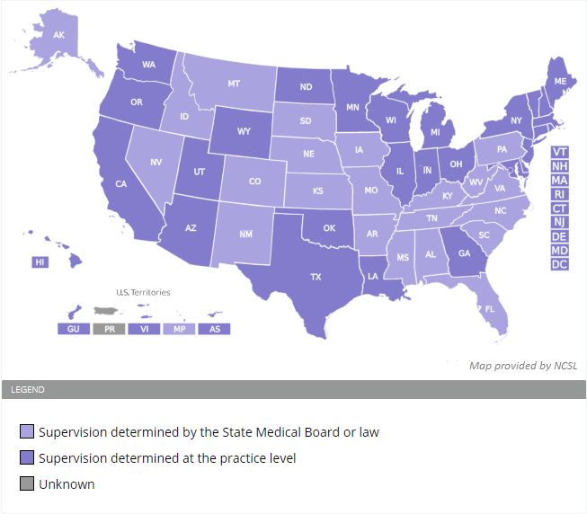
PA Supervision
Supervision determined by law/regulation
State law or board rules provide supervision requirements
Supervision determined at practice level
A written job description or collaborative agreement between physician and PA
3

Slide 4
PA Supervision Continued
A primary supervising physician shall not have more than four PAs to supervise, and supervise not more than two at any one time, except:
  A primary supervising physician may supervise up to four PAs at any one time in a group practice with other supervising physicians.
An alternate supervising physician may also supervise up to four PAs in an institutional setting (eg. hospital or clinic), when on call for a primary supervising physician, or when otherwise approved by GCMB as an alternate.
O.C.G.A. § 43-34-103(b)
4

Slide 5
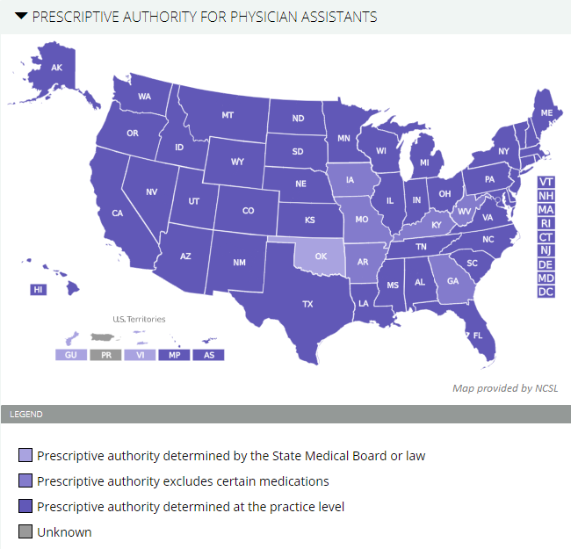
PA Prescriptive Authority
Georgia allows PAs to prescribe schedule III, IV, and V controlled substances.
44 states and D.C. allow PAs to prescribe schedule II, III, IV, and V controlled substances.
Prescriptive authority allowed for drugs only if a physician has delegated as provided in the PA’s job description.
PA may order refills for up to 12 months. For scheduled drugs, refills up to six months.
5

Slide 6
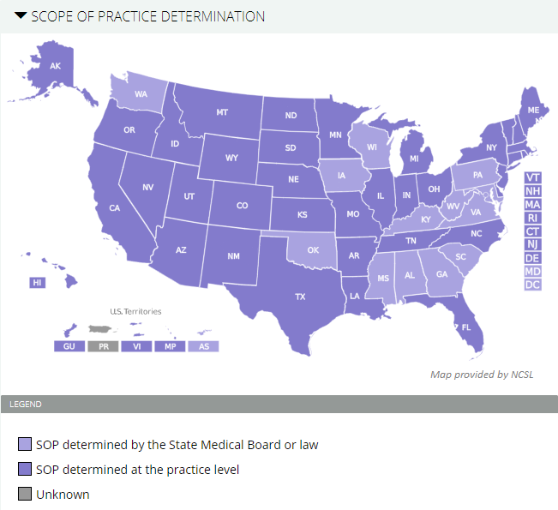
PA Scope of Practice
Georgia’s scope of practice laws are based on the supervising physician’s delegation, limited to only the physician’s scope and must be approved by GCMB (same as South Carolina, Alabama, etc.).
States such as Florida, Louisiana, Texas, etc. do not require medical board/regulator approval.
6

Slide 7
PA Education, License Requirements
PA students attend formal physician assistant education programs approved by GCMB
Usually six years of education – four years undergraduate/bachelors and two years in PA school
Must pass the Physician Assistant National Certifying Exam (“PANCE”) administered by the National Commission on Certification of Physician Assistants
Continuing education requirements
  40 hours biennially, 10 hours of which are in the physician’s specialty
  3 hours in pharmaceuticals for PAs with prescriptive authority
Citizenship, legal permanent resident, or qualified alien status requirement
Good moral character references by two physicians, may not be physician seeking to use the PA (Board regulation)
7

Slide 8
Advance Practice Registered Nurse Regulation Basics
Licensed by the Board of Nursing as a registered nurse, authorized as an APRN by the Board
15,422 authorized APRNs
  Of these, 12,459 are nurse practitioners
Georgia requires a written protocol between a supervising physician and APRN
  Board of Nursing regulations limit physician’s supervision to four APRNs, with exceptions
Prescribing authority is allowed pursuant to a written protocol and if authorized by the GCMB
APRNs: Nurse-midwife; nurse practitioners; certified registered nurse anesthetist, clinical nurse specialist psychiatric/mental health; clinical nurse specialist
8

Slide 9
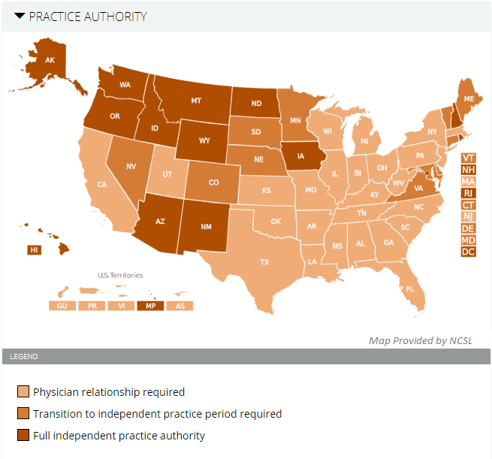
APRN Practice Authority
26 states require a physician relationship.
24 states allow APRN independent practice.
9

Slide 10
APRN Supervision
A delegating physician may not enter into a nurse protocol agreement with more than four APRNs at any one time, except when the APRN is practicing in:
  A licensed hospital;
  A college or university;
  DPH, county board of health, or CSBs;
  A free health clinic, or birthing center;
  A non-profit entity primarily serving uninsured or indigent Medicaid, Medicare patients;
  FQHCs or other federally-authorized, -funded entity;
  Local boards of education with school nurse programs;
  Health maintenance organization; or
  An EMS system, under local authority, with a full time physician medical director.
O.C.G.A. § 43-34-25(g)
10

Slide 11
APRN Supervision Continued
A supervising physician may not enter into a nurse protocol agreement with more than eight APRNs, and supervise no more than four at any one time, at locations which:
  Maintain evidence-based clinical practice guidelines;
  Accredited by a nationally recognized organization (eg. Joint Commission);
  Require the physician maintain a record of review of at least 10 percent of the APRN’s medical records;
  Require physicians and APRNs to participate in and maintain quarterly clinical collaboration meetings; and
  Require the delegating physician’s contact information be provided to a patient’s PCP.
O.C.G.A. § 43-34-25(g.1)
11

Slide 12
APRN Supervision Continued
A supervising physician may not enter into a nurse protocol agreement with more than eight APRNs at any one time, or supervise more than four at any one time, in any EMS system operated by or on behalf of a local authority with a full-time medical director.
O.C.G.A. § 43-34-25(g.2)
12

Slide 13
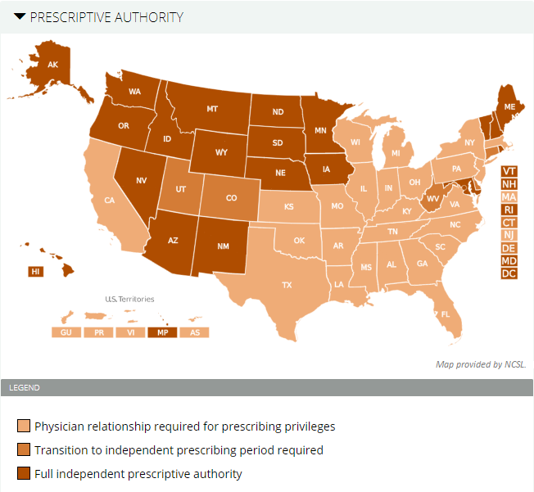
APRN Prescriptive Authority
All states + D.C. allow APRNs to prescribe.
Georgia allows APRNs to prescribe schedule III, IV, and V controlled substances pursuant to a written protocol.
45 states allow APRNs to prescribe schedule II, III, IV, and V controlled substances.
13

Slide 14
APRN License, Education Requirements
APRN students attend Board of Nursing-approved masters/graduate programs
Usually six years of education – four years undergraduate/nursing program, two years in an approved advanced program
Must be certified by a national board approved by the Board of Nursing
Submit required documents as an RN, including passage of the NCLEX
Required continuing education for renewal, but multiple options
  Can be through continuing education classes, maintaining certification by a national board, completing a Board-recognized academic program, verification of competency from a facility with 500 hours practiced, or any other Board-approved methods.
14

Slide 15
2019 Georgia Legislation
SB 168 – Allows APRNs working in an EMS system overseen by a physician medical director to order up to a 14 day supply of drugs in emergency situations, excluding schedule II substances and benzodiazepines; prohibits APRNs from ordering radiographic imaging, diagnostic studies, and medical devices; and requires referral of the patient to a physician, dentist, or FQHC (Passed – Effective April 25, 2019)
HB 409 – Proposes to remove “life-threatening situation” as a prerequisite for APRNs ordering radiographic imaging tests; raises the number of APRNs a physician may supervise (In House Committee)
SB 109 – Removes “life-threatening situation” as a prerequisite for APRNs licensed for at least five years to order radiographic imaging tests (Tabled)
15

