Slide 1
GTLA PRESENTATION:
SENATE STUDY COMMITTEE ON REDUCING THE COST OF DOING BUSINESS
JON POPE
HASTY POPE LLP - GAINESVILLE

Slide 2

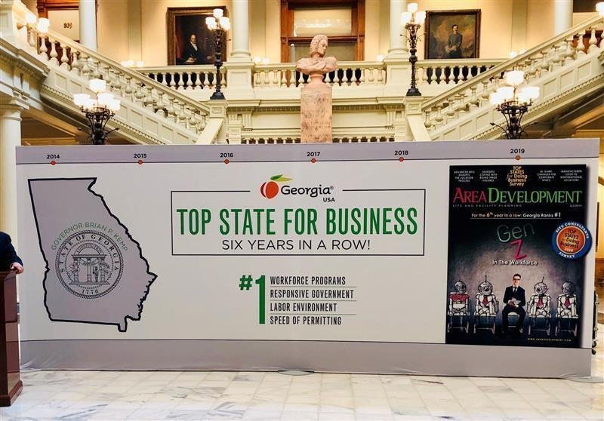
#1 STATE FOR BUSINESS

Slide 3


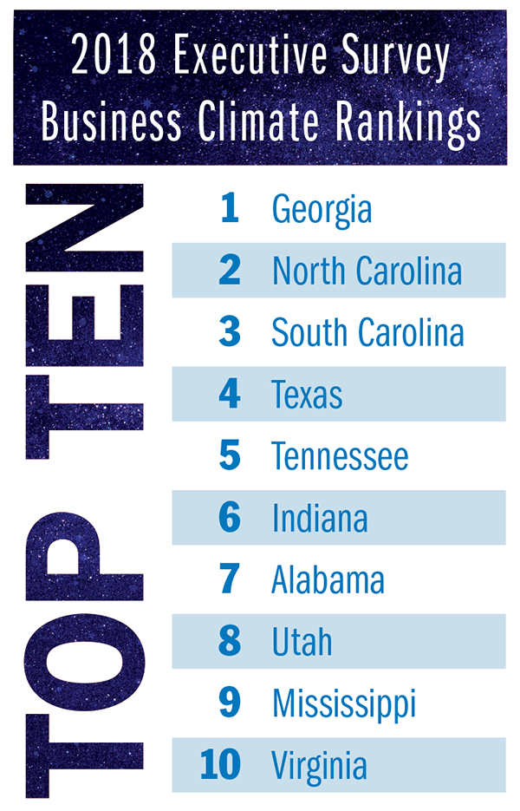

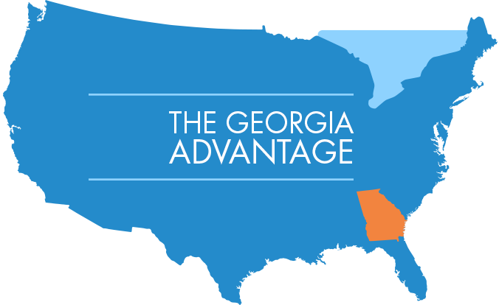
7 YEARS IN A ROW

Slide 4
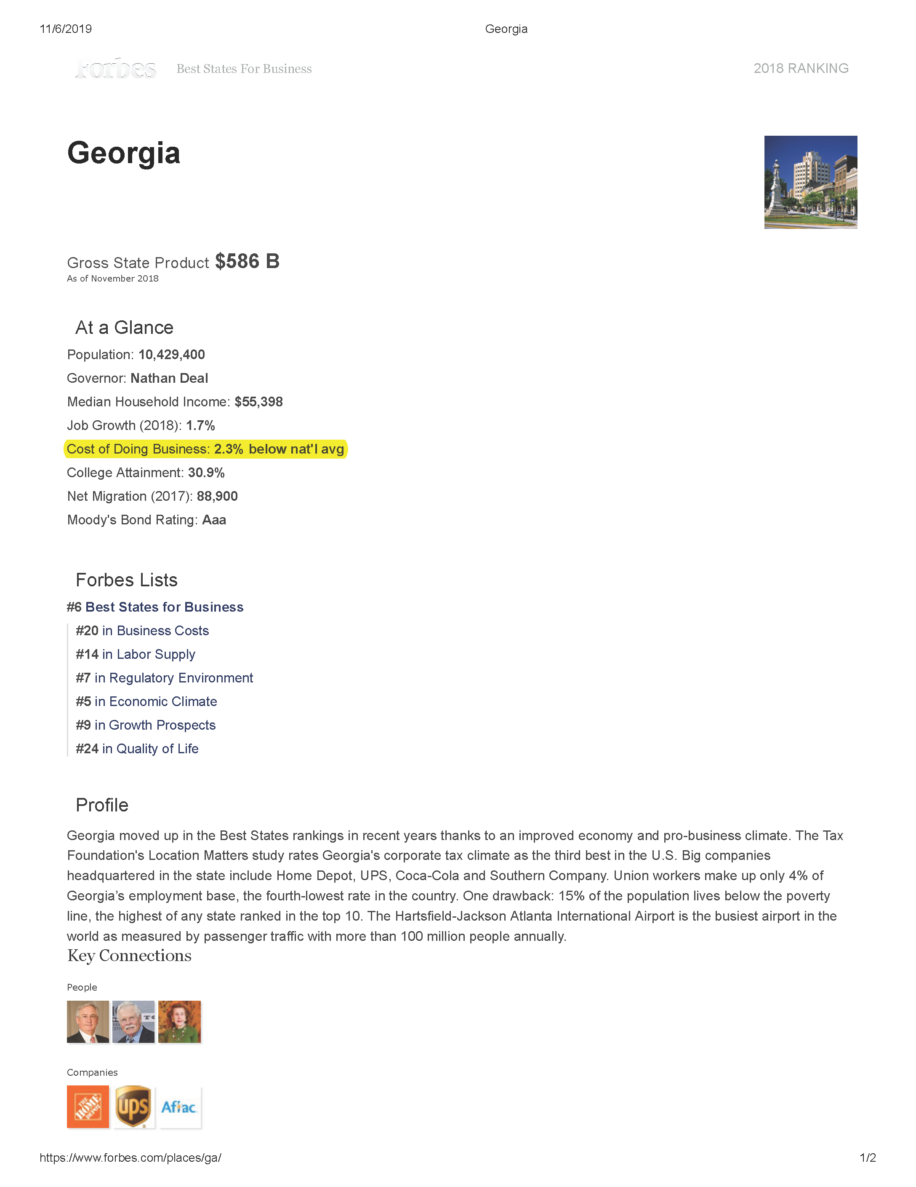

Slide 5
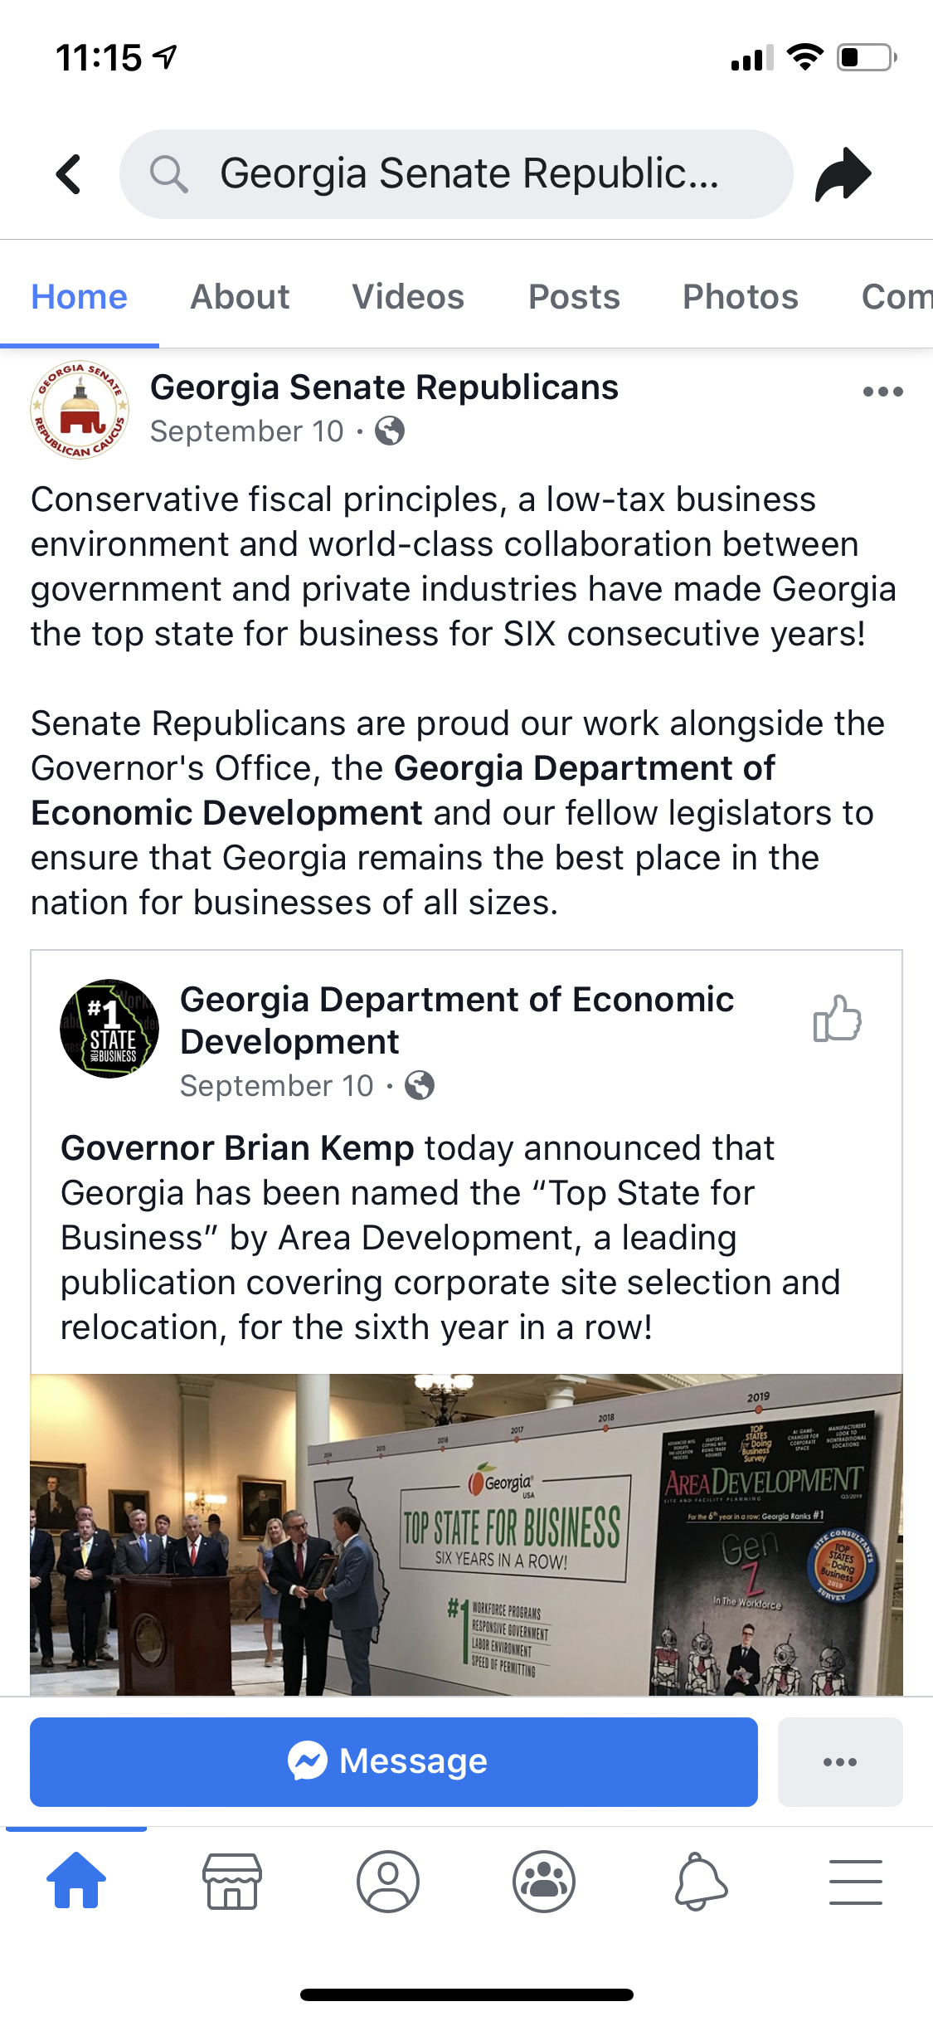
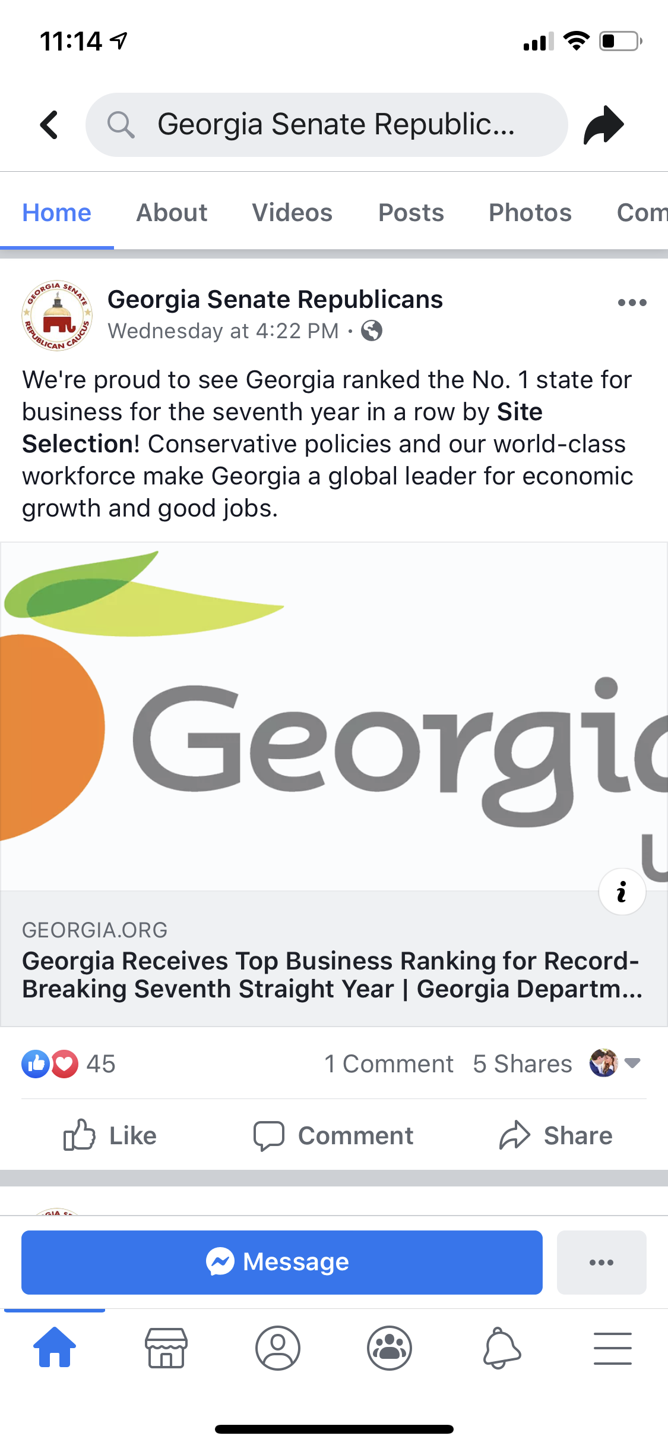
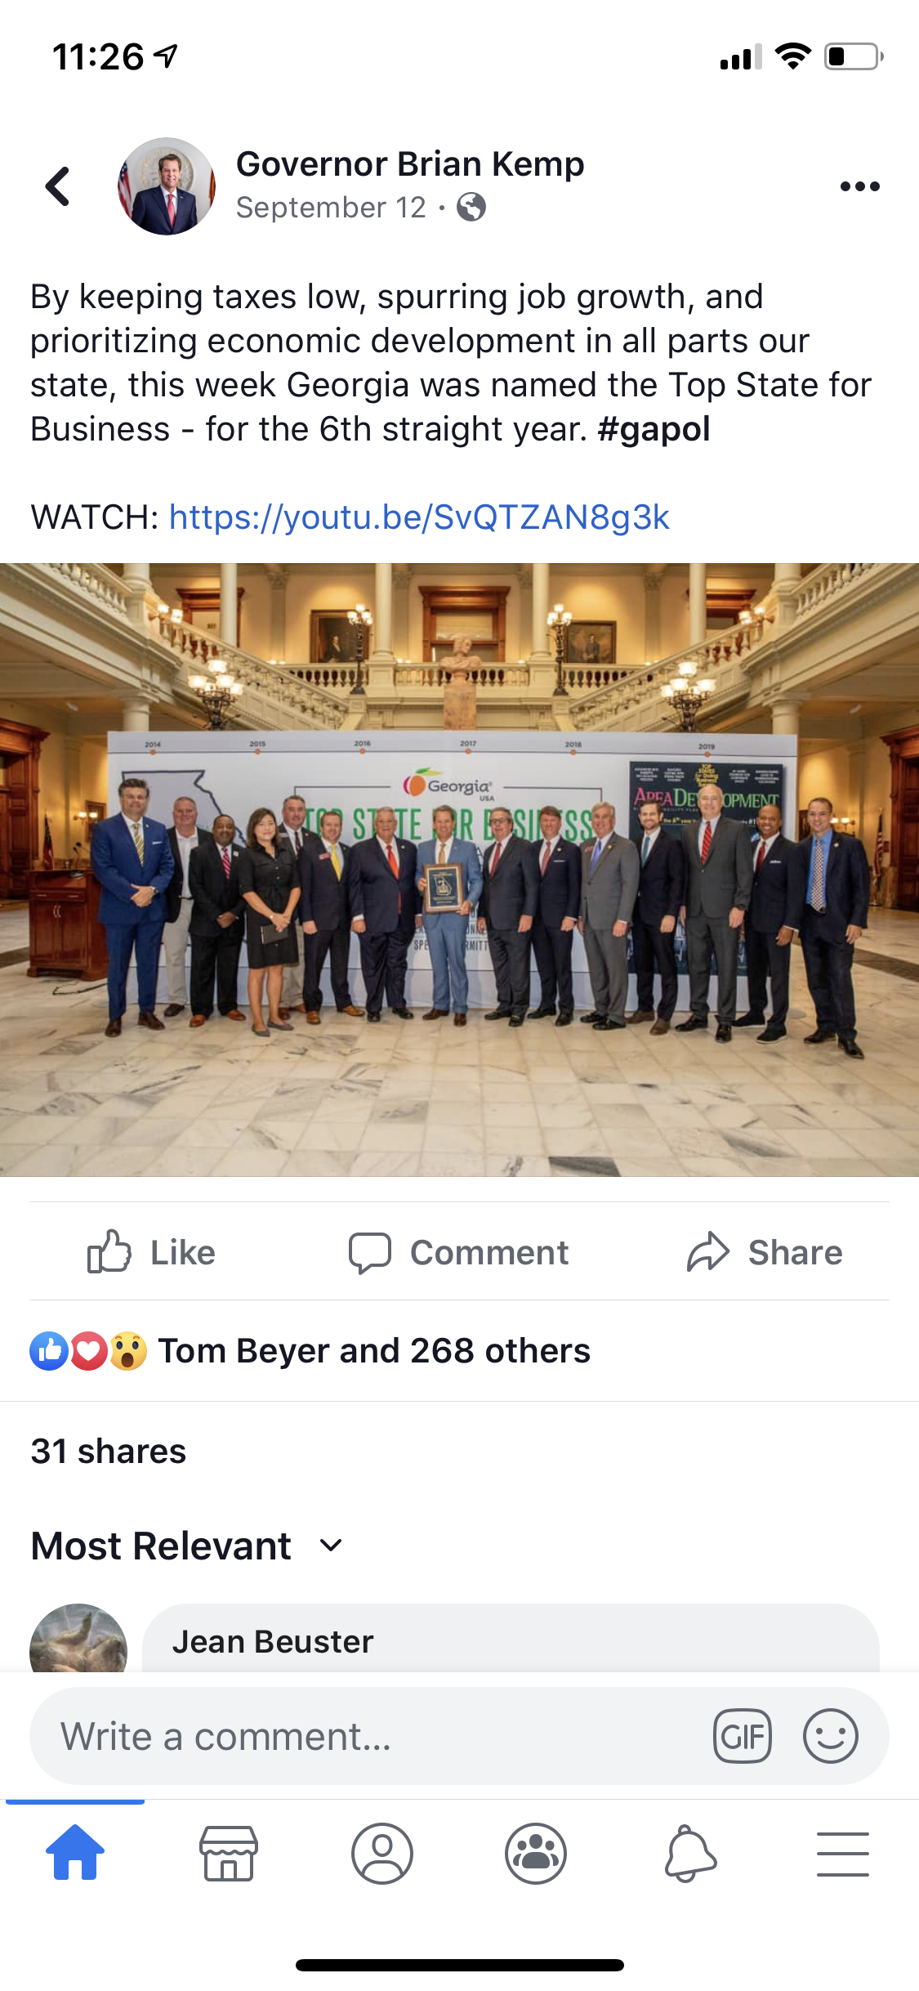
“…a global leader for economic growth and good jobs.”

Slide 6
HOW DO WE REMAIN THE #1 STATE FOR BUSINESS AND DO IT SAFELY?

Slide 7
SEATBELT ADMISSIBILITY
What does it do?
Currently, the failure of a victim injured by the negligence of another driver to wear a seatbelt is not admissible in trial over the fault of the collision or the degree of injury. The proposed legislation would allow a jury to consider the victim’s failure to wear a seatbelt as evidence of how injuries were caused and whether they are negligent and responsible for their injury.

Slide 8
SEATBELT ADMISSIBILITY
REALITY
Currently excluded under Georgia (and 30 other states) law because it is unduly prejudicial to the jury
Evidence regarding seat belt usage is often determined by investigating officers well after a collision occurs.
The issue of how failure to wear a seat belt contributed or did not contribute to an injury will force victims to hire expert witnesses in cases where they are not at fault, dragging out and driving up the cost of litigation

Slide 9
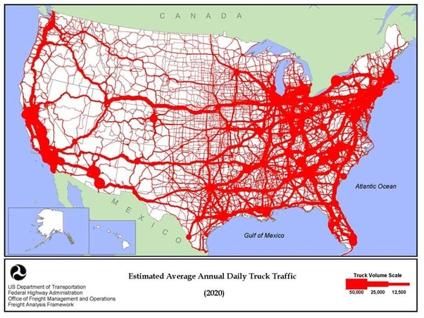

Slide 10
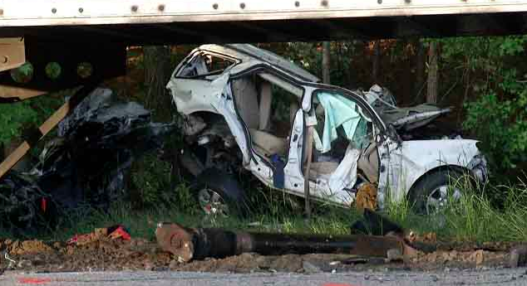

Slide 11
SEATBELT ADMISSIBILITY
WHO WILL IT HELP?
Those who caused the accident *Under current Georgia law, the at-fault defendant’s driving record and related citations are also excluded
WHO WILL IT HURT?
The 98.5% of Georgians who wear their seatbelt at all times and will now be required to take costly measures to prove that they were belted *According to the Governor’s Office of Highway Safety

Slide 12
ELIMINATION OF THE COLLATERAL SOURCE RULE
What does it do?
A change to Georgia law that has been in place for over 100 years would limit an injured party’s recovery to only the amount the injured parties’ health insurance agreed to pay.

Slide 13
ELIMINATION OF THE COLLATERAL SOURCE RULE
WHO WILL IT HELP?
Big insurance companies People without health insurance Those who caused the accident
WHO WILL IT HURT?
Military Service Members & their families Veterans using VA benefits Rural Georgians paying for helicopter ambulance insurance Working Georgians with group healthcare plans through work Individuals who buy the best health insurance coverage for their families Retirees on Medicare

Slide 14
ELIMINATION OF THE COLLATERAL SOURCE RULE
COMMITTEE PRESENTATION
“It is about basic fairness”
REALITY
Injured parties with the same injury who receive the same care from the same medical providers would be treated differently solely based on the type of health insurance
People who pay health insurance premiums would be penalized for the negotiated and discounted amounts even though they paid premiums for the coverage
The party that caused the harm and the liability insurer would receive a financial benefit because the injured party paid a health insurance premium to receive the discounted rate

Slide 15
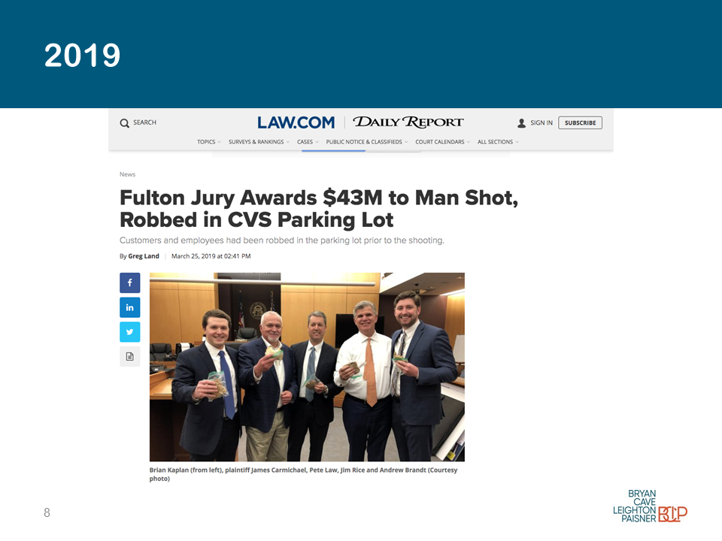
Premises Liability “Crisis”

Slide 16
Premises Liability “Crisis”
REALITY
CVS admitted at trial that the plaintiff was a customer as video evidence showed him in the store purchasing contact solution
He was attacked by a complete stranger (not someone who “lured him there”)
The incident did not take place after hours as that same video evidence showed the victim stumbling around in the open store visibly wounded
Multiple former-CVS employees testified to filing reports to management of being afraid to come to work because of the frequent crime. CVS management did nothing.
COMMITTEE PRESENTATION
“Even if the plaintiff is not your customer and the store closed”

Slide 17
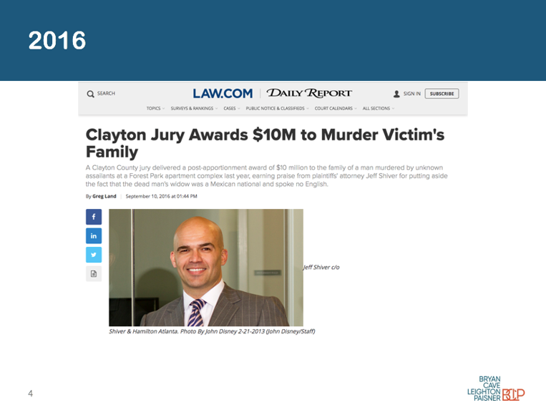
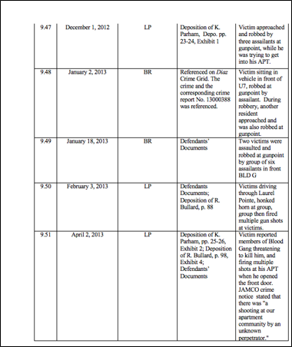
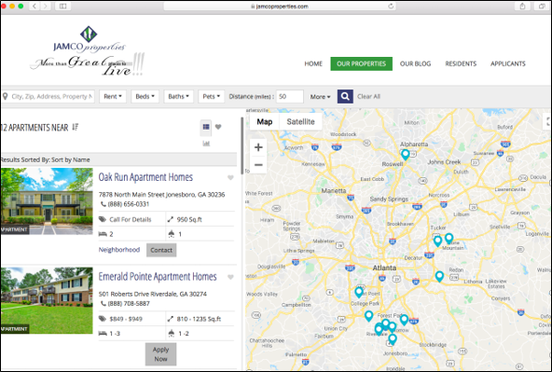
PREMISES LIABILITY
…AND THE REST OF THE STORY
Resident Florencio Gomez-Mendez was returning home from the grocery store when he was shot and killed in the common area of his JAMCO apartment complex in January of 2015
More than 80 incidents of violent crime were reported on residents/guests in the common areas of two adjacent JAMCO properties between 2010-2015
JAMCO admitted making NO security changes after 2013 shooting death of a 12 year-old boy
JAMCO still owns/operates 12 apartment complexes in metro Atlanta

Slide 18
Columbus, Georgia Verdict
Madere v. Schnitzer Southeast
REALITY
Truck driver fatigued – 5 hours of sleep Truck driver had 3 prior accidents - no discipline Tractor trailer Out of Service (“OOS”)
Truck driver crossed the centerline and killed 5 people spanning 3 generations of one family
Insurance company declined 3 offers – no counter Insurance company ASKED FOR TRIAL Trucking company argued deceased driver SHOULD HAVE DONE MORE TO GET OUT OF THE WAY
Case did not resolve for verdict amount – significantly less
COMMITTEE PRESENTATION
“Nuclear Verdict” “Just an accident”

Slide 19
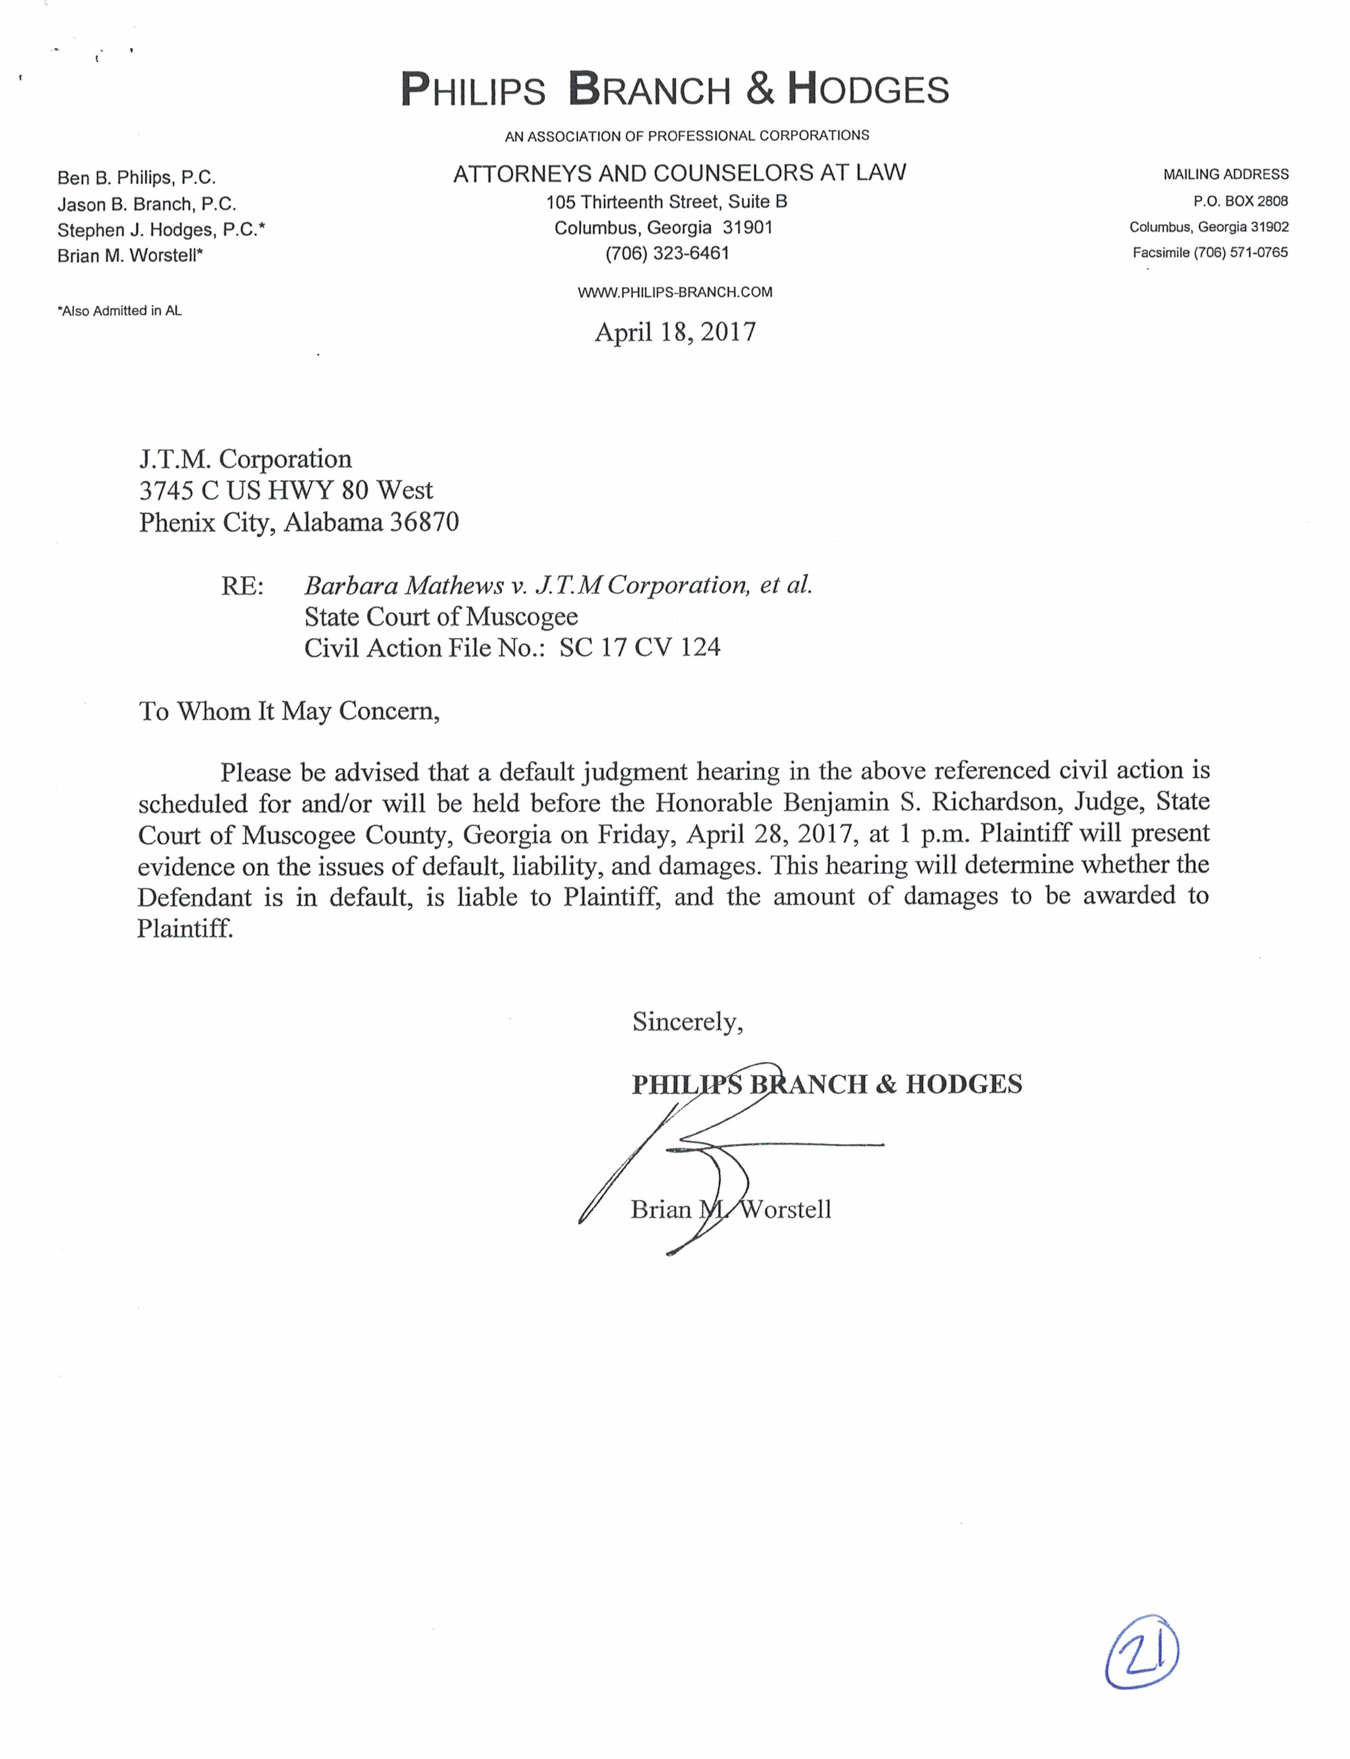
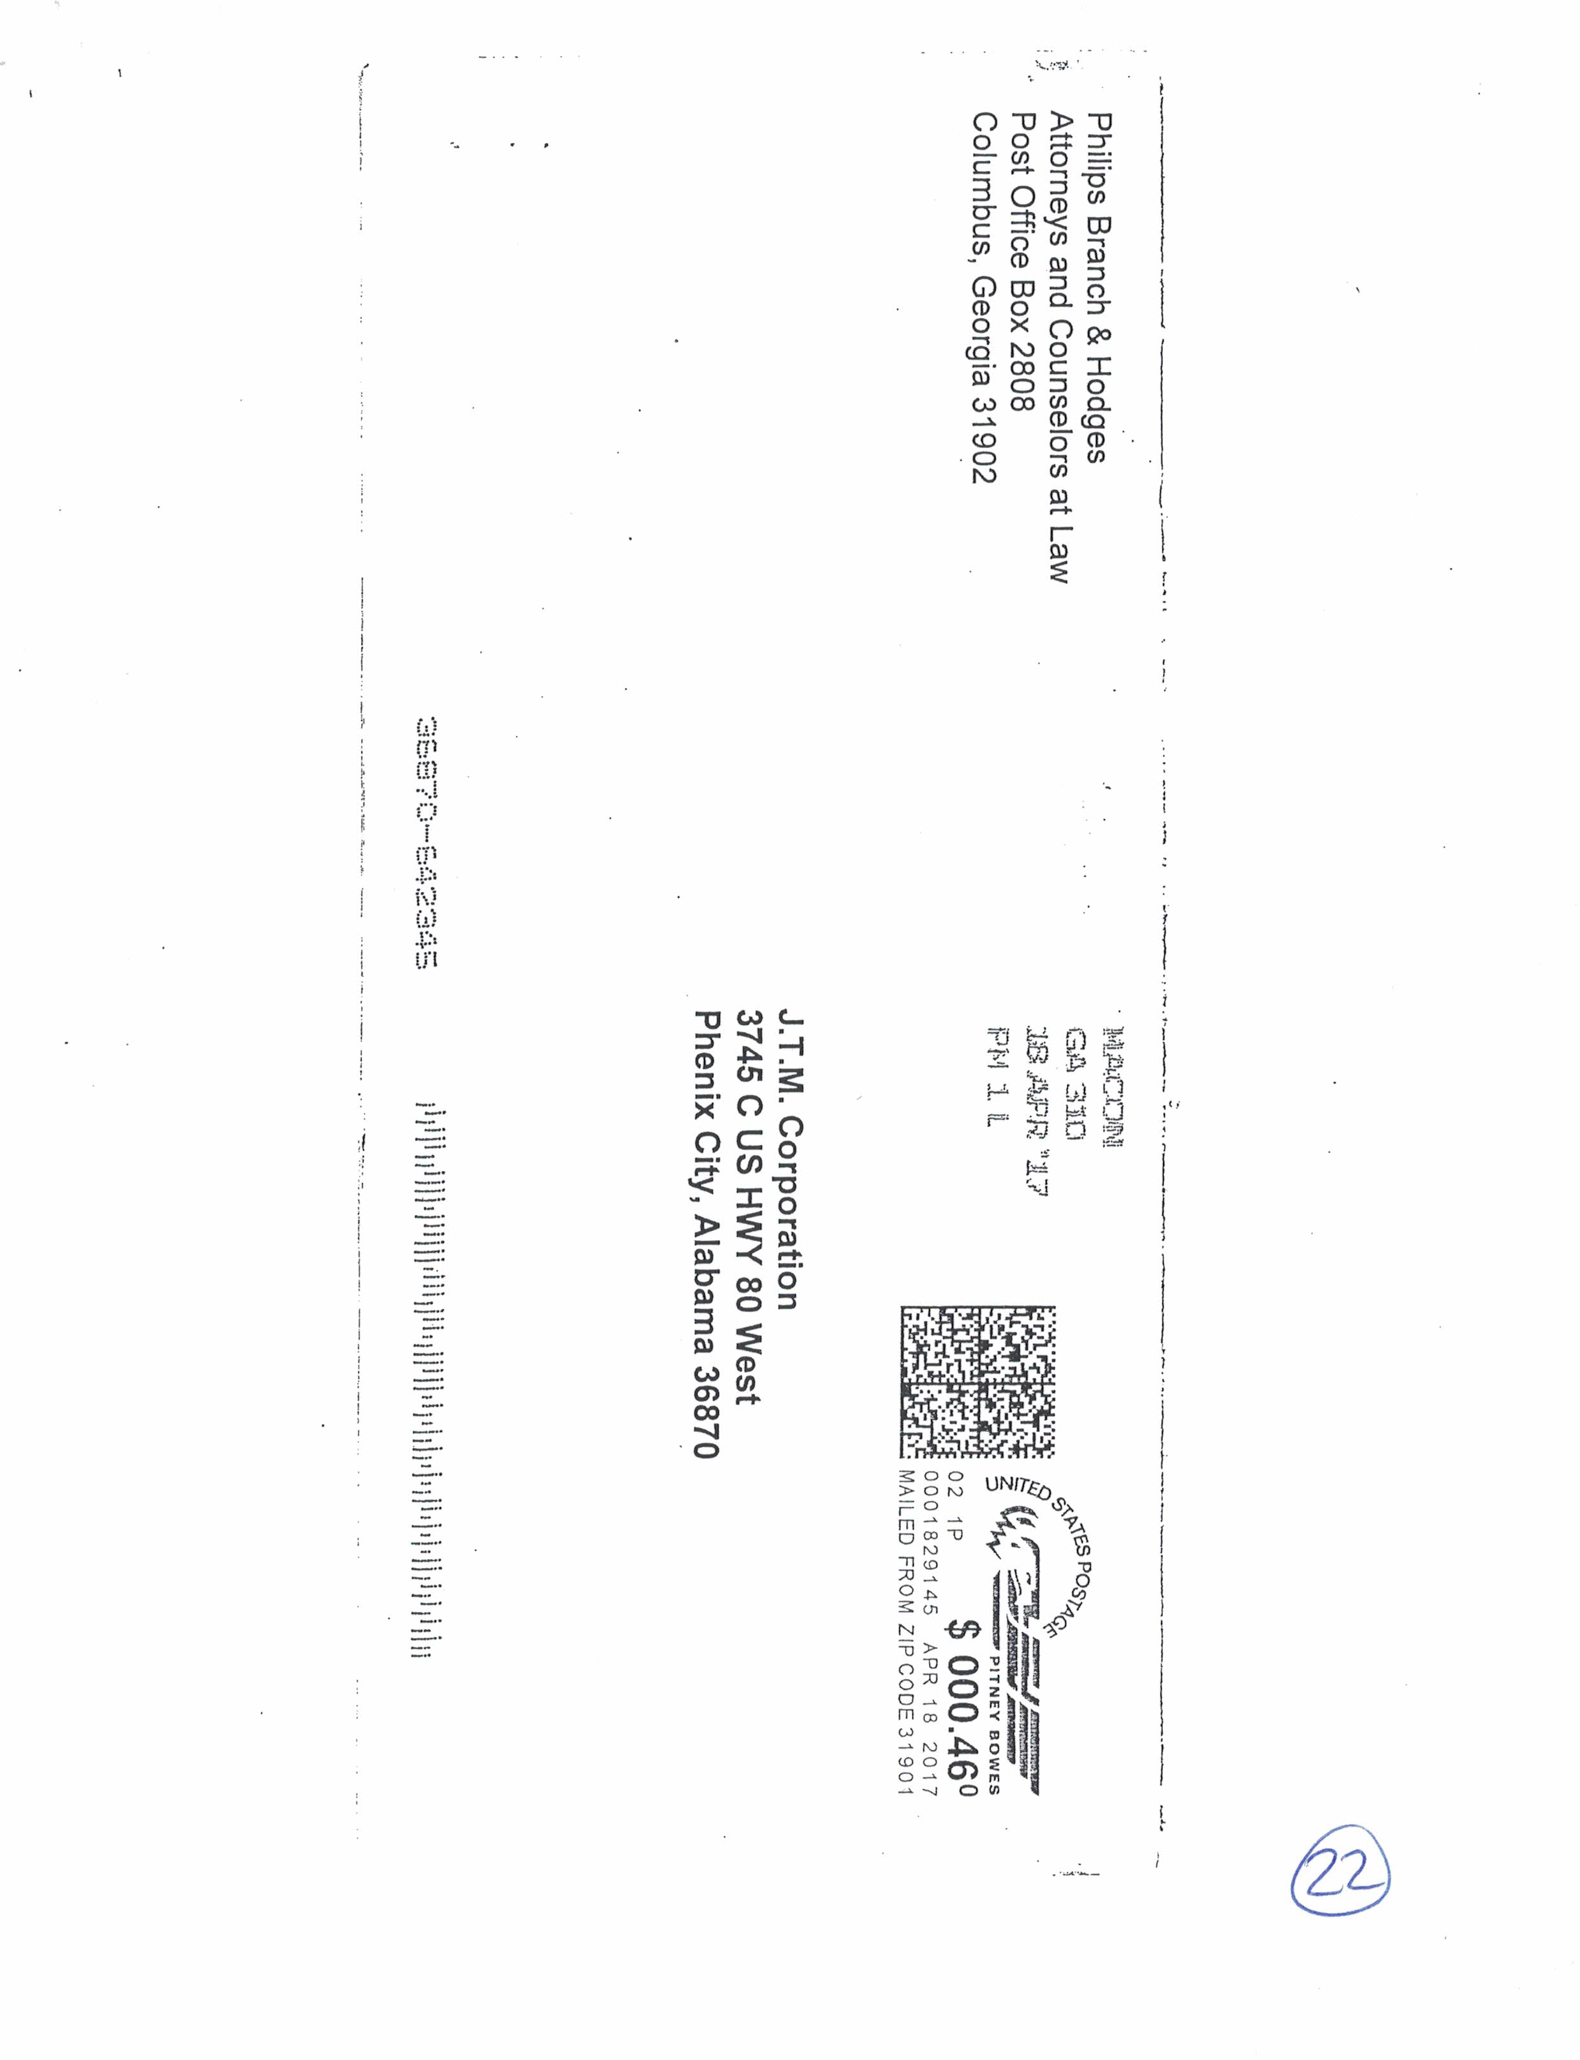
PIGGLY WIGGLY SLIP & FALL CASE
COMMITTEE PRESENTATION
“We did not receive notices of default judgement hearing”
REALITY
A letter and accompanying envelope postmarked for April 18, 2017 was sent to J.T.M. Corporation

Slide 20
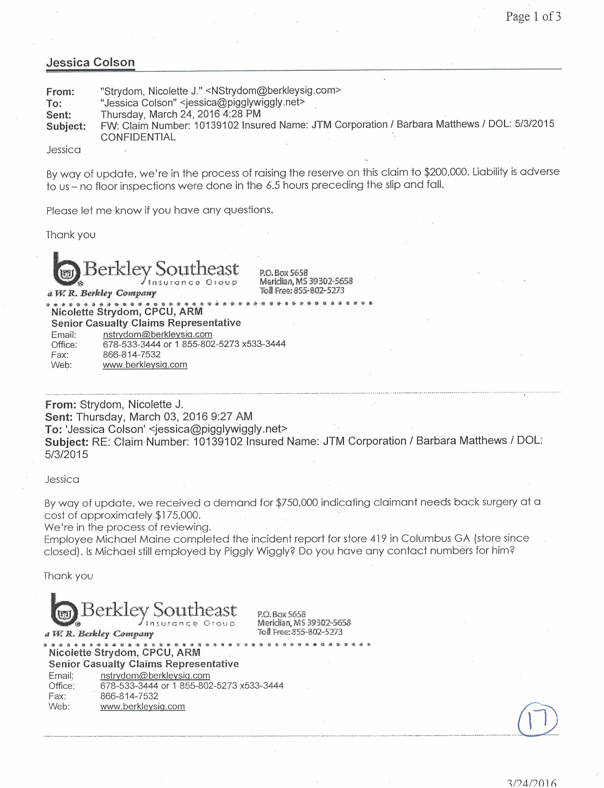
PIGGLY WIGGLY SLIP & FALL CASE
REALITY
Not a single floor inspection was done in the 6.5 hours prior to the incident
The representative from the insurance company warned against using the video as she claimed “liability is adverse to us”
COMMITTEE PRESENTATION
“Multiple floor inspections were conducted on the floor”
“The video of the incident would have resolved this but we weren’t allowed to enter it”

Slide 21
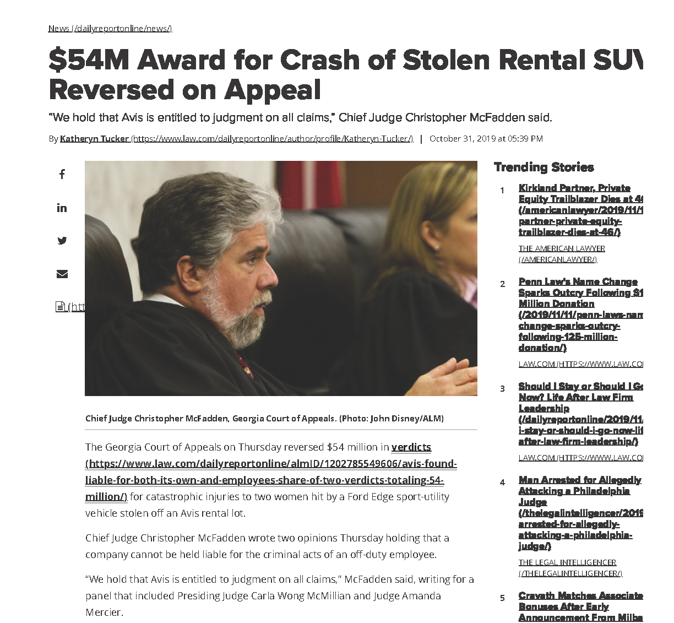
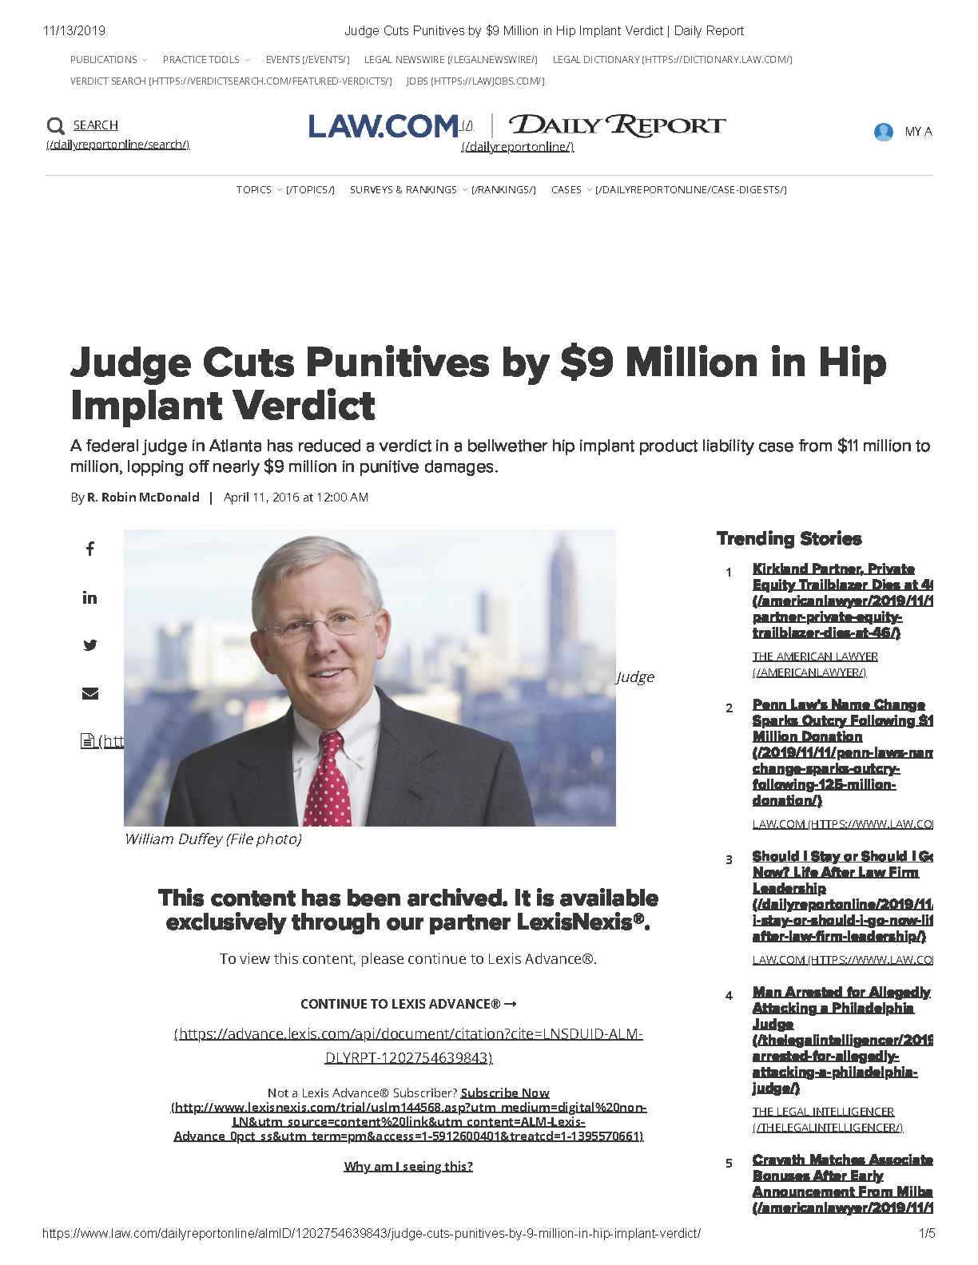
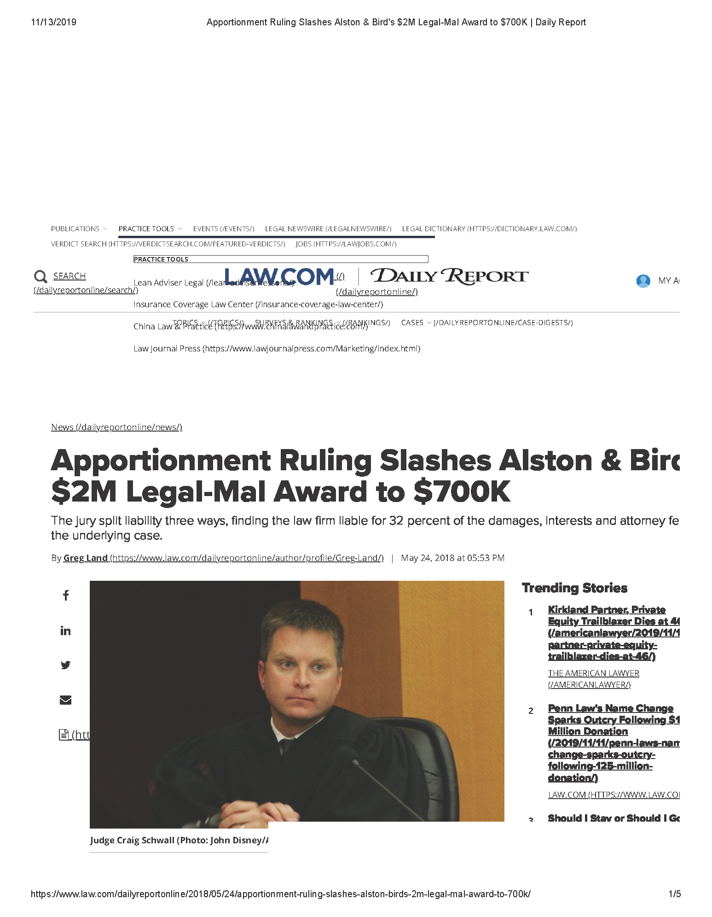
Motion to Dimiss
Motion for Summary Judgment
Directed Verdict
Loser Pays
Remitter (Judges’ discretion)
Court of Appeals/Supreme Court

Slide 22
