Slide 1
Senate Higher Education Outcomes Study Committee
September 27, 2019

Slide 2
Who We Are
26 institutions.
Enroll 328,000+ students.
Economic impact of $17.7 billion.
Generate 168,000 jobs statewide.

Slide 3
Economic Competitiveness
Jobs since the Great Recession: 70% went to workers with at least a bachelor’s degree.
Georgia jobs within the next decade: Two-thirds will require some education beyond high school.

Slide 4
USG Goals
Make college more affordable and control costs.
Find opportunities to be more efficient and make college more accessible.
Ensure more Georgians enter the workforce with a college credential.

Slide 5
Affordability
Tuition: No tuition increase 2 of the last 4 years. Average increase is 1.7% the last 5 years.
Textbooks: 10,000+ course sections now include free online textbooks and study materials.
Student Financial Aid: Tell students how much they owe, what their monthly payment will be and what it will be if they borrow more.

Slide 6
Efficiency
Consolidations: From 35 institutions in 2011 to the USG’s current 26; more offerings; and better student outcomes.
Comprehensive Administrative Review: All institutions and the University System Office.

Slide 7
Momentum Year
Starting this fall, all USG students must pick a focus area.
Changes to remedial education; pass rates increased from 15% to 75%.
“15 to Finish:” Advise students to take as many hours as possible; seeing increases in average course loads.

Slide 8
Skilled Workforce
Georgia FinTech Academy.
Cybersecurity partnerships.
Nexus degrees in high-demand career areas.

Slide 9
Results
The number of USG students earning degrees annually since 2011 has increased almost 24%, enrollment up just 3.4%.
Adjusted for inflation, USG spending per degree has declined by 6.5% since FY08.

Slide 10
Georgia High School Graduates

Slide 11
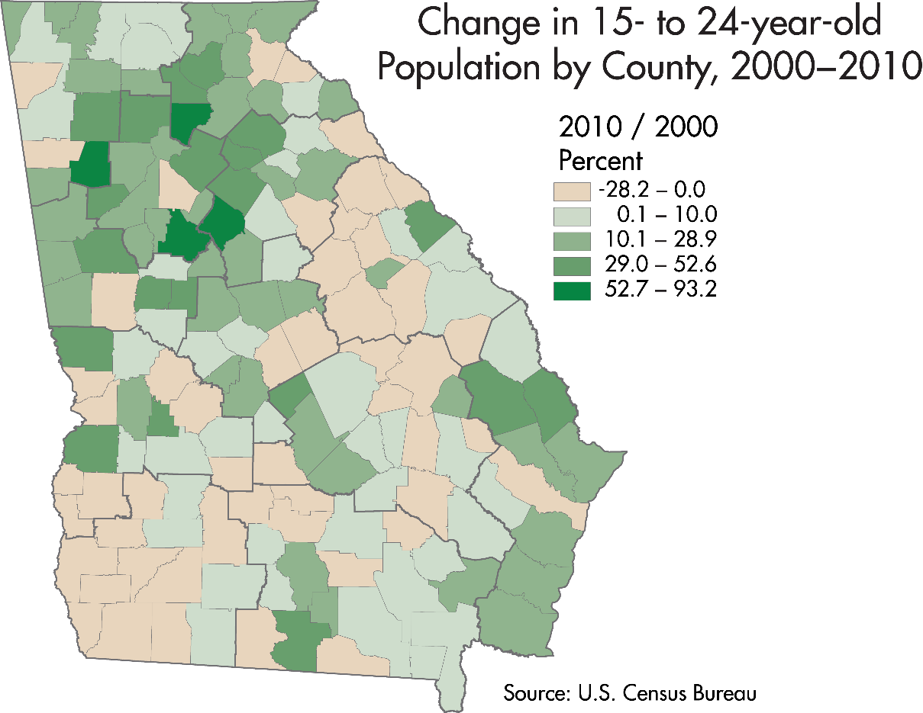
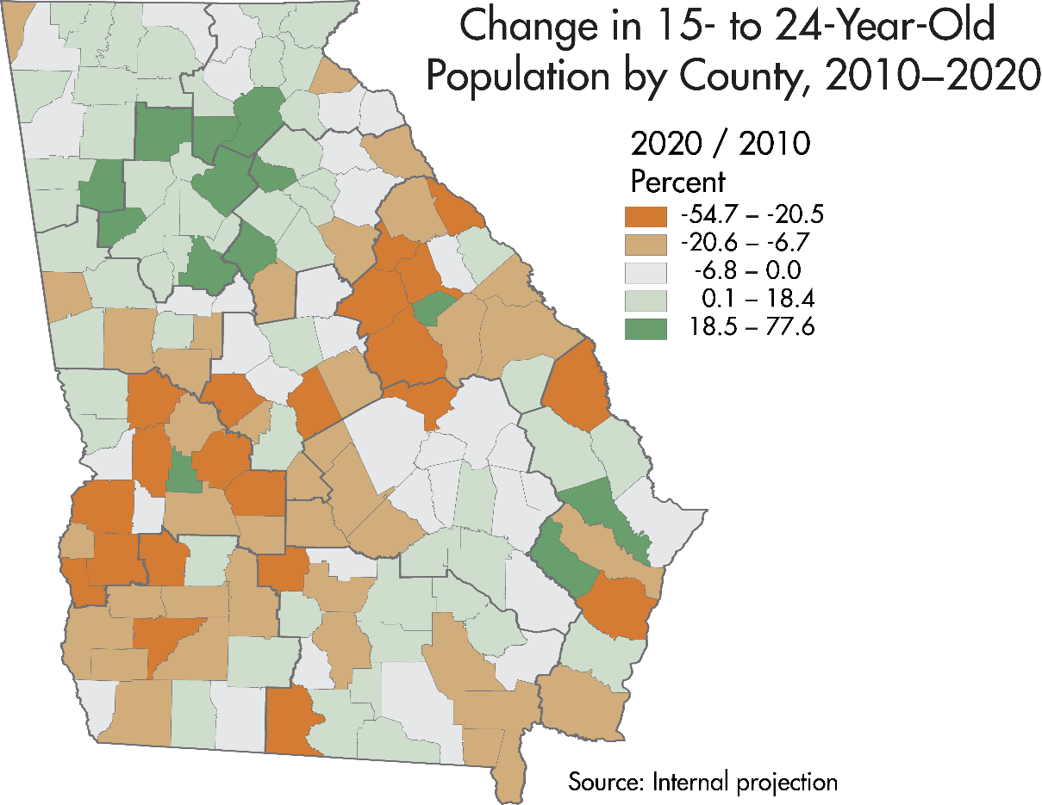
Population Trends for
15 to 24 Year-Olds

Slide 12
Thank you

