Slide 1
U.S. Department of Justice
Civil Rights Division
Service Animals and the ADA
Food Marketing Institute Kathleen Wolfe and Liz Savage
U.S. Department of Justice August 7, 2018

Slide 2
U.S. Department of Justice
Civil Rights Division
SERVICE ANIMALS and the ADA
Reasonable Modification
□ Legal Basis:
General Rule in ADA regulation:
"A public accommodation shall make reasonable modifications in policies, practices, or procedures when necessary to afford goods, services, facilities, privileges advantages, or accommodations to individuals with disabilities, unless the public accommodation can demonstrate that making the modifications would fundamentally alter the nature of the goods, services, facilities, privileges, advantages, or accommodations."

Slide 3
SERVICE ANIMALS and the ADA
U.S. Department of Justice Civil Rights Division
Basic Rule: A public accommodation shall modify its policies, practices, or procedures to permit the use of a service animal by an individual with a disability.
Rule of Thumb: Allow service animal to go anywhere members of public go

Slide 4
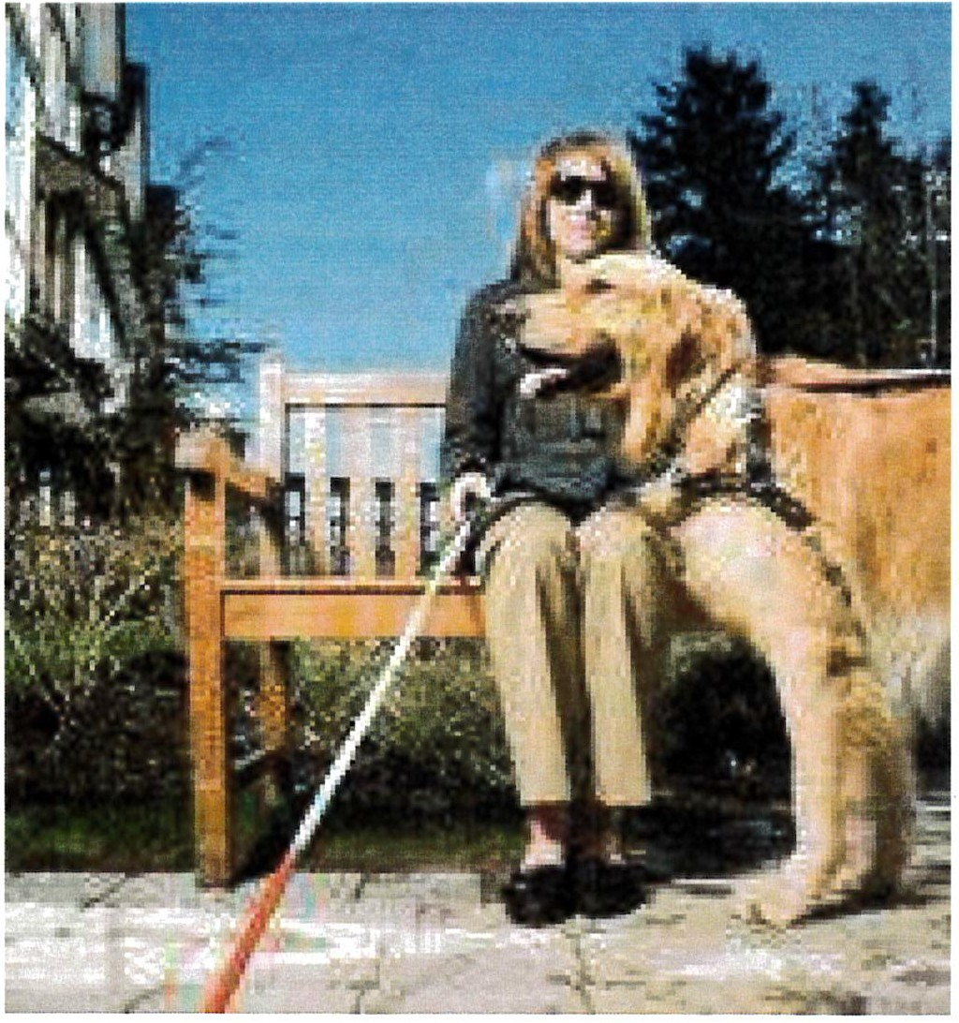
U.S. Department of Justice
Civil Rights Division
SERVICE ANIMALS and the ADA
A dog that is individually trained to do work or perform tasks for the benefit of an individual with a disability, including a physical, psychiatric, sensory, intellectual or other mental disability.

Slide 5
U.S. Department of Justice
Civil Rights Division
SERVICE ANIMALS and the ADA
What does this definition mean?
Limits the species of service animals to dogs for the ADA
Comfort, emotional support, therapy, or companionship dogs are not service animals
Those with psychiatric, intellectuaI, or other mental disabilities can use service dogs

Slide 6
U.S. Department of Justice
Civil Rights Division
SERVICE ANIMALS and the ADA
Examples of Tasks (1)
Guiding or wayfaring for persons who are blind or have low vision
Alerting persons who are deaf or hard of hearing to sounds
Pulling a wheelchair
Retrieving items for persons who use
wheelchairs

Slide 7
U.S. Department of Justice
Civil Rights Division
SERVICE ANIMALS and the ADA
Examples of tasks (2)
Detect the onset of a seizure and assist during sei■ zure
Remind person with a disability to take medication or retrieve medicine or other items
Enter and examine unfamiliar space and come back and signal it is safe to enter
Help individual with dissociative identity disorder to remain grounded

Slide 8
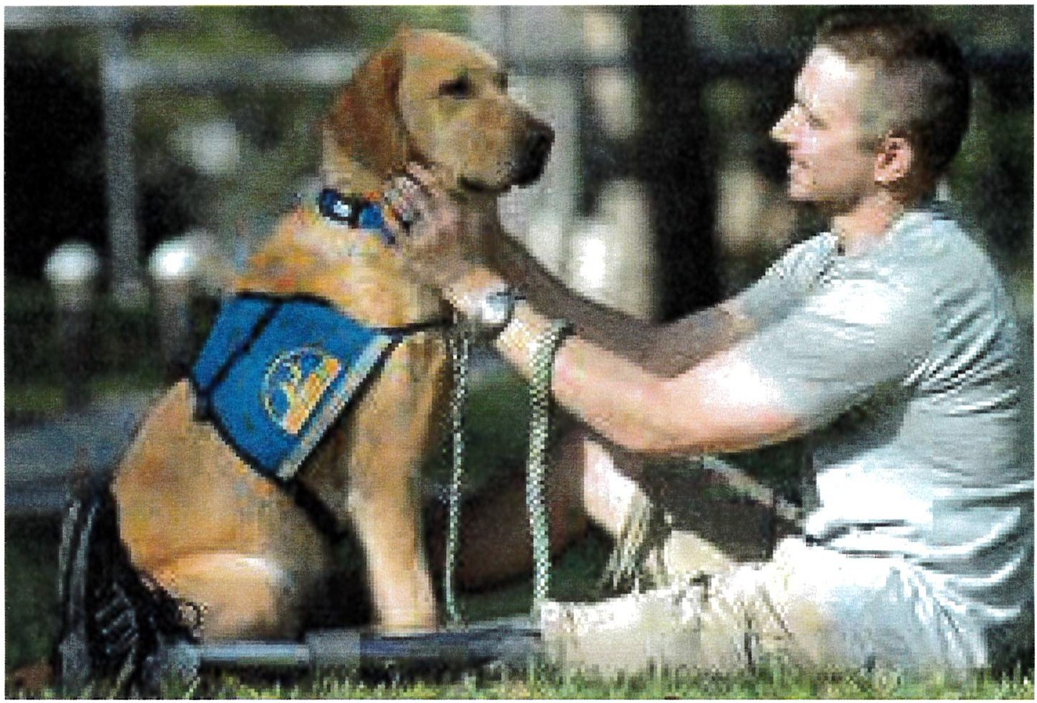
U.S. Department of Justice
Civil Rights Division
SERVICE ANIMALS and the ADA
Examples of tasks (3)
Prevent/interrupt impulsive or destructive behavior
Assist with balance, stability
Provide non-violent
protection or rescue work

Slide 9
U.S. Department of Justice
Civil Rights Division
SERVICE ANIMALS and the ADA
Psychiatric Service Dog
Service dogs for people with psychiatric disorders are recognized under DOJ regulations
Handler generally does not cue dog
Dog takes independent action to alert - e.g. prior to anxiety/panic attack
Dog's action is consistent

Slide 10
U.S. Department of Justice
Civil Rights Division
SERVICE ANIMALS and the ADA
Emotional support/comfort?
Providing emotional support or comfort is not a recognized
task under DOJ service animal regulations
If the dog's mere presence provides comfort, it is not a service animal under DOJ regulations
You typically cannot determine on sight whether a dog is a service animal under the ADA or an emotional support or comfort animal that is not covered by the ADA.

Slide 11
U.S. Department of Justice
Civil Rights Division
SERVICE ANIMALS and the ADA
Service Dog Definition
"Individually Trained":
  Professional training not required
  Dogs in training are not service dogs
Must be able to perform disability-related task

Slide 12
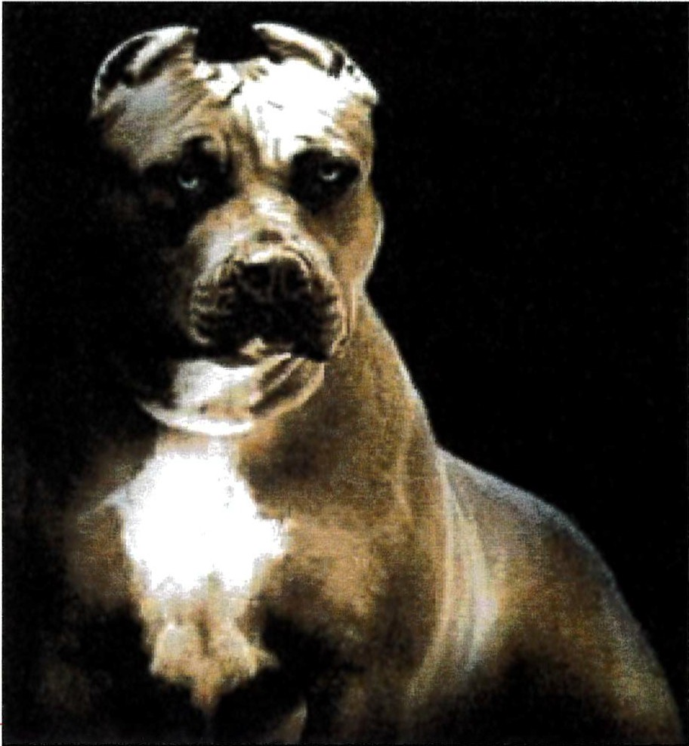

U.S. Department of Justice
Civil Rights Division
SERVICE ANIMALS and the ADA
What Can Store Employees Ask?
Permissible Inquiries: Can ask only two questions (when not obvious that the dog is a service animal)
Whether dog is required because of a disability
What work or tasks the dog is trained to perform
Canno t ask for ciem o
t---rat -••-----

Slide 13
U.S. Department of Justice
Civil Rights Division
SERVICE ANIMALS and the ADA
What If the Person Won't Answer?
If an employee asks the two permissible questions and the patron won't answer -
The store does not need to allow the service animal in.
Remember, though, if obvious that dog is a service animal (e.g., a guide dog for a blind person), then can't ask the two questions.
If exclude the dog because patron won't answer, then still must permit patron to enter/access
services without the dog.

Slide 14
U.S. Department of Justice
Civil Rights Division
SERVICE ANIMALS and the ADA
Documentation
D No certification, identification, licensure or registration, licensure, required
DOJ does not recognize any document sold online by any individual or organization as proof that a dog is a service animal

Slide 15
U.S. Department of Justice
Civil Rights Division
SERVICE ANIMALS and the ADA
Exclusion of Service Dogs
D General Rule: Covered entities must permit service animals to enter all areas where members of the public go
D Two specific exceptions:
When the animal is out of control and the handler does not take effective acti'on to control it
The animal is not housebroken

Slide 16
U.S. Department of Justice
Civil Rights Division
SERVICE ANIMALS and the ADA
What is Handler's Control?
Must have harness, leash, or other tether
If handler is unable to use these because of disability, animal must otherwise be under the handler's control: voice control, signals, or other effective means

Slide 17
U.S. Department of Justice
Civil Rights Division
SERVICE ANIMALS and the ADA
Under Control:
Dog is on a leash, walking on the floor
Dog is on handler's chest in a carrier/pack (where for a disability­ related reason)

Slide 18
U.S. Department of Justice
Civil Rights Division
SERVICE ANIMALS and the ADA
Not Under Control:
Dog is:
  In a shopping cart
  Sniffing around food
  Barking more than once or twice
  Growling
  Showing its teeth
  Nipping or Biting

Slide 19
U.S. Department of Justice
Civil Rights Division
SERVICE ANIMALS and the ADA
General: Limitations
D Entity not required to take steps that:
"fundamentally alter" the nature of the program or activity.
result in a direct threat to the health or safety of others.
□ Rare that presence of service dog meets these limitations

Slide 20
U.S. Department of Justice
Civil Rights Division
SERVICE ANIMALS and the ADA
General: Direct Threat
A direct threat is a significant risk that cannot be eliminated or reduced to an acceptable level by the modification of its policies, practices, or procedures, or by the provision of auxiliary aids or services.
The public accommodation's determination that a person poses a direct threat to the health or safety of others may not be based on generalizations or stereotypes about the
effects of a particular disability

Slide 21
U.S. Department of Justice
Civil Rights Division
SERVICE ANIMALS and the ADA
Other issues
Cannot exclude service dog because
of the allergies or religious beliefs of
others, including employees, but may consider these issues in how access is provided
No exclusion of certain breeds of dogs
Dog not required to wear vest, patch,
or SQecial harness

Slide 22
U.S. Department of Justice
Civil Rights Division
SERVICE ANIMALS and the ADA
Other Issues (2)
□ Local ordinances:
local dog licensing
and vaccination requirements are ok, special registration of service dogs is not
□ Multiple service dogs allowed
per task)
(one dog

Slide 23
U.S. Department of Justice
Civil Rights Division
SERVICE ANIMALS and the ADA
Which Law Applies: Federal, State, or Local?
ADA requires: whichever law provides more protections or access for people with disabilities
E.g. Local ordinance restricting breeds

Slide 24
U.S. Department of Justice
Civil Rights Division
SERVICE ANIMALS and the ADA
Resources
www .ADA.gov
  Frequently Asked Questions about Service Animals and the ADA on ADA.gov
Revised ADA Requirements: ADA.gov
ADA Information Line
Service Animals on
800-514-0301
800-514-0383 (tty)

