Slide 1


Smart Decisions Coalition
Recommendations
Solutions to increase college enrollment & completion to build Georgia’s workforce of the future.

Slide 2
About the Coalition
Coalition formed in December 2018
Mission- The Smart Decisions Coalition aims to eliminate barriers to post-secondary success by improving college affordability and access to advance Georgia’s workforce.
Goals:
Highlight relevant research, current initiatives & programs
Change the conversation to focus on the return on investment of post-secondary education
Consider outside of the box barriers

Slide 3
Why It Matters
By 2025, 60% of Georgia jobs will requires some form of college
Industries are evolving and will continue to do so with more disruptions & technological advances
Risk: Without the right skills, individuals will be displaced
Opportunity: Increased economic mobility & prosperity for more Georgians

Slide 4
Analyzing Barriers & Opportunities
 | Policy Levers | Info & Transparency | Solutions that require $ | Alignment
Affordability
Access & Logistics
Immediate Employability
Long-term Career Adaptability

Slide 5
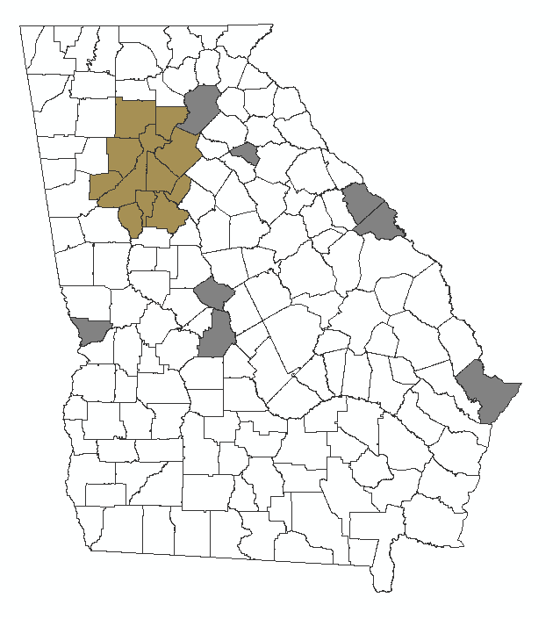
Analyzing Barriers & Opportunities
County Designations
Atlanta: 11 counties clustered around Atlanta job centers
Hub Counties: 8 counties with job total of more than 65,000 or nexus to a hub county
Rural: 140 other counties

Slide 6
Recommendations
Georgia Students Need:
Targeted college and career guidance
Assistance with completing the FAFSA to make college affordable
Opportunity to take the SAT/ACT during the school day
Last mile completion grants in college to prevent stopping out
Industry aligned curriculum
Skills to make them adaptable as industries evolve

Slide 7
Questions?
Daniela B. Perry
Senior Director, Public Policy
Georgia Chamber of Commerce dperry@gachamber.com

