Slide 1

Jennifer H. Lindstrom, Ph.D.
Associate Professor
Department of Communication Sciences & Special Education

Slide 2

Topics
Assessment and Identification in the Schools
Role of EIP
Teacher Training
Recommendations

Slide 3
Assessment and Identification in the Schools

Slide 4

Lindstrom, J.H. (2018). Dyslexia in the schools: Assessment and identification. Teaching Exceptional Children. Advance print. DOI: 10.1177/0040059918763712

Slide 5
Step 1
Step 2
Assess reading performance through the use of individually administered, norm-referenced tests of achievement and cognitive processing, as well as statewide assessments and curriculum-based measures.
Step 3
Step 4
Step 5
Consider assessing cognitive processing to determine whether there are weaknesses in any specific area associated with reading.
Specific cognitive processes linked to reading include phonological processing, orthographic awareness, rapid naming, processing speed, and working memory.
Provide evidence that the impact of the reading disability is of such magnitude that the student needs special education and that the student’s learning difficulties require specially designed instruction (in accordance with IDEA, 2004).
Determine that the student is not achieving adequately for the child’s age or grade-level standards.
This step requires sufficient assessment or review of records.
Verify that the student's poor reading performance is not primarily due to factors included in the exclusionary criteria – visual, hearing, or motor disability; intellectual disability; emotional disturbance; cultural factors; environmental or economic disadvantage; limited-English proficiency; or lack of instruction.
Collect data specific to student's reading as part of the pre-referral (i.e., RTI) process.
Rule-out attention issues that may be caused by deficits in executive functioning.
Consider data collected from previous instruction and intervention (through curriculum-based measures), and review information from teacher and parents.
Refer the student to the eligibility team due to lack of sufficient progress in Tiers 1 and 2.
Framework for Eligibility as a Student with Dyslexia

Slide 6
Assessing Reading and Language Skills
Demonstrate evidence of low achievement in reading (Steps 1 & 2)
Consider data specific to students’ reading performance that were collected as part of the RTI process.
    Letter-naming fluency
    Letter-sound fluency
    Oral reading fluency
    Nonsense word reading
    Spelling
    Oral language (vocabulary acquisition, word-finding, rhyming, grammar)

Slide 7
Consideration of Exclusionary Criteria
Determine that a deficit is not primarily due to factors included in the exclusionary criteria (Step 3):
    visual, hearing, or motor disability; intellectual disability; emotional disturbance; cultural factors; environmental or economic disadvantage; limited English proficiency; or lack of instruction
      Students in Detroit Are Suing the State Because They Weren’t Taught to Read
      Too Many Children in California Can’t Read, Lawsuit Claims
      The right to read: My dyslexic daughter got the help she needed. All kids should.

Slide 8
Consideration of Assessing Cognitive Processes
Because the operational definition of SLD is defined, in part, as “a disorder in one or more of the basic psychological processes involved in understanding or in using language, spoken or written” (20 U.S.C. §1401[30] and 34 C.F.R. §300.8[c][10]), assessing cognitive processes should be considered (Step 4).
    phonological processing
    orthographic awareness
    rapid naming
    processing speed
    working memory
    executive functioning

Slide 9


Evidence of Substantial Impact
Even if a student exhibits a deficit in at least 1 area of cognitive processing that is impacting 1 or more areas of reading (i.e., fluency, decoding), the team must determine that a student’s learning difficulties require specially designed instruction.
It is possible (though unlikely) that a student may have a SLD as identified through the operational definition but would NOT require specialized instruction due to adequate performance in the classroom.

Slide 10
Final Eligibility Determination
Does the student perform significantly below peers on measures of letter-sound knowledge, word decoding, reading fluency, and/or spelling?
Has the student had sufficient instruction?
Has it been determined that the difficulties identified earlier are not due to another factor, such as intellectual disability, ADHD, or emotional disturbance?
Does the student have a deficit in phonological processing, phonological memory, orthographic awareness, rapid naming, processing speed, or working memory?
Does the student have broad oral language abilities within the average range?

Slide 11
Role of EIP

Slide 12
Tier 2 Eligibility Criteria and the Identification of Dyslexia in Georgia
Purpose
    To investigate the degree of alignment between schools regarding Tier 2 eligibility decision making and implementation in the state of Georgia
Research Questions
    To what extent do Tier 2 eligibility criteria vary across schools in Georgia?
    How closely are schools’ eligibility criteria aligned with the criteria provided by the Ga DOE?
    To what extent are schools currently using measures that can be used to identify students at-risk for dyslexia as part of the Tier 2 screening process?

Slide 13
Participants
The participant pool included EIP Coordinators (i.e., Principals, Assistant Principals, Instructional Coaches) from the ~1,000 public primary and elementary schools (including state-approved charter schools) in the state
The emails of principals from public schools in Georgia were obtained from the state Ga DOE’s office of Curriculum and Instruction.
N = 97
    Principals: 31%
    Assistant principals: 18%
    EIP coordinators: 16%
    EIP teachers: 20%
    Special education coordinators: 1%
    Other: 14%

Slide 14
Survey
An 18-question survey was implemented using Qualtrics
9 background questions; 9 core questions
The survey questions addressed the following areas:
(a) awareness of eligibility criteria and procedures provided by Ga DOE
(b) implementation of eligibility criteria and procedures provided by Ga DOE
(c) alternative or supplemental district- or school-specific Tier 2 EIP eligibility criteria and procedures, and
(d) use of measures that can be used to identify students at-risk for dyslexia as part of the Tier 2 screening process.

Slide 15
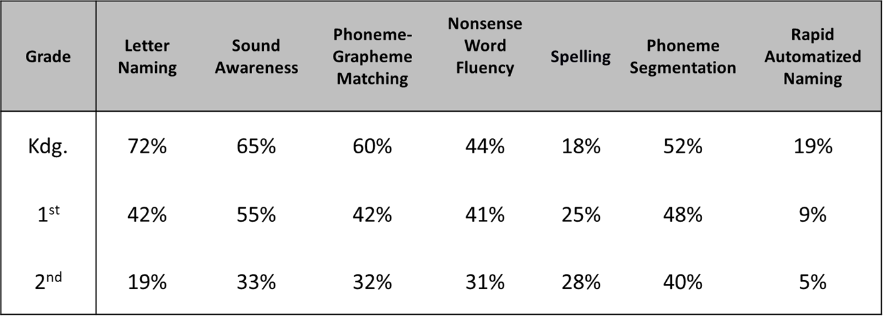
Findings
Percent of respondents who indicated that their school administered each of these early literacy measures at least twice a year to students in grades K-2.

Slide 16
Teacher Training

Slide 17


Slide 18
Overview of the UGA GCD Program
UGA’s Online Graduate Certificate in Dyslexia is designed to provide educators with specific knowledge related to reading disability, including reading and language development; assessment; and instruction and remediation.
The program combines academic coursework, 30 hours of training in the Orton Gillingham approach for reading intervention, and hands-on experience in implementing and applying research-based intervention and instruction.
It conforms to the International Dyslexia Association's (IDA) standards for preparation, certification, and professional development of teachers who serve students with reading difficulties.
Currently, no other institutions of higher education in the state of Georgia offer explicit and focused training in dyslexia as part of their graduate degree program or as a stand-alone graduate certificate program.

Slide 19



UGA GCD Current Funding
Zeist Foundation is funding 20 teachers (10 per cohort) from Atlanta Public Schools (Thomasville Heights and Slater Elementary)
In partnership with The Atlanta Speech School and The Schenck School
Teachers were nominated by their administrators; will serve as literacy/dyslexia specialists
Funding covers tuition, student fees, and course materials
On-site visits each fall and spring to The Atlanta Speech School and The Schenck School to conduct classroom observations, meet with leadership team, and learn about admissions and assessment process

Slide 20
Recommendations

Slide 21
Recommendation 1
    In grades K-2, use data collected through RTI process to identify students who are at-risk for dyslexia
      AimsWeb, DIBELS, G-Kids, iReady, Star Enterprise, KREP
      Systematically apply cut scores (e.g., scores ≤ 25th %ile on
      4/5 measures)
    Place those students in Tier 2 to receive specialized instruction by a Dyslexia Specialist (see Recommendation 4)

Slide 22
Recommendation 2
  Provide professional development to current Early
  Childhood (K-2) teachers to improve instructional
  practices related to reading instruction
    Online modules focusing on early indicators of dyslexia
    and structured literacy approaches

Slide 23
Recommendation 3
  Work with Early Childhood teacher preparation programs to ensure that a minimum of one course focused specifically on structured literacy approaches is included in their program of study
      (a) explicit, systematic, and sequential teaching of literacy at multiple levels—phonemes, letter–sound relationships, syllable patterns, morphemes, vocabulary, sentence structure, paragraph structure, and text structure;
      (b) cumulative practice and ongoing review;
      (c) a high level of student– teacher interaction;
      (d) the use of carefully chosen examples and nonexamples;
      (e) decodable text; and
      (f) prompt, corrective feedback

Slide 24
Recommendation 4
  Train current EIP teachers to become Dyslexia
  Specialists (1-2 per school)
  Utilize those EIP teachers to provide systematic,
  multisensory instruction to students at-risk for, or
  already identified, with dyslexia (not all Tier 2 students)

Slide 25

Questions?

