Slide 1
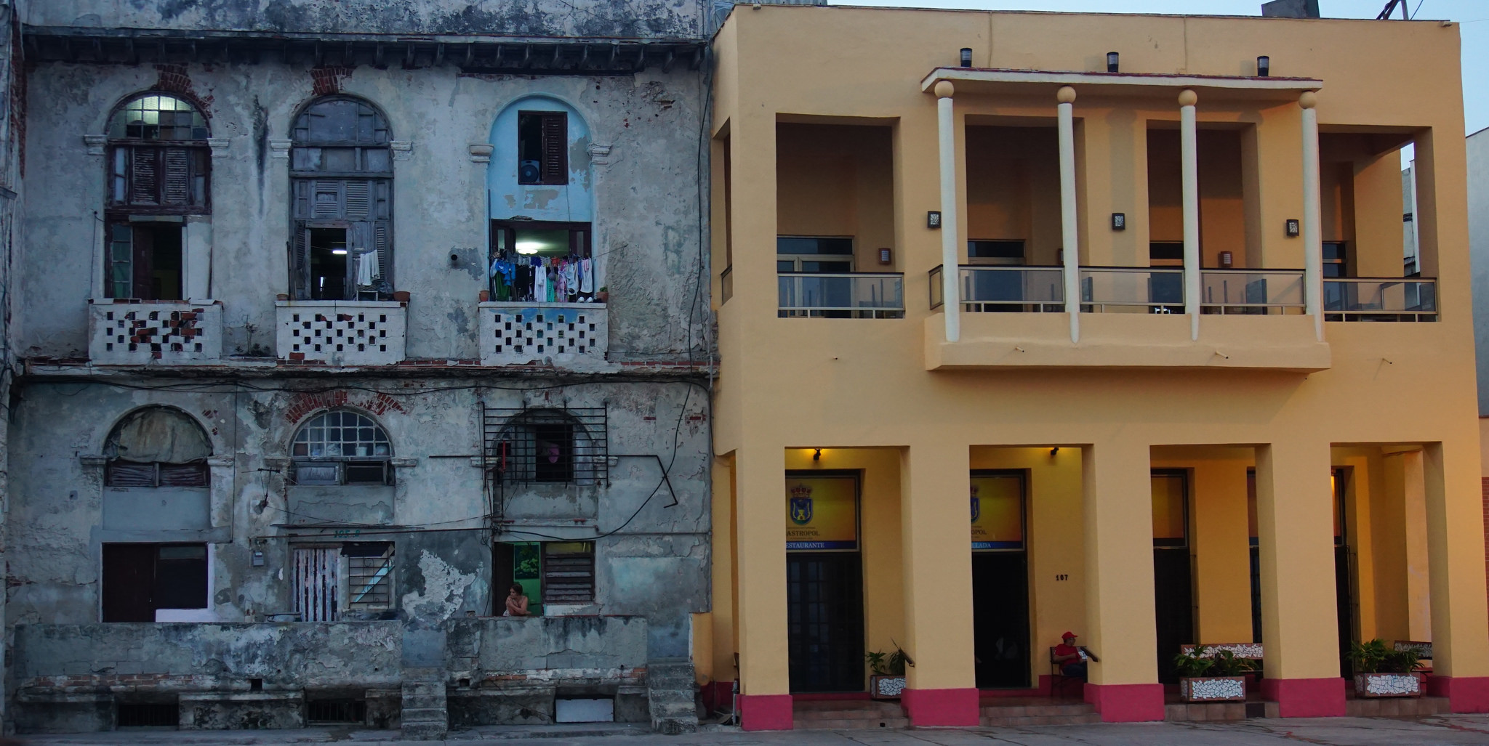

The Effect In Georgia of
Normalization of Relations with Cuba
Ambassador Charles Shapiro
President, World Affairs Council of Atlanta
www.wacatlanta.org
@shapiro_wac

Slide 2
Normalization
Diplomatic Relations
Trade
Executive Branch
Naming of Ambassador Requires Senate Confirmation
Embargo is law, not policy

Slide 3
Diplomatic Relations should be the norm
          Cuba
          Iran
          North Korea

Slide 4
Trade Relations
U.S. has restrictions on trade with:
    Cuba
    Iran
    North Korea
    Sudan
    Syria
    Burma (Myanmar)

Slide 5
2015 U.S. Ag Exports to Cuba

Slide 7
Georgia and Cuba
Hartsfield-Jackson
Port of Savannah

Slide 8


