Slide 1
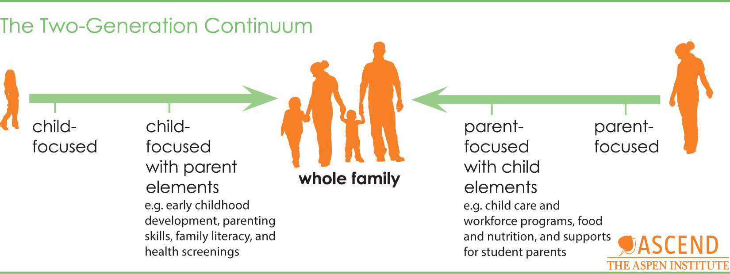
A multigenerational approach works best

Slide 2
Forces effecting children, adults and families
Language Nutrition | Health | Transit/Access
Developmental activities | Housing | Employment
Healthy relationships | Food/Nutrition | Financial
Support System | Education | Relationships
Other | Other | Other

