Slide 1

Presentation to Senate Study Committee on Evaluating E-scooter and other Innovative Mobility Options for Georgians
Andrew J. Heath, P.E.
State Traffic Engineer
November 4th, 2019

Slide 2
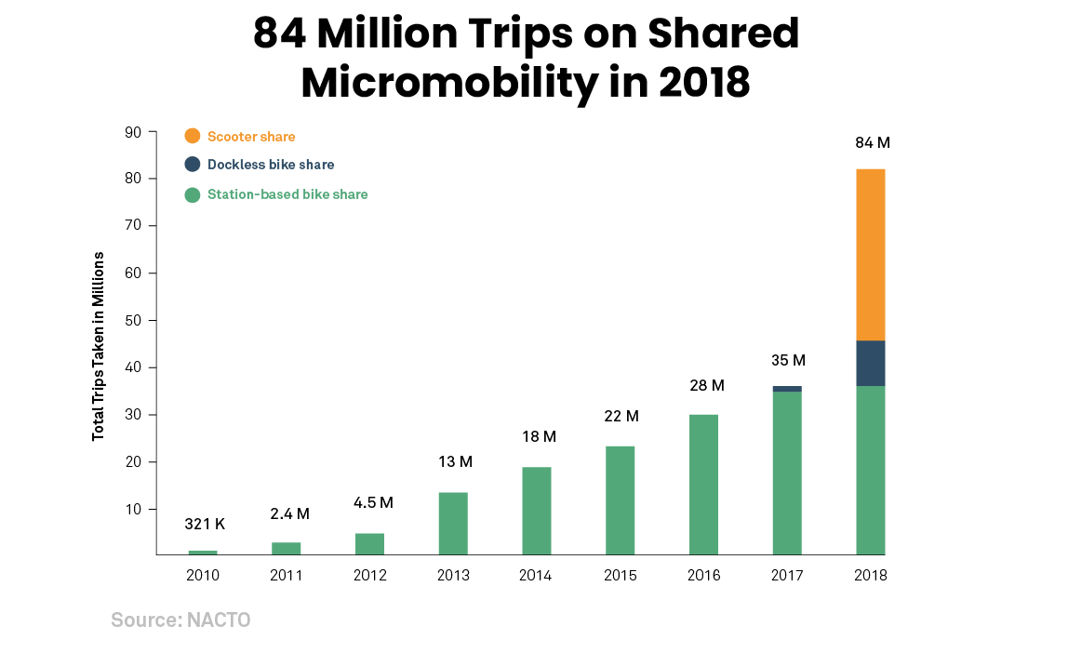
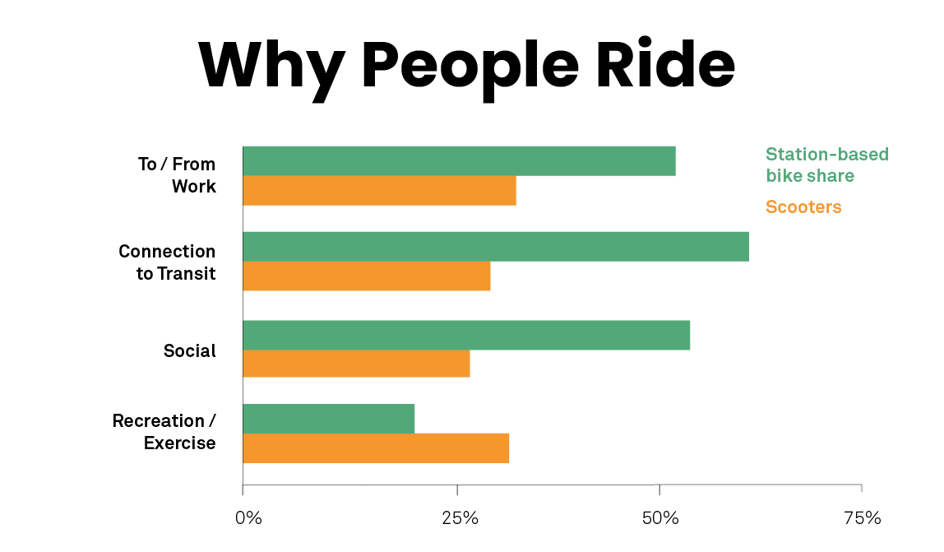
Addressing Last Mile Connectivity
Notes:
Blaine Leonard
Introduce the Challenge, refer to the map of participants

Slide 3
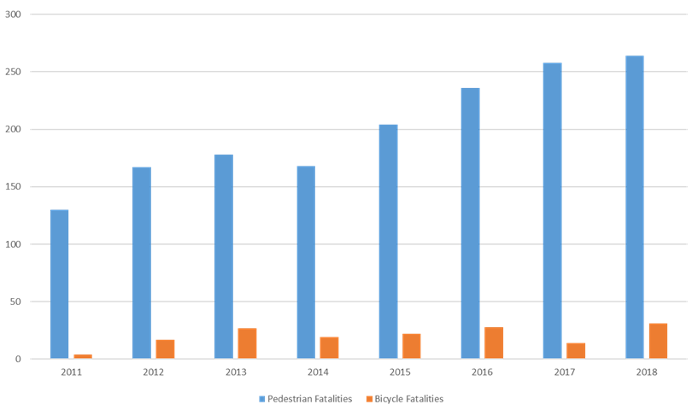
Pedestrian & Bicyclist Safety
Notes:
Blaine Leonard
Introduce the Challenge, refer to the map of participants

Slide 4
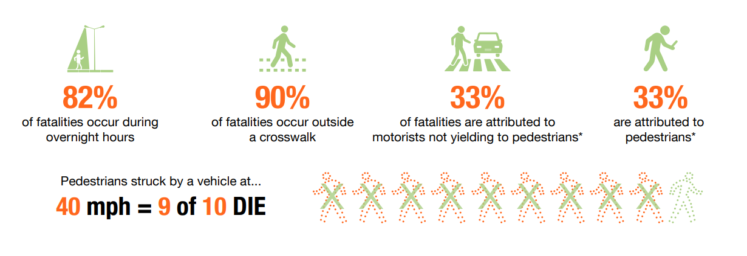
Micro Mobility & Vulnerable Users
Commonality in Safety Trends/Concerns
Notes:
Blaine Leonard
Introduce the Challenge, refer to the map of participants

Slide 5

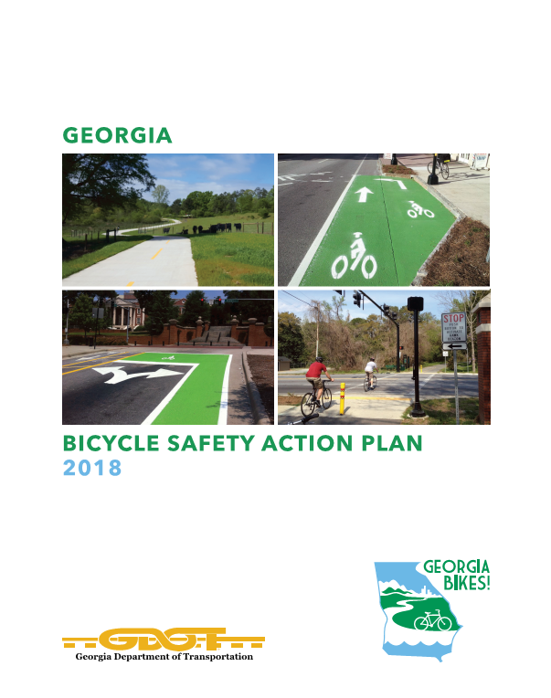
GDOT Tools
Pedestrian & Bike Safety Action Plans
Notes:
Blaine Leonard
Introduce the Challenge, refer to the map of participants

Slide 6
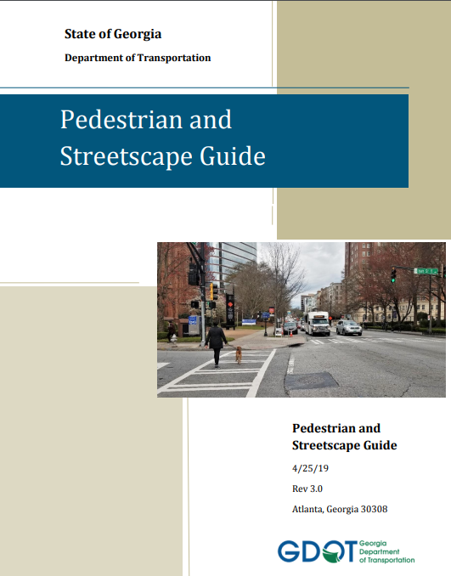
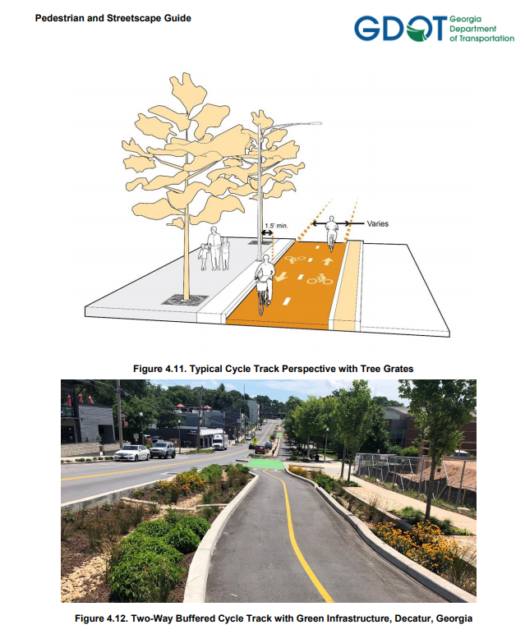
GDOT Tools
Pedestrian Streetscape Guide & Complete Streets Policy
Notes:
Blaine Leonard
Introduce the Challenge, refer to the map of participants

Slide 7

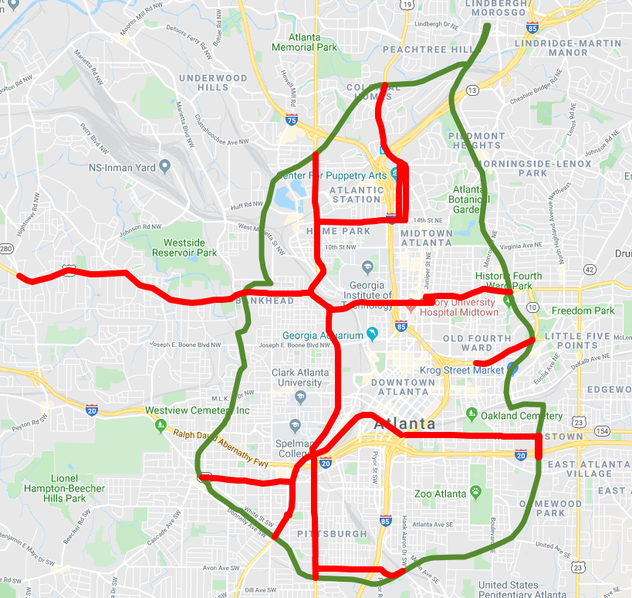
Working in Partnership with Locals
City of Atlanta
Notes:
Blaine Leonard
Introduce the Challenge, refer to the map of participants

Slide 8
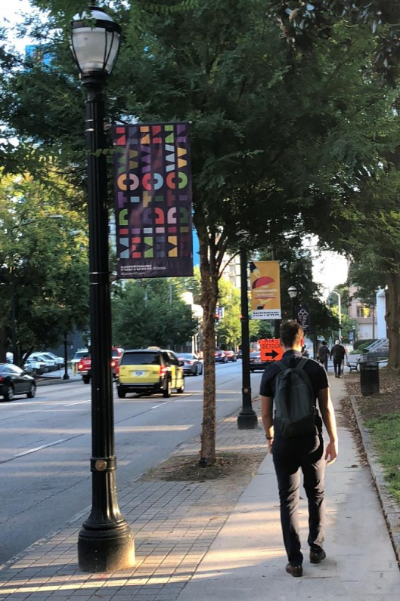
Questions & Challenges
Encourage Deployment and Provide a Safe Environment
    How to apply right tools in the toolbox (Infrastructure)
    Coordination with Local Governments on ordinance specifics
    Education, Enforcement, Engineering
Defining the Technology
    Crash Reports
    Data Collection/Usage
Enable technology to fit into transportation network
    Pace of Change
Notes:
Blaine Leonard
Introduce the Challenge, refer to the map of participants

Slide 9
Questions?
Andrew J. Heath, P.E.
aheath@dot.ga.gov
404-635-2828
Notes:
Blaine Leonard
Introduce the Challenge, refer to the map of participants

