Slide 1

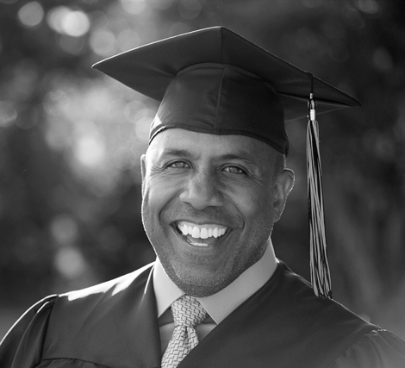




Slide 2
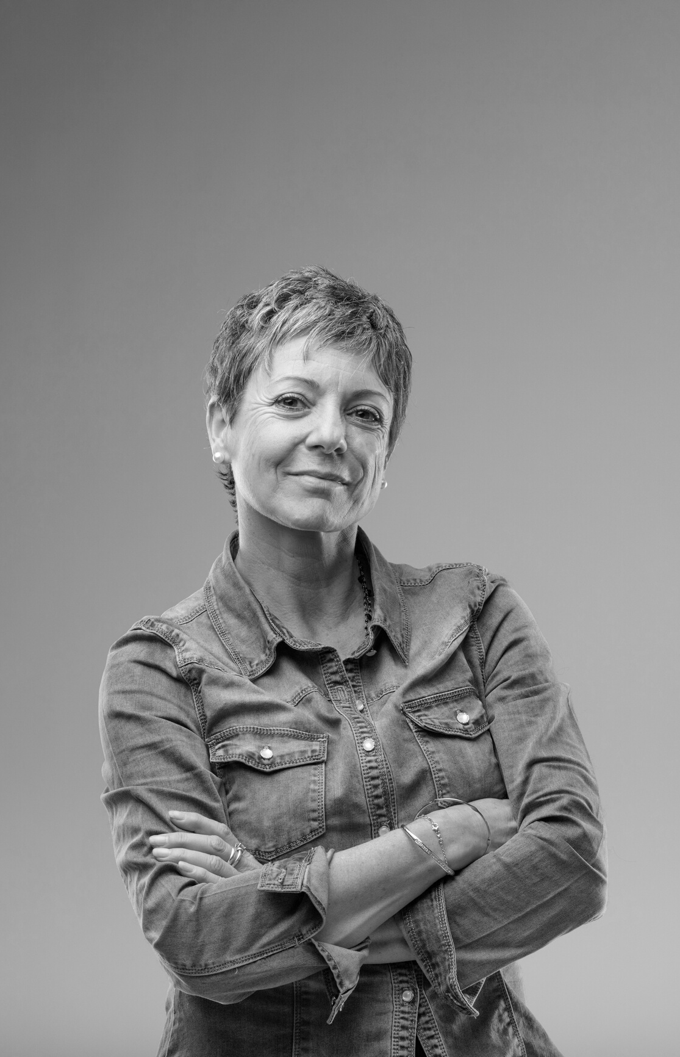

The Office of Adult Education is a Division of the Technical College System of Georgia. The office provides oversight to adult education and literacy programs across the state in the following areas:
Adult Secondary Education
High School Equivalency
Adult Basic Education
Adult Literacy
English & Citizenship
Classes
Family Literacy
Job Training

Slide 3

Credentialing and Oversight
GED® Testing
HiSET® (new in FY21)
Career Plus (new in FY20)

Slide 4
Adult Education Funding
Workforce Innovation & Opportunity Act (Federal)/Title II - Adult Education & Family Literacy Act (AEFLA)
Annual State appropriation
Continuation after first year based on meeting milestones, including measurable skill gains; employment; attainment of a secondary school diploma; and transition to postsecondary education and training.
Subsequent Years
Funding based on performance for future continuations.

Slide 5


Student Outcomes
In the last year…
Over the last decade…
32,205 adult learners served in all 159 counties
6,271 GEDs awarded
678 industry-recognized credentials earned
1 in 4 graduates transitions to postsecondary within 1 year
588,644 adult learners served in all 159 counties
119,111 GEDs awarded
68% entering below 9th grade level

Slide 6
National Recognition
Feature presenter for Burlington English regarding WIOA focus during COVID-19
Featured presenter for National Training Institute
Featured article in COABE journal regarding Integrated Education and Training (IET)
Selected instructors for Teaching Skills That Matter

Slide 7
“For instance, several adult learners who completed the medical administrative assistant IET program are now employed as patient aides or bilingual medical administrative assistants. One student who completed the information technology IET decided to enroll at GTC to pursue an Associate’s Degree in computer science and secured an internship with GTC’s information technology department.”
- Spring 2020/Tio, R. & Overby, L., COABE Journal
Workforce Preparation

Slide 8
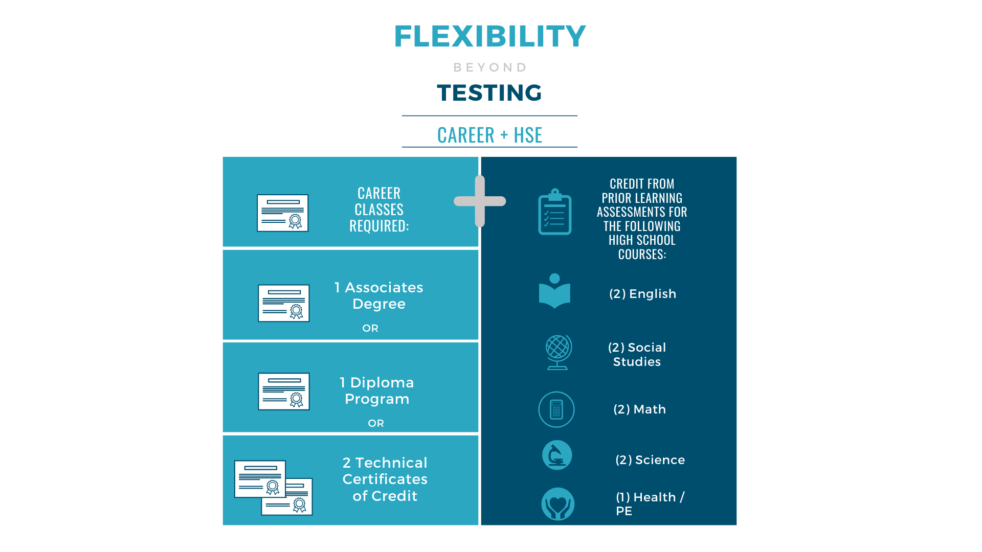

Slide 9
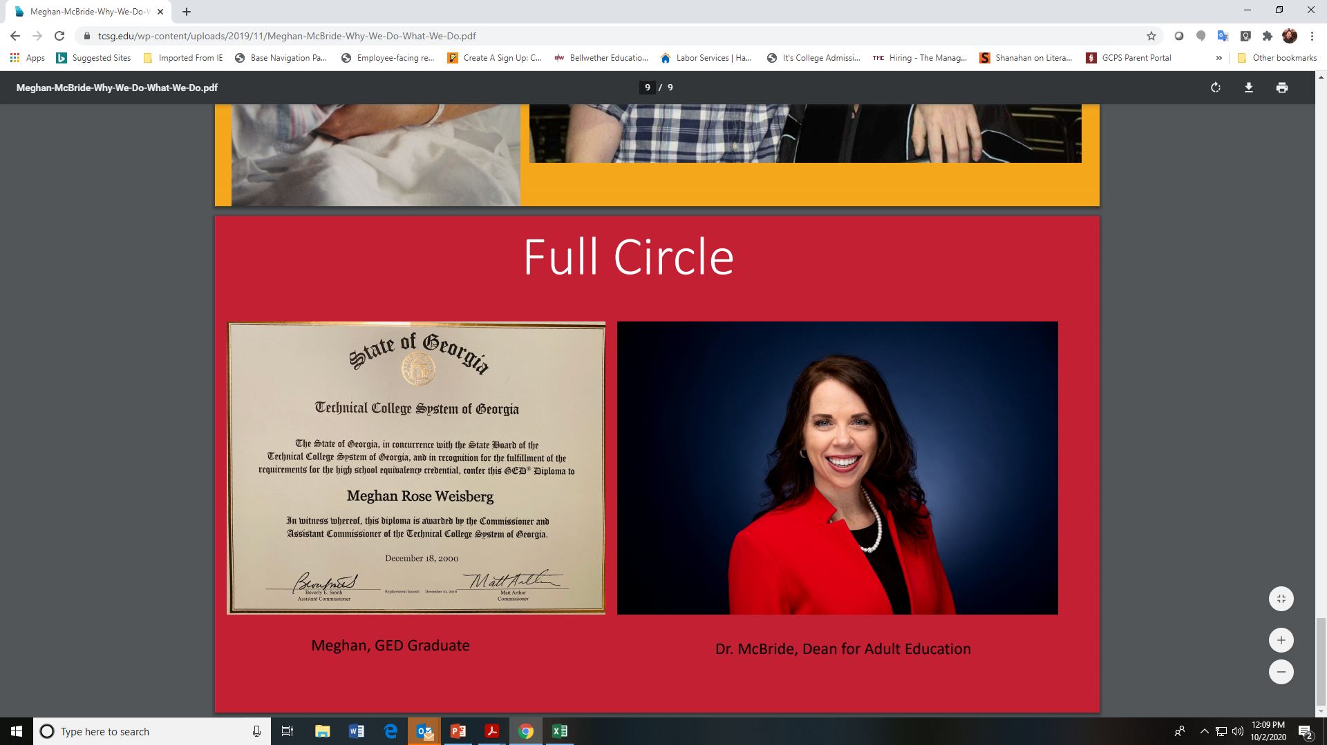
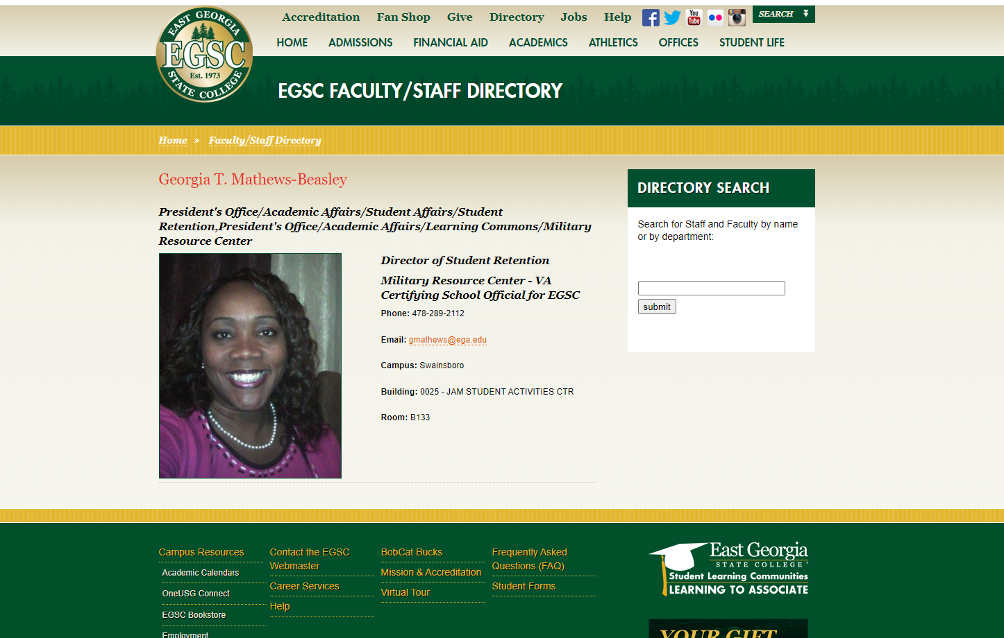
Georgia Adult Education Success Stories
Jonathan Swinsburg, Athens Technical College instructor and program chair, a 2016 Hart County Honors GED® graduate
Featured COABE keynote speaker, Dr. Meghan McBride
Georgia Matthews, Director of Admissions, East Georgia State College

