Slide 1


PORTABLE BENEFITS:
A SOLUTION FOR TODAY’S ECONOMY
Shelly Steward, PhD
Atlanta, Georgia
October 30, 2019
Notes:
A generation ago, many workers in the US accrued benefits through their jobs
System developed through second half of 20th century, product of collection action, compromise, and legislation
Rather than a cohesive, comprehensive system, it developed piecemeal from specific historical moments
Health insurance first offered during federally imposed pay freeze to prevent inflation in 1942
System offered security to the economy
Employers saw workers as central to their profits, invested in workforce to increase growth and drive retention
Workers saw their jobs as long term sources of security
Still left many out in law or in practice—especially people of color and women
These shortcomings have become more pronounced, and impacted more and more workers, as we’ve entered a new century

Slide 2

ABOUT THE FUTURE OF WORK INITIATIVE
The Aspen Institute Future of Work Initiative is a nonpartisan effort to identify concrete ways to address the challenges American workers and businesses face due to the changing nature of work in the 21st century. The Initiative focuses on policy ideas at the federal, state, and local level to:
1
Improve economic security for both traditional and non-traditional workers
2
Expand investment in and access to effective education and training programs
3
Reduce pressure on public companies to prioritize short-term profits and encourage investment in long-term value creation

Slide 3

PORTABLE BENEFITS:
A SOLUTION FOR TODAY’S ECONOMY
1
WHAT’S WRONG WITH WORKPLACE BENEFITS TODAY?
2
PORTABLE BENEFITS: DEFINITION AND DESIGN QUESTIONS
3
MOVING FORWARD: APPROACHES AND EXAMPLES

Slide 4
DEFINITIONS
WORKERS
Individuals who earn income for labor performed. This includes those who perform labor across any work arrangement, including employees as well as independent contractors (sometimes referred to as the self-employed, sole proprietors, entrepreneurs, freelancers, or small-business owners).
        EMPLOYERS
        We use this term in its common speech meaning—one that employs or makes use of something or somebody, where “employs” means “to use or engage the services of”—and not its legal meaning relative to worker classification.
TRADITIONAL WORK
Permanent, full-time, year-round work, with workers classified as employees.
NON-TRADITIONAL WORK
Work that falls outside traditional work as defined above. This includes both independent contract work and employment that is part-time, short-term, subcontracted, on-call, or seasonal.
Notes:
The issue of worker classification is highly relevant to the issue of benefits because there is a significant discrepancy in benefits coverage between employees—especially full-time employees—and independent contractors. Workers are classified as either employees or independent contractors. Typically, employees are hired to work directly for a company or individual, whereas independent contractors are hired to perform discrete services or tasks. Employees are covered by federal and state labor laws, including the Fair Labor Standards Act, which ensures minimum wage and overtime pay. Their employer withholds income taxes, pays payroll taxes on their behalf (including Social Security, Medicare, and state Unemployment Insurance), and issues a Form W-2 documenting their income annually. Independent contractors are not typically covered by federal or state labor laws. The company that hires them generally does not withhold taxes or make Social Security or Medicare contributions on their behalf. Independent contractors usually receive a Form 1099 from each company that hires them. There is not one set of criteria used for determining whether a worker should be classified as an employee or an independent contractor. The Internal Revenue Service, the U.S. Department of Labor, and state Departments of Labor all offer guidance on how to classify workers. Although varying in specific criteria and level of complexity, all forms of guidance consider the degree of control the hiring party has in its relationship with the worker. In general, the more control the hiring party has, the more likely the worker should be classified as an employee rather than an independent contractor. Misclassification is when a company hires a worker as an independent contractor, but in fact, the relationship with the worker is that between an employer and employee. Although hiring independent contractors can be less expensive for companies, if courts or government agencies determine a company has misclassified employees, the company faces fines and retroactive payments. A number of high-profile misclassification lawsuits in the past decade have drawn increased attention to the issue, including several addressing whether workers who arrange jobs through certain online platforms should be classified as employees or independent contractors.

Slide 5




HOW WORK HAS CHANGED
RETIREMENT?
Social Security Trust Fund exhausts by 2035
401(K)
RETIREMENT
Social Security
Medicare
Employer pension
CAREER
CAREER
Multiple jobs over career
Rise of on-demand economy and non-traditional work
Increased financial insecurity
Employer benefits (health care, retirement)
Government protections (minimum wage, collective bargaining, overtime, anti-discrimination)
EDUCATION
EDUCATION
Universal high school movement
Higher Education Act
GI Bill
Student debt
Value of 4-year vs. 2-year
Alternative pathways
Notes:
Past system developed largely out of historical accident
It seems intuitive because it’s been that way for so long, but it does not match the realities of today
Left out many, especially typically underserved populations, and was particularly difficult for small businesses to deal with.

Slide 6
OUR SYSTEM OF BENEFITS
IS INADEQUATE
BUSINESSES
Need new ways to invest in workers that match the realities of today’s economy
WORKERS
Have increased financial insecurity
Are left with a fractured, complex, and expensive landscape of options
Are unable to move jobs, explore new opportunities, or become entrepreneurs

Slide 7
NON-TRADITIONAL WORK LANDSCAPE
Non-traditional work
Employment classification
Employee
Independent contractor
IRS designation
W-2
1099
Does worksite entity pay worker?
Yes, worker paid directly
No, worker employed and paid by intermediary
Varies
Bureau of Labor Statistics designation
Full-time
Part-time
On-call
Temporary help agency
Contract firm
Independent contractor
Representative occupations
Office clerk
Machine operator
Physician assistant
Flight attendant
Retail cashier
Bartender
Adjunct professor
Fitness instructor
Substitute teacher
Farm laborer
Construction worker
Receptionist
Warehouse associate
HR specialist
Security guard
Janitor
Software developer
Real estate agent
Massage therapist
Rideshare driver
Musician
Hair stylist
A range of benefits mandated by law; others voluntarily provided
Some benefits mandated by law; few benefits typically voluntarily provided by employers
Few benefits mandated by law or voluntarily provided
Access to benefits
Notes:
Non-traditional arrangements have always existed, but have grown in prevalence.
Colloquially, non-traditional work is often called “gig work.”

Slide 8


HOW MANY GIG WORKERS ARE THERE?
ENGAGED IN ANY CAPACITY
Primary and supplementary work
About 1 in 3
AS MAIN JOB
Independent work is primary
About 1 in 10
ONLINE PLATFORMS
Uber, Lyft, TaskRabbit, and others
Less than 1%
Total U.S. workforce

Slide 9

WHAT’S HAPPENING IN GEORGIA?
Atlanta saw a 51.9 percent increase in transportation industry gig employment from 2012 to 2014
compared to a 48 percent increase nationally, and a 4.2% decrease in payroll employment.
5.4 percent of workers in Georgia are unincorporated self-employed workers
compared to 6.4 percent nationally.
2.3 percent of Georgia’s workforce generates income using online platforms, the second highest rate of all states
compared to 1.6 percent nationally.
3.7 percent of workers in Georgia do not expect their job to last
compared to 3.8 percent nationally.
Based on October 2017. Source: The Online Platform Economy in 2018, September 2018 JPMorgan Chase Institute.
Source: 2015 Nonemployer Statistics, US Census Bureau, compiled by Brookings Metropolitan Policy Program
Source: 2017 Contingent Worker Supplement, May 2017 Current Population Survey, Bureau of Labor Statistics
Source: March 2015 Current Population Survey, Bureau of Labor Statistics
Notes:
As difficult as data is at the national level, it’s even harder at the state level.
Some of the few sources we have, all of which should be understood as individual data points that are part of a bigger picture we’re still working to understand.
A hotspot for the online platform economy
At or slightly below national measures of other non-traditional work
Georgia is the top state for film production, an industry which is comprised largely of independent workers

Slide 10
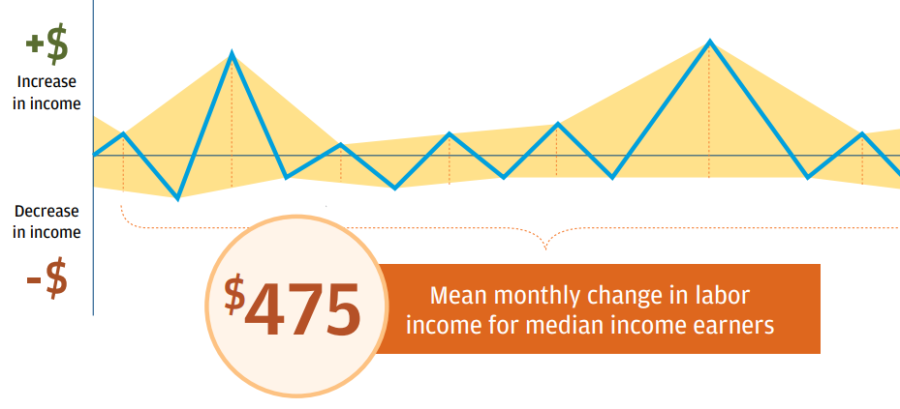
FINANCIAL INSECURITY TODAY
FOUR IN TEN ADULTS CANNOT AFFORD AN EMERGENCY EXPENSE OF $400
FINANCIAL PLANNING IS DIFFICULT FOR NON-TRADITIONAL WORKERS, WHOSE INCOME OFTEN FLUCTUATES MONTH-TO-MONTH.
Source: Survey of Household Economic Decision-Making. Federal Reserve. 2019,
Source: The Online Platform Economy in 2018, September 2018 JPMorgan Chase Institute.
Notes:
Workplace benefits have the potential to mediate the insecurities of today’s world, but increasing numbers of workers are left without.

Slide 11
EMPLOYER-PROVIDED BENEFITS
BENEFITS | TRADITIONAL WORKERS | NON-TRADITIONAL WORKERS
 | PERMANENT, FULL-TIME EMPLOYEES | OTHER EMPLOYEES | INDEPENDENT CONTRACTORS
HEALTH INSURANCE | Usually; required by federal law for employers with 50+ full-time employees | Sometimes; part-time and short-term workers not included in mandate | Can access plans through ACA without employer contributions
SOCIAL SECURITY/ MEDICARE | Yes; required by federal law | Yes; required by federal law | No employer contributions; worker pays both employer and employee contributions
UNEMPLOYMENT INSURANCE | Yes; required by state law in most states | Depends on state UI regulations | No
SPONSORED RETIREMENT | Often; employer contributions not required | Sometimes; though employer contributions are rare | Rare; self-funded plans available
WORKERS’ COMPENSATION | Yes; required by state laws* | Yes; required by state laws* | Rare
TEMPORARY DISABILITY | Often; required by law in some states | Unknown** | Rare; self-funded plans available

Slide 12
EMPLOYER-PROVIDED BENEFITS
BENEFITS | TRADITIONAL WORKERS | NON-TRADITIONAL WORKERS
 | PERMANENT, FULL-TIME EMPLOYEES | OTHER EMPLOYEES | INDEPENDENT CONTRACTORS
LIFE INSURANCE | Often | Unknown** | Rare; self-funded plans available
PAID SICK LEAVE | Often; required in some states and cities | Unknown** | Rare
PAID FAMILY & MEDICAL LEAVE | Unpaid leave required for employers with 50+ full-time employees; paid leave required in some states | Both federal unpaid leave and state paid leave required for many but may be limited due to eligibility requirements | Rare; though able to opt in to some state programs
PAID VACATION | Sometimes | Rare | Rare
CHILD CARE ASSISTANCE | Rare | Rare | Rare
EMERGENCY CASH SAVINGS | Rare | Rare | Rare

Slide 13
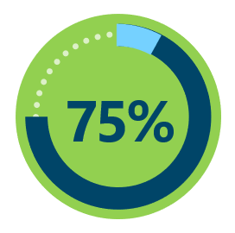
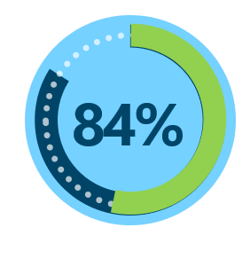
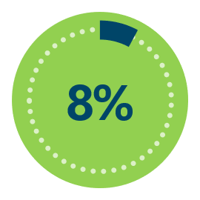
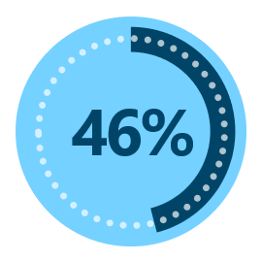
GIG WORKERS LACK BENEFITS
EMPLOYER-SPONSORED HEALTH INSURANCE
EMPLOYER-SPONSORED RETIREMENT PLANS
8%
53%
Non-traditional Workers
Traditional Workers
Non-traditional Workers
Traditional Workers
75% of non-traditional workers have health insurance through some means, compared to 84% of traditional workers
Source: 2017 Contingent Worker Supplement, May 2017 Current Population Survey, Bureau of Labor Statistics

Slide 14
PORTABLE BENEFITS:
A SOLUTION FOR TODAY’S ECONOMY
1
WHAT’S WRONG WITH WORKPLACE BENEFITS TODAY?
2
PORTABLE BENEFITS: DEFINITION AND DESIGN QUESTIONS
3
MOVING FORWARD: APPROACHES AND EXAMPLES

Slide 15
WHAT ARE PORTABLE BENEFITS?
PORTABLE
Benefits are connected to an individual, rather than a single employer, and can be taken from job to job without interruption in coverage or loss of funding
PRORATED
Benefits can be funded by contributions from a variety of sources - including employers, customers, government, and workers - either simultaneously or sequentially
Contributions can be allocated in proportion to hours worked or other relevant units of labor
UNIVERSAL
Benefits are accessible to all workers, regardless of hours worked or type of work arrangement.

Slide 16
GOALS OF PORTABLE BENEFITS
IMPROVE FINANCIAL SECURITY OF ALL WORKERS
The social safety net our nation built to help ensure economic security for hard-working Americans has not kept pace with changes in the economy.
Portable benefits models aim to extend essential benefits to more workers.
CREATE MORE EQUITY BETWEEN TRADITIONAL AND NON-TRADITIONAL WORKERS
Companies have a strong financial incentive to hire workers as independent contractors, for whom they are not required to provide benefits.
Portable benefits can narrow the differences between traditional and non-traditional workers and their ability to access benefits and protections.
FUEL A MORE DYNAMIC LABOR MARKET
With benefits that are portable across work arrangements, individuals have the protection they need to make a job change or take on an entrepreneurial endeavor.

Slide 17
PORTABLE BENEFITS’ BENEFITS
WORKERS
Opportunity to accrue not only income but also benefits across sources of income
WORKER ADVOCATES
Opportunity to build a constituency and revenue model around provision of benefits
EMPLOYERS
Limits administrative burden and requires less specialized in-house expertise (especially for small businesses)
POLICYMAKERS
Broader benefits coverage would reduce burden on public safety net programs
Ownership of benefits makes it easier to move from job to job
Reduced cost through group purchasing power
Could serve groups such as domestic workers, who have been working without a functional set of benefits/protections for many years
Could create benefits access for workers at small businesses currently excluded from many benefit mandates
Potential to attract and retain talent in a competitive employment market
Opportunity to improve worker security across work arrangements
Address long-term economic concerns associated with retirement and health care costs

Slide 18
TWO APPROACHES
PORTABLE BENEFITS POLICY
Create a new portable benefits system
Expand existing and emerging government programs
Notes:
Additional approaches can, and may need to be considered along with portable benefits in order to improve financial health for workers.
Pay
Workplace protections
Worker classification

Slide 19
PORTABLE BENEFITS:
A SOLUTION FOR TODAY’S ECONOMY
1
WHAT’S WRONG WITH WORKPLACE BENEFITS TODAY?
2
PORTABLE BENEFITS: DEFINITION AND DESIGN QUESTIONS
3
MOVING FORWARD: APPROACHES AND EXAMPLES

Slide 20
TO CONSIDER: FOUR DESIGN QUESTIONS
What benefits will be included?
Who will be eligible for benefits?
How will benefits be funded?
Who will administer benefits?

Slide 21
WHAT BENEFITS WILL BE INCLUDED?
OPTIONS
CONSIDERATIONS
  A wide range of benefits could be offered, from health insurance and retirement to training programs and childcare allowances.
  Some benefits pool risk among participants, while others are held as individual accounts.
  Which benefits do workers value most?
  Which benefits could improve sustainability of public programs?
  Should the inclusion of certain benefits be required or should benefits selection be left to designated administrators?

Slide 22
WHO WILL BE ELIGIBLE?
OPTIONS
CONSIDERATIONS
  Those in specific work arrangements, such as independent contractors or short-term workers
  A subset of workers within an arrangement, such as online platform workers
  Workers in specific industries or occupations
  How does defining a population of workers impact how portable benefits are?
  Should self-employed individuals and small businesses be able to opt in to coverage?
  Should all eligible workers be required to participate?

Slide 23
HOW WILL BENEFITS BE FUNDED?
OPTIONS
CONSIDERATIONS
  Employers
  Customers
  Government
  Workers
  What is the funding mechanism?
  How do models relate to existing programs and regulatory frameworks?
  Should contributions be mandatory or voluntary, particularly for employers and/or customers?

Slide 24
WHO ADMINISTERS THE BENEFITS?
OPTIONS
CONSIDERATIONS
  Government
  Nonprofit
  For-profit
  Are administrators financially sustainable?
  To whom do administrators have fiduciary duty?
  Do workers have a voice in governance?

Slide 25
BASIC APPROACHES
LEARN MORE
ENCOURAGE INNOVATION
Use data to better understand the relevant worker population
Designate a responsible body or party
Establish
benefits innovation fund
Encourage private and nonprofit innovation
Engage philanthropy
INFORMS
USE POLICY TO CREATE PORTABLE BENEFITS
INFORMS
Expand existing and emerging government programs
Create a new portable benefits system

Slide 26
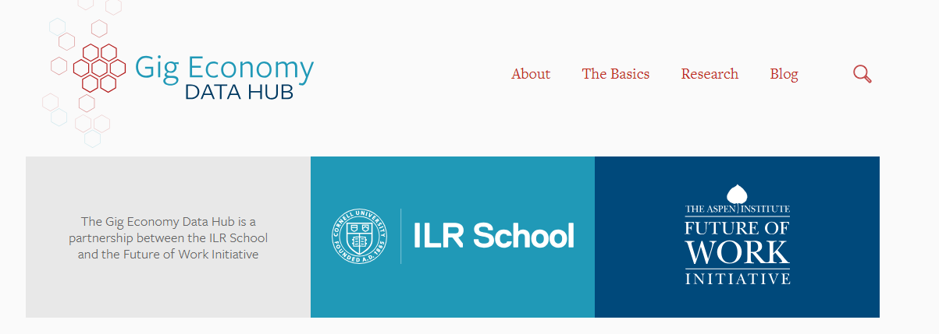
www.gigeconomydata.org

Slide 27
NEW POLICY APPROACHES
CREATE A BENEFITS EXCHANGE
Regulated exchange of private providers
Affordable Care Act
Washington Small Business Retirement Marketplace
SINGLE-PROVIDER PROGRAMS
Publicly designated private provider, subject to oversight
Black Car Fund
Auto-enrollment retirement programs with private administrators
PUBLIC OPTION
Government administered benefits
Social Security
Unemployment insurance

Slide 28
CREATE NEW POLICY MODELS
BLACK CAR
FUND
Applies to black car drivers in NY, including rideshare drivers
Legislatively created in 1999; expanded in 2017
Provides workers’ compensation insurance for drivers
Funded by 2.5% customer surcharge
WASHINGTON LEGISLATION
Applies to any company that connects workers with clients, online or offline
Requires company contribution to worker benefits fund, administered by a non-profit
Includes “hold harmless” provision to protect companies from misclassification accusations
ALABAMA LEGISLATION
Applies to online platform companies only
Defines worker as “Marketplace Contractor,” defining classification based on how work is arranged rather than nature of work relationship
Gives online platform companies the option to offer benefits but does not mandate or structure a program

Slide 29
EXPAND EXISTING POLICY MODELS
AUTO-ENROLLMENT IRAS
Example: OregonSaves
Requires employers that don’t provide retirement benefits to automatically enroll workers in a portable retirement benefits
Typically funded through voluntary employee contributions and privately managed
Programs have been created in 10 states, with some allowing the self-employed to enroll
EDUCATION AND TRAINING
Example: Lifelong Learning and Training Accounts
Portable accounts funded by workers, employers, and government, and could be used by workers to pay for education and training opportunities over the course of their career
Proposed at Federal level, in two states, and two cities
PAID FAMILY AND MEDICAL LEAVE
A social insurance program funded by employers and workers
Multiple-job holders are able to receive benefit
Some programs include and opt-in option for the self-employed
Passed in six states and the District of Columbia
Notes:
MODERNIZE UNEMPLOYMENT INSURANCE
Example: Self-Employment Assistance Program
Allows unemployed workers to continue receiving UI benefits while starting a business
Implemented in Mississippi and eight other states

Slide 30
FEDERAL LEGISLATION
PORTABLE BENEFIT INNOVATION FUND
Bipartisan, bicameral legislation introduced to create Department of Labor seed fund to incentivize state and local innovation
Introduced by Sens. Warner (VA) & Young (IN); Rep. DelBene (WA)
LIFELONG LEARNING & TRAINING ACCOUNTS
Bipartisan, bicameral legislation introduced to create portable accounts that help workers finance education and training opportunities throughout their career
Introduced by Sens. Klobuchar (MN) & Sasse (NE); Reps. Kilmer (WA) & Thompson (PA)
AFFORDABLE CARE ACT (ACA)
Government-run exchanges allow independent contractors to purchase health care benefits
1 in 5 of those who receive coverage through the ACA are small businesses or self-employed individuals

Slide 31
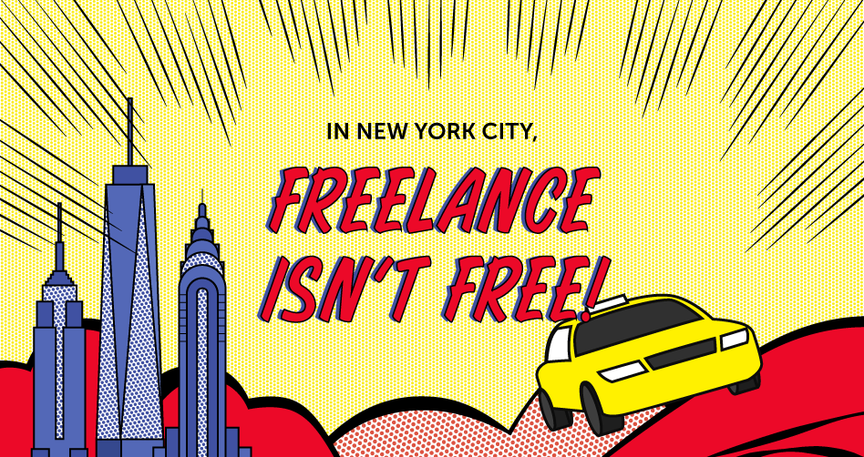


MUNICIPAL MODELS
FREELANCE ISN’T FREE ACT (NEW YORK CITY)
Provides basic protections for New York City freelancers, including the right to a written contract, timely and full payment, and protection from retaliation
SAMASCHOOL
(SAN FRANCISCO)
In partnership with San Francisco’s Office of Economic and Workforce Development, Samaschool helps prepare low-income populations to succeed as independent workers
DOMESTIC WORKERS
(SEATTLE)
Entitles house cleaners and other domestic workers in Seattle to minimum pay, rest breaks and representation on a special board

Slide 32

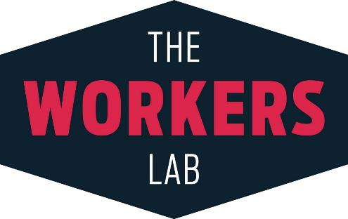
NON-PROFIT MODELS
ALIA / NATIONAL DOMESTIC WORKERS ALLIANCE
Online platform created to help house cleaners access benefits through client contributions
Cleaners can purchase benefits including: paid time off; disability, accident, critical illness, and life insurance
THE WORKERS LAB & THE ROCKEFELLER FOUNDATION
Design Sprint for Social Change to design ways to provide independent contractors access to $1,000 when needed for unexpected expenses

Slide 33

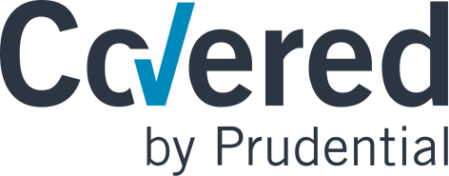

FOR-PROFIT MODELS
PRUDENTIAL - COVERED 1099
Tax withholding, short term savings, retirement and life insurance
Builds on proven expertise in insurance and financial management to expand offerings to new populations
CARE.COM
Benefits platform offering caregivers access to medical and dental insurance plans
Families can contribute to caregiver’s benefits just as traditional employers do for employees
CATCH.CO
Platform offering access to health plans, retirement accounts, tax and paid leave savings accounts and other benefits
Connects to bank accounts to streamline benefits contributions out of paychecks
Notes:
STRIDE
Platform to search, compare and purchase benefits, including: health coverage, tax-related mileage and expense tracking; dental, vision, accident, term life and disability insurance; and Health Savings Accounts and other short and long-term savings options
Partners with online platform companies and traditional employers

Slide 34
WHY PORTABLE BENEFITS
ALIGNS WITH WORK PATTERNS OF TODAY – AND TOMORROW
Creates benefits access model for all workers, regardless of work arrangement
ENABLES ACCESS TO TALENT
Helps employers attract and invest in unique talent, even on a short-term basis
PROMOTES ENTREPRENEURSHIP
Gives individuals financial security to support risk taking and new business creation

Slide 35
WHY PORTABLE BENEFITS POLICY
CREATES SHARED SET OF EXPECTATIONS
Levels the playing field
Promotes better planning and decision making
Fuels a dynamic labor market
Acknowledges multiple income earners’ need for benefits interoperability
FORWARD-LOOKING POLICY SIGNALS THAT GEORGIA IS OPEN FOR BUSINESS
Attracts cutting edge businesses
Appeals to unique talent
CREATES A WORKER-FRIENDLY ECOSYSTEM

Slide 36



CONTACT INFORMATION
Shelly.Steward@aspeninstitute.org
@ShellySteward
www.aspeninstitute.org/futureofwork
@AspenFutureWork

Slide 37
TODAY’S ECONOMY IS FAST-PACED AND FLEXIBLE
BUSINESSES
Must adjust hiring practices to ever-changing market pressures in order to stay competitive
Struggle to attract and retain talent
WORKERS
Face high levels of uncertainty and insecurity
Expect flexibility and mobility

Slide 38



EXAMPLE: FILM INDUSTRY
LONG STANDING EXAMPLE OF GIG WORK
Most work done by independent contractors on a temporary basis
BENEFITS ACCESS THROUGH GUILDS
All workers (union and non-union) accrue benefits funded by production companies but managed by guilds
WORK MAY BE INTERMITTENT BUT COVERAGE IS CONTINUOUS
Benefits follow workers from job to job

Slide 39
ALTERNATIVE WORK
ARRANGEMENTS BY INDUSTRY
Analysis of BLS data. U.S. Bureau of Labor Statistics, Contingent and Alternative Employment Arrangements, May 2017. https://www.bls.gov/news.release/pdf/conemp.pdf.

Slide 40
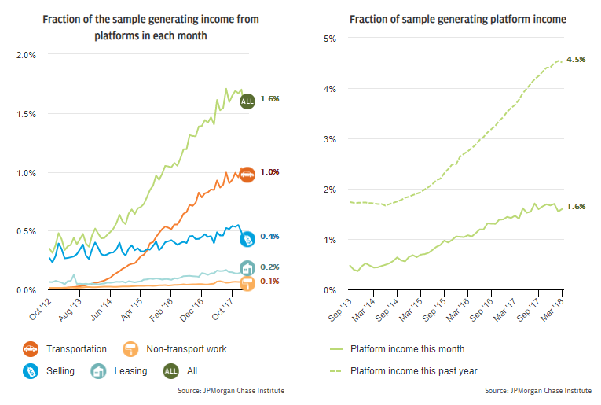
ONLINE PLATFORM ECONOMY
THE ONLINE PLATFORM ECONOMY HAS CONTINUED TO GROW – NOW ACCOUNTING FOR ROUGHLY 1.6 PERCENT OF THE WORKFORCE (BASED ON SAMPLE).
Notes:
But if you look at one area where there has been growth – that’s through online platforms. While small relative to the overall population of independent workers, this segment is growing very quickly.
According to a recent JPMorganChase study, the fraction of the sample earning platform income increased from 0.3 percent in the first quarter of 2013 to 1.6 percent in the first quarter of 2018. As of March 2018, 4.5 percent of families had participated in the Online Platform Economy at some point over the prior year. Between 2013 and 2018, transportation platforms have grown to dominate in terms of both the number of participants and total transaction volume. By March 2018, transportation platforms accounted for as many participants and as many dollars as the other three sectors combined.

Slide 41
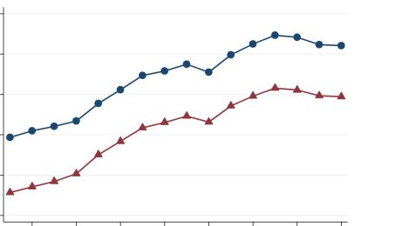
SIDE HUSTLES
Tax and other administrative data show steady increases in the number of people engaged in independent work.
13%
Percent of workers filing
Schedule SE
12%
Schedule C
11%
10%
9%
8%
2000
2002
2004
2006
2008
2010
2012
2014
Source: The Rise of Alternative Work Arrangements: Evidence and Implications for Tax Filing and Benefit Coverage, U.S. Department of the Treasury, 2017

Slide 42
NUMBER OF CONTRACTORS PER COMPANY
TASKRABBIT
140k
ROVER
300k
UBER
3.9m
LYFT
1.1m
DOORDASH
700k
HANDY
214k
POSTMATES
300k
INSTACART
70k
Source: Axios, April 2019
Notes:
Chart data: Lyft, Uber and Handy sourced from securities filings. TaskRabbit is for "background-checked" contractors, although not all are necessarily on the network currently. DoorDash, Instacart and Postmates data provided by companies to Axios. Axios also asked Caviar, which said "tens of thousands" and Wag, which declined to provide data.

