Slide 1


Slide 2
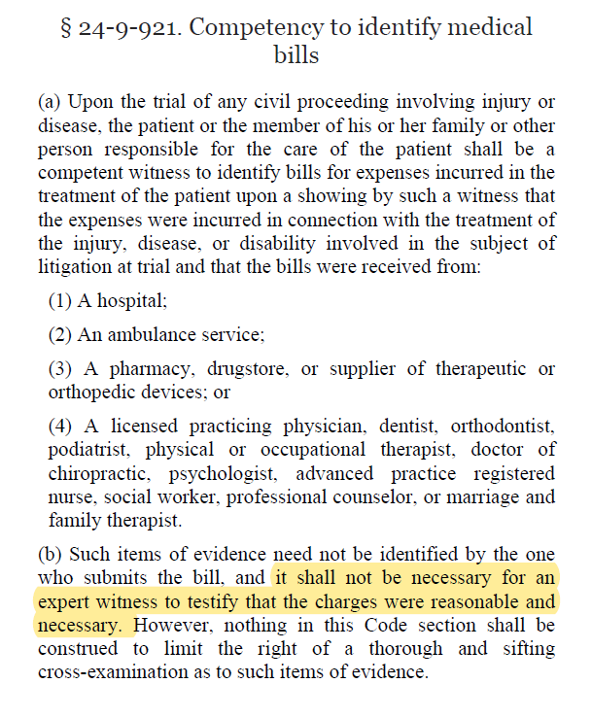

Slide 3
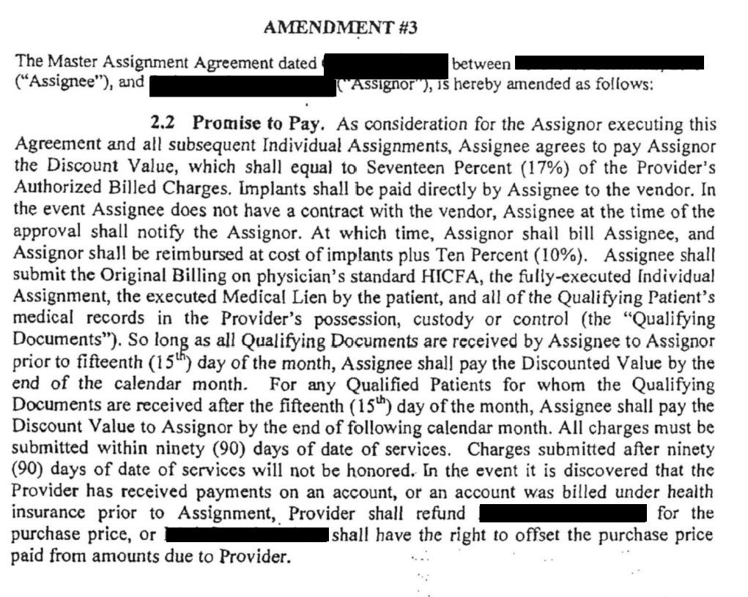

Slide 4
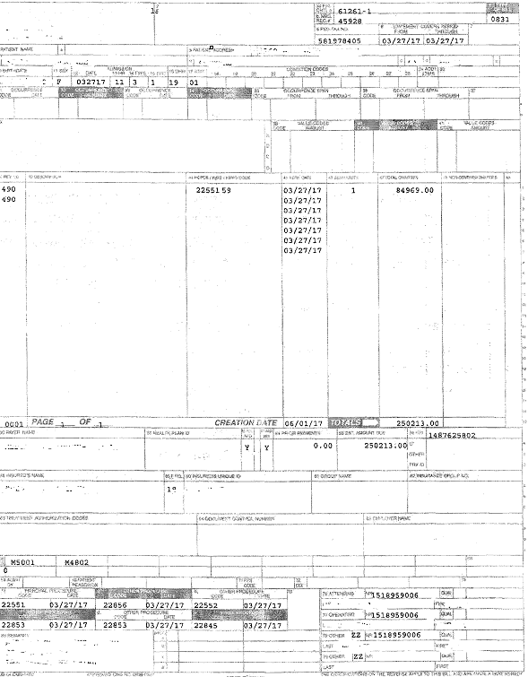

Slide 5
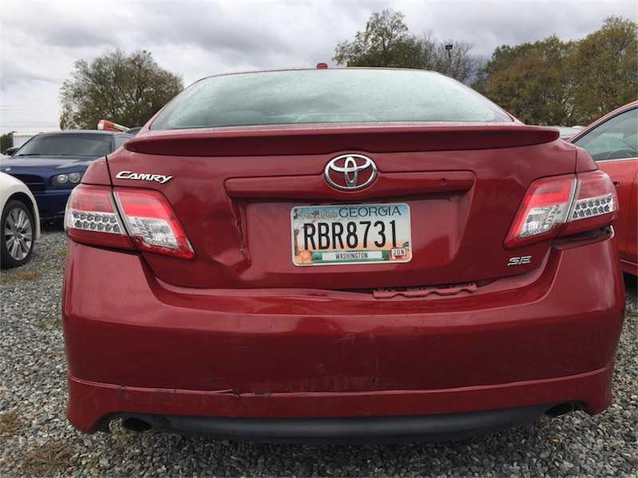
$124,000 in medical expenses

Slide 6
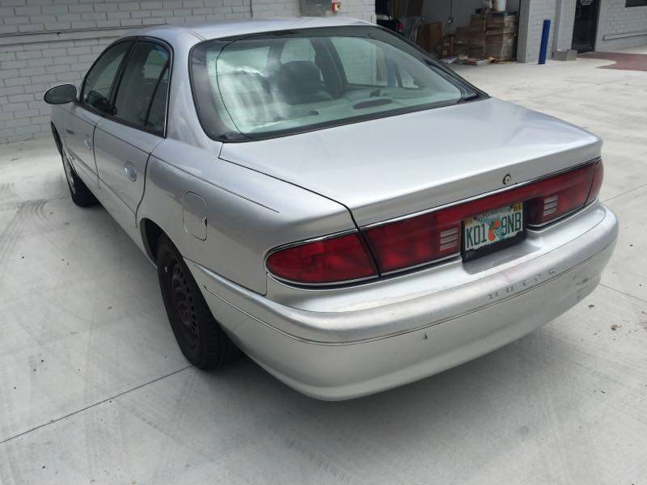
$162,000 medical expenses

Slide 7
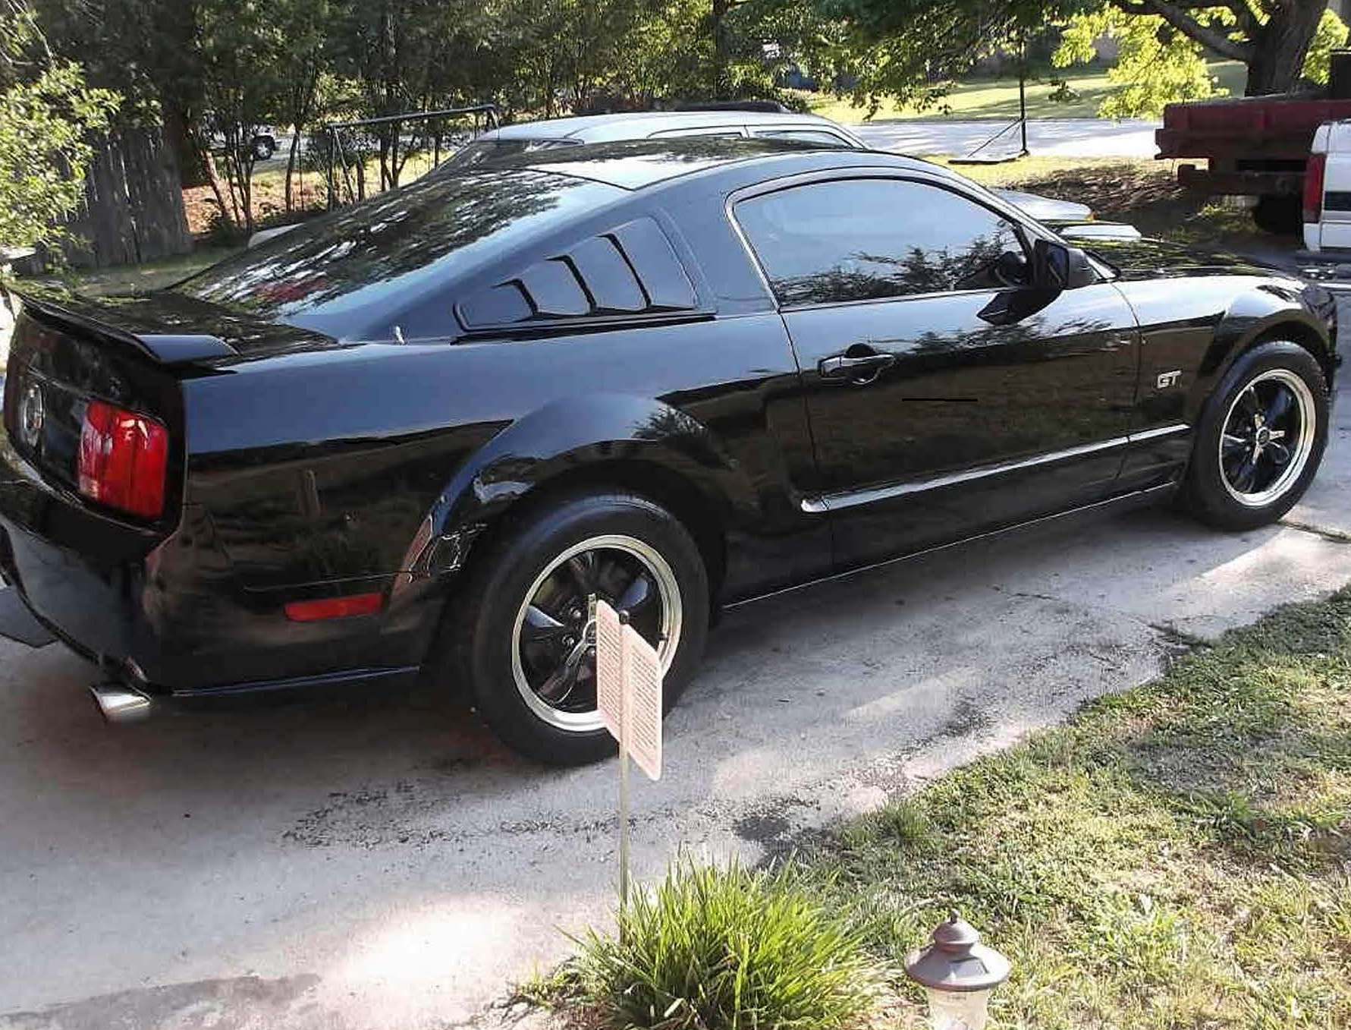
$566,000 in medical expenses

Slide 8
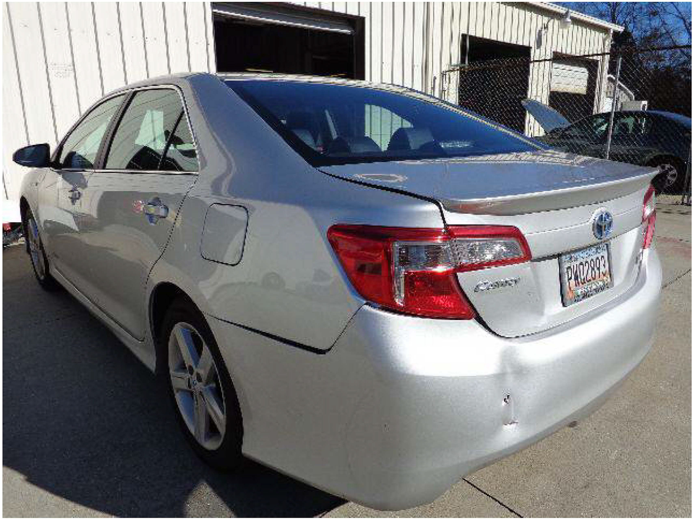
$245,000 in past medical expense + $286,000 in future medical expenses

Slide 9

$144,000 in medical expenses

Slide 10
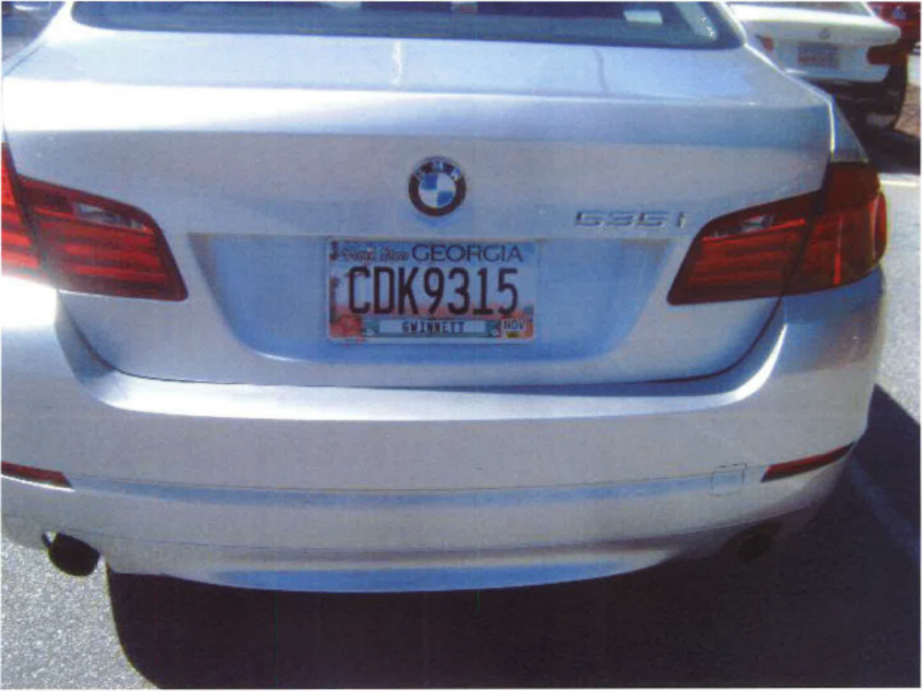
$320,000 in past medical expenses and $150,286 in future medical expenses

