Slide 1
Evaluating E-Scooters and Other Innovative Mobility Options for Georgians
Georgia Senate Study Committee
November 4th, 2019
Jonathan Rupp, Ph.D.
Associate Professor & Director for Research
Department of Emergency Medicine
Emory University School of Medicine
Daniel T. Wu, M.D.
Chief Medical Information Officer, Grady Health System
Associate Professor, Emergency Medicine
Emory University School of Medicine

Slide 2
Objectives
Describe how hospitals currently identify and record mechanisms of injuries
Describe the challenges specific to identifying electric scooter injuries
Share Grady’s initial scooter injury data
Next steps

Slide 3











Grady: An Invaluable Asset
Exclusive 911 and ambulance services for
City of Atlanta-Fulton,
with expansion to 16
rural counties
Industry-leading Marcus Stroke and Neuroscience Center
Georgia Cancer Center for Excellence and Avon Breast Center
State-of-the-art Correll Cardiac Center
Busiest Level 1 Trauma Center in Georgia – ACS Nationally Certified
One of the country’s largest infectious disease programs
Nationally acclaimed burn center – 1 of only 2 in GA
World’s first 24-hr comprehensive sickle-cell center
Georgia’s only poison control center
6 Neighborhood Health Centers in Fulton and DeKalb and Crestview Nursing Facility
Hughes Spalding Children’s Hospital (operated by CHOA)
Notes:
At any given moment there are 400 clinical trials underway at Grady Health System
Grady is the command center for all Atlanta region disasters, responsible for coordinating the response of healthcare facilities throughout the area
Grady partners with the military and offers training opportunities, including for Army Ranger medics and the Georgia National Guard

Slide 4








High Quality Care for All
APPROXIMATELY
700,000
PATIENT VISITS
25%
OF ALL GEORGIA PHYSICIANS RECEIVED SOME OF THEIR TRAINING FROM GRADY
GRADY EMS RESPONDED TO MORE THAN
141,000
911 CALLS
153,000+
PATIENTS TREATED IN THE EMERGENCY DEPARTMENT
300
VOLUNTEERS DEDICATED TO HELPING PATIENTS AND FAMILIES
6
GRADY NEIGHBORHOOD HEALTH CENTERS
GRADY IS THE LARGEST HOSPITAL IN GEORGIA WITH
654
STAFFED BEDS
MORE THAN
7,000
EMPLOYEES

Slide 5
Hospital Injury Data -
How do we identify Scooter injuries?
Ways to identify patients with scooter related injuries
  ICD 10 coding
    Numerous non-specific codes for scooters
    Most commonly V-codes (mechanism), often unbillable
  Trauma Registry
    Skewed towards seriously injured cases (admissions)
  Chart Reviews
    The term “Scooter” is not defined or used consistently

Slide 6
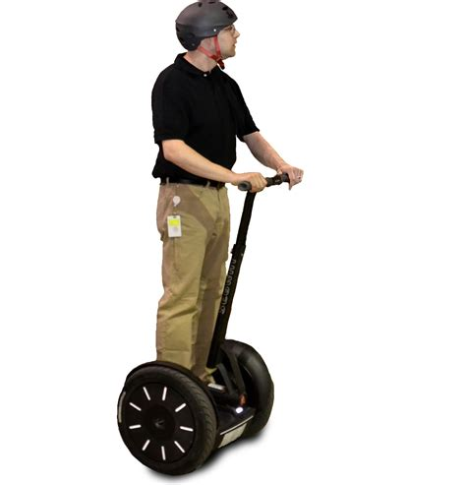
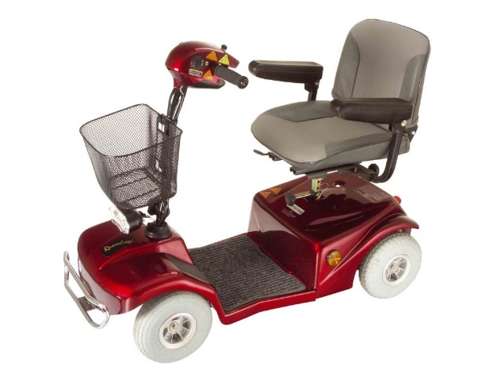
Challenges - What are we looking for?
“Non powered” Scooter
“Motorized” Scooter
“Mobility” Scooter
“Segway” Scooter

Slide 7
Challenges - What's in a Name?
Scooter
Electric Scooter
Standing Scooter
Dockless Scooter
Motorized Scooter
Micro-Mobility Scooter
Brand name (Bird/Lime/Lyft/Jump/Bolt/Boaz/Wheels/Spin/Gotcha)

Slide 8
Atlanta Timeline
Bird 5/1/2018
Lime 6/25/2018
Nine Companies
11,650 Permits
6/26/2019
Lyft 12/21/2018
Uber 12/19/2018

Slide 9
Our Approach
Created SCRATCH injury registry (Scooter CRash And Trauma CoHort)
Searched all ED notes from June 2018 – Sept 2019 for key words (i.e. – scooter, eScooter, company name, etc.)
Manual chart review to confirm case involved a standup electric scooter

Slide 10
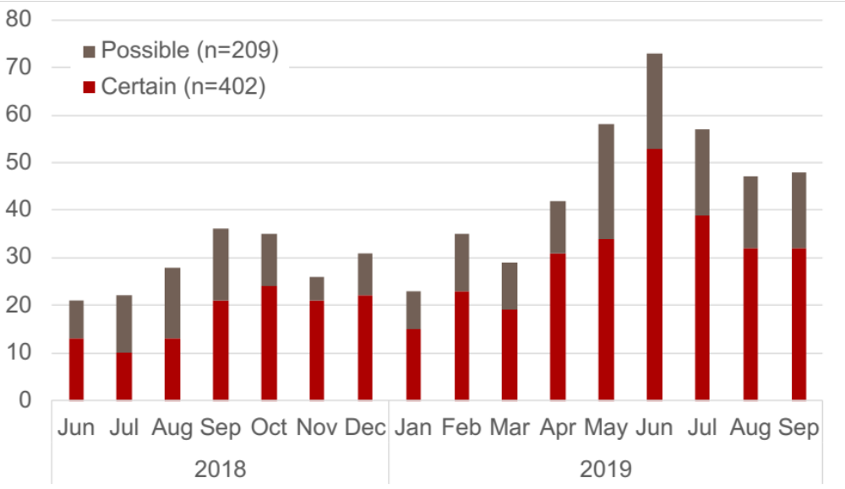
Numbers of Injuries per Month

Slide 11
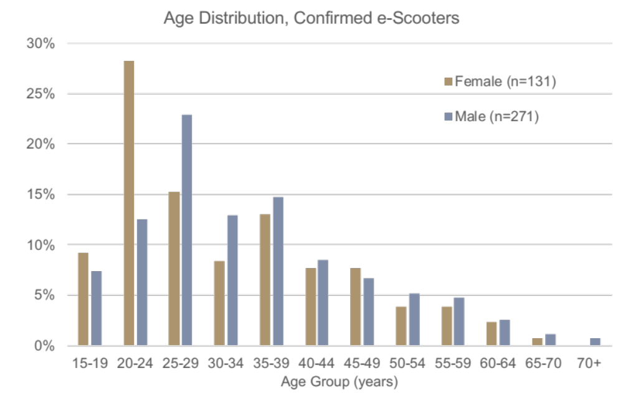
Age Distribution by Sex

Slide 12
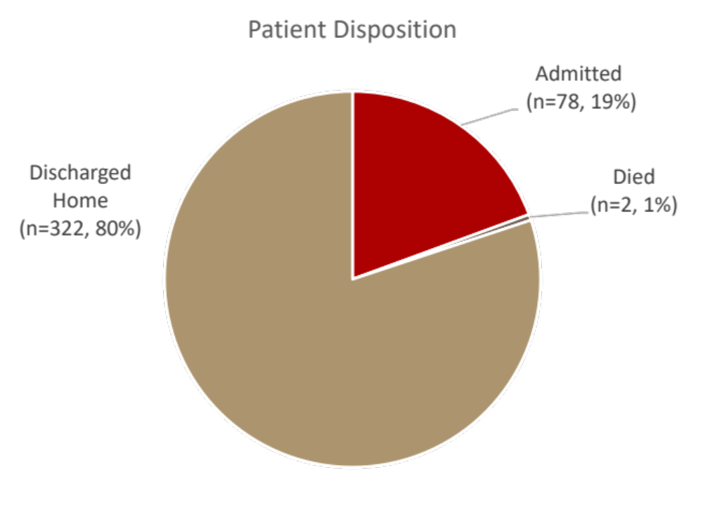
Final Disposition

Slide 13
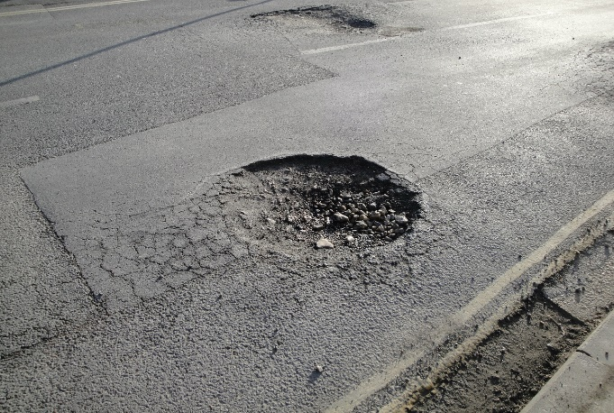

Additional Findings
Built environment commonly noted (>15%)
Mechanical issues (~3%)
17% Motor Vehicle Collision
Helmets rarely used
ETOH common (30% of 141 pts tested had EtOH≥0.08 g/dL)

Slide 14
Additional Findings, continued
Most common chief complaints (69 total over 402 patients):
  Fall (29%),
  Motor cycle crash (15%),
  Trauma (10%),
  Motor-vehicle crash (4%)

Slide 15
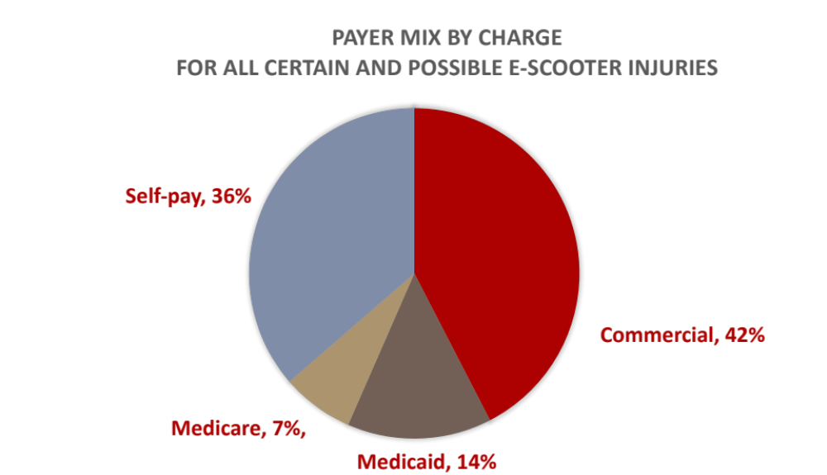
Financial Distribution
Median Charge for all possible and certain cases:
$8,060
Notes:
Average per patient charges are $26790.40 for the combination of certain and possible scooter crashes and $28,903.54 when the dataset is limited to only certain scooter crashes. One thing to note when using these numbers is that the data aren’t normally distributed and thus average charges can be a little misleading in terms of a statistic. The median (50%ile) charge is $8060 for all possible and certain scooter crashes and $9584 for only e-scooter crashes that we’ve characterized as certain.

Slide 16
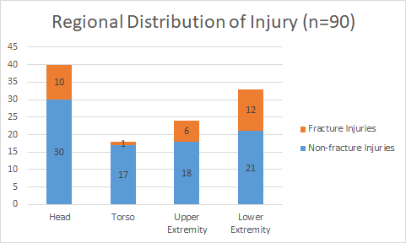
Injury Patterns
(Subset analysis)
44% of patients had head injuries (included face)
37% had lower extremity injuries
Severe ankle injuries most common (10/12)
Of UE injuries, distal are more common than proximal
Notes:
Nasal bone fractures/broken teeth and lip lacerations were common – Unable brace themselves for fall
LE injuries are interesting. Would think UE more common if face and head involved.

Slide 17
Admitted patients – Trauma Registry
(Subset analysis)
19 admitted
Avg Injury Severity Score (ISS) – 6, high of 14
2 ICU admits
Avg hospitalization – 4 days, high 13
All discharged to home except 1 (SNF)
Notes:
1 removed for Sickle cell admission
SNF patient, homeless man run over by a scooter and broken arm.

Slide 18
How to complete the picture
Hospital data will identify the most severe injuries
Urgent Care Centers
Student Health Centers at local Universities
Robust rider feedback

Slide 19
Next Steps
In-Depth analysis of SCRATCH data
Engage patients prospectively for better data collection (obtain accident related factors like helmet use, ETOH, built environment)
Identify and implement injury prevention interventions

Slide 20
Questions?
Daniel Wu, M.D.
dtwu@emory.edu
Jonathan Rupp, Ph.D.
jrupp2@emory.edu

