Slide 1


THE EXCEL CENTER®
ENVISIONING GEORGIA’S FIRST TUITION-FREE
^{HIGH SCHOOL FOR ADULT LEARNERS}

Slide 2
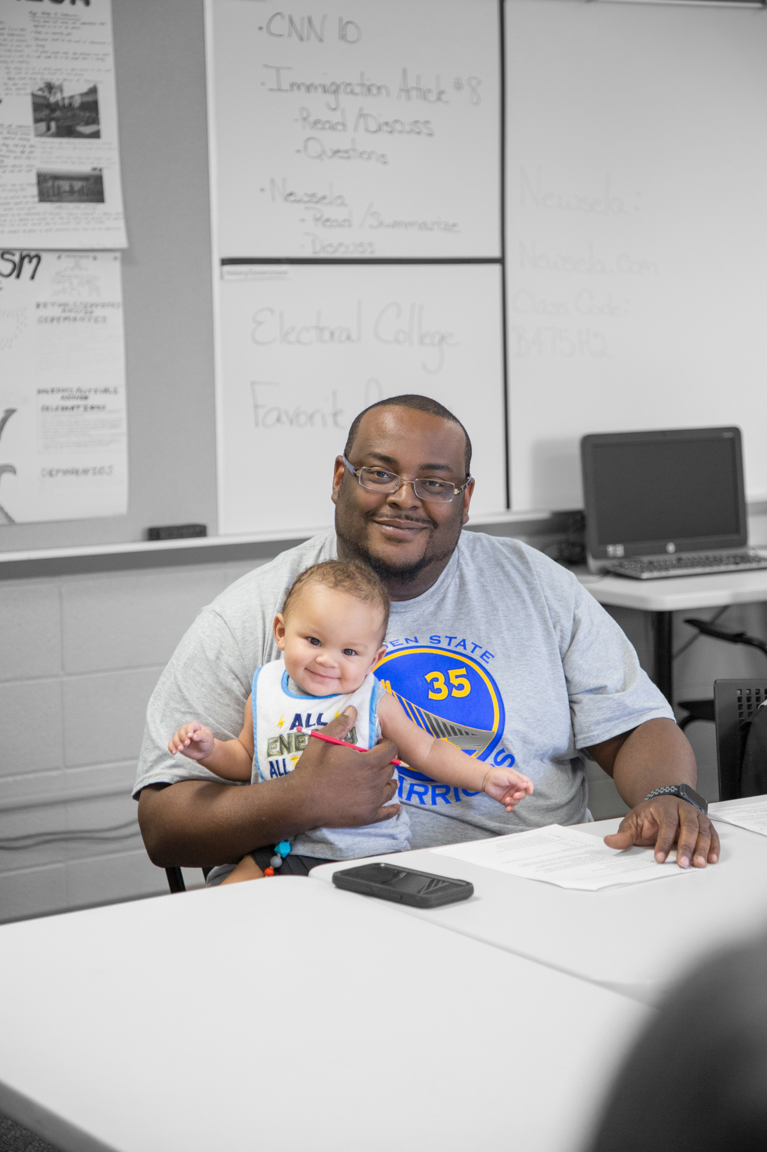
THE CHALLENGE
32 Million American Adults Without a High School Diploma
  A high school diploma is the passport
  to participation in today’s labor market.
  In Georgia, 1,000,000+ people do not
  have a high school diploma.
    As the number of jobs requiring some form of education beyond high school continues to grow, people without
    a high school diploma are falling even farther behind.
  At least
  60%
  of all jobs in the
  United States
  require education
  beyond high school

Slide 3



ADULTS WITHOUT A HIGH SCHOOL DIPLOMA
By the Numbers
2
3
70%
2X
OUT
OF
=
=
=
adults without a high school diploma
are low income
how much less adults without a high school diploma will earn
more likely that a child
will drop out of
high school if their
parents did not graduate
3

Slide 4

What would happen if the Georgia residents without a high school diploma accessed the learning they need to not only enter the workforce but to thrive in it?
  What would that mean for their
  families and communities?
  What would that mean for Georgia?

Slide 5


THE SOLUTION
Unlocking potential
  through free and high-quality diplomas
    Goodwill’s high school for adults imagines a future where any adult without a high school diploma can access a free and excellent education that empowers them to increase their independence, attain meaningful employment and reach their full potential.
5

Slide 6


THE EXCEL CENTER NATIONAL NETWORK
We currently serve more than 7,000 students at 31 Excel Centers across the country.
9
Established
Projected
Pursuing
6
6

Slide 7
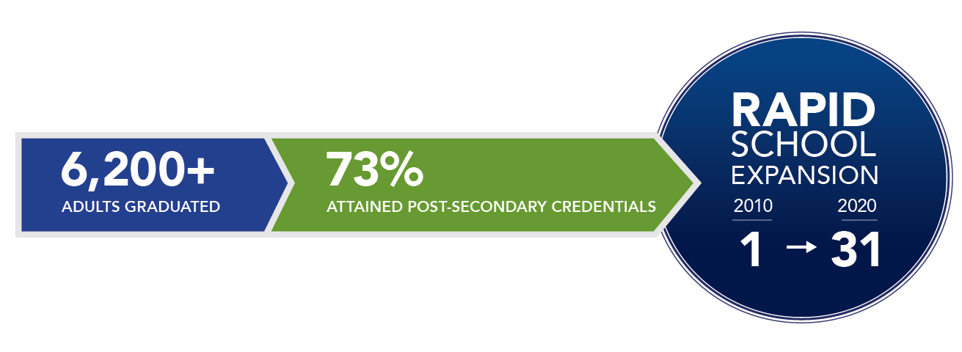
OUR TRACK RECORD
For 10 years The Excel Center has been eliminating barriers
to education, employment and self-sufficiency.
  Every graduate creates a ripple effect that improves the well-being of their families, children and communities.
7

Slide 8
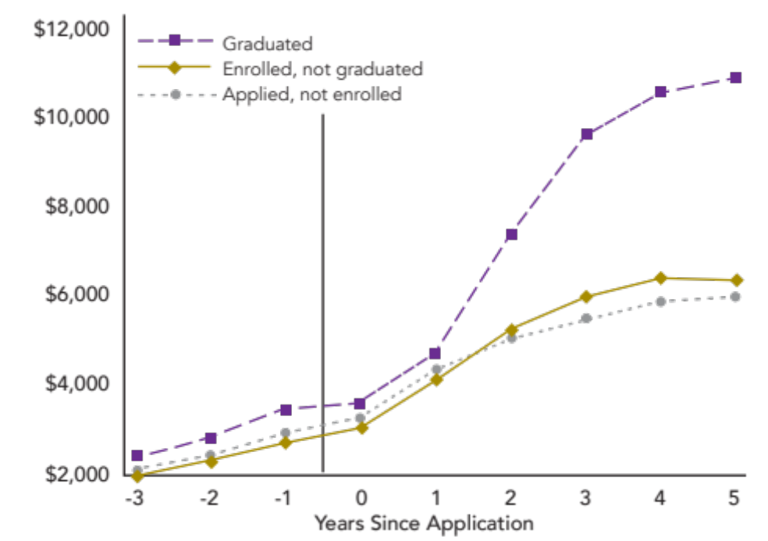
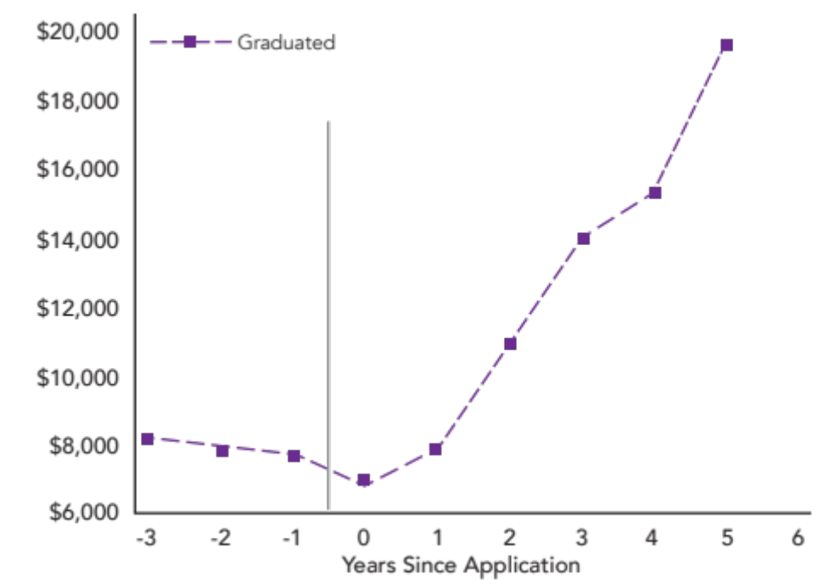
LONG-TERM, TRANSFORMATIONAL RESULTS
FOR FAMILIES…
Average earnings of
2013 Excel Center applicants in Indiana
Average earnings of employed 2013
Excel Center graduates in Indiana
Research conducted by Laboratory for Economic Outcomes (LEO) at the University of Notre Dame
8

Slide 9
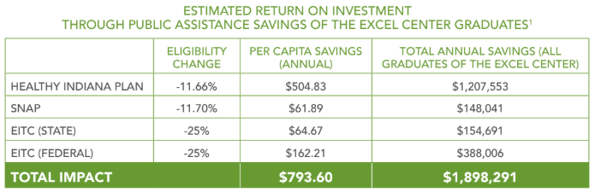
…AND COMMUNITIES
Research conducted by Laboratory for Economic Outcomes (LEO) at the University of Notre Dame
9

Slide 10
EXPENSES
Estimated Annual Expense per School: $2,176,800
10

Slide 11





OUR EQUATION FOR SUCCESS
11

Slide 12
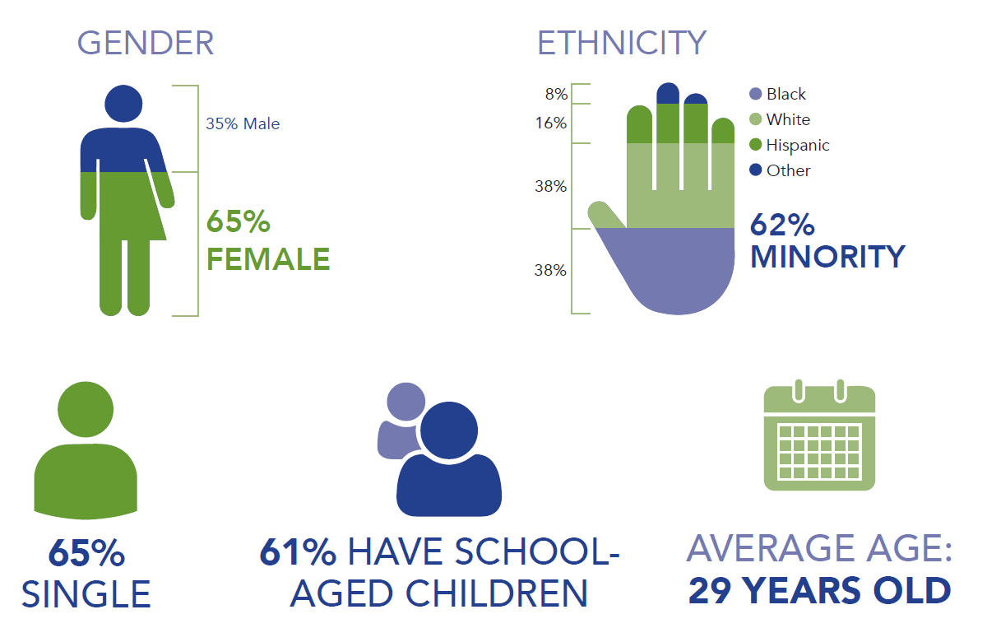






WHO WE SERVE
GENDER
RACE/ETHNICITY
35% Male
65% Female
12

Slide 13
HOW WE EXCEL
We meet underserved students where they are in their education by:
1
2
3
4
5
Removing
barriers to
education
Providing life coaches
Awarding
a state-recognized, high-quality high school diploma
Supporting transitions to technical college and career
Ensuring continuous improvement
13

Slide 14

America needs the skills and talents of all our people. It’s time to unleash the potential of Georgia residents in need of a high school diploma.

Slide 15
THANK YOU.

